Slide 1

Il Cloud. Pensato per l’Italia.
Alessandro Pasero
Partner Engineering Manager, Google Cloud Italy

Slide 2

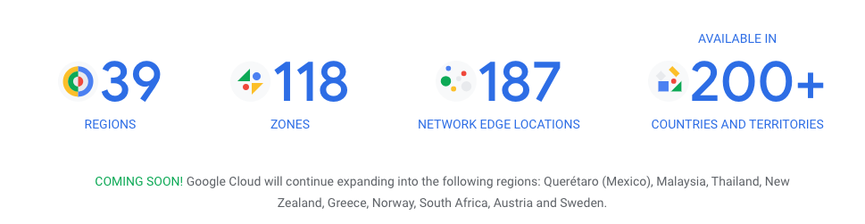
La Region di Torino è ora disponibile
Turin
23 marzo 2023
Milan
15 giugno 2022
Finland
Netherlands
Berlin
London
Frankfurt
Warsaw
Belgium
Paris
Zurich
Milan
Turin
Madrid
Regions
Future Regions

Slide 3
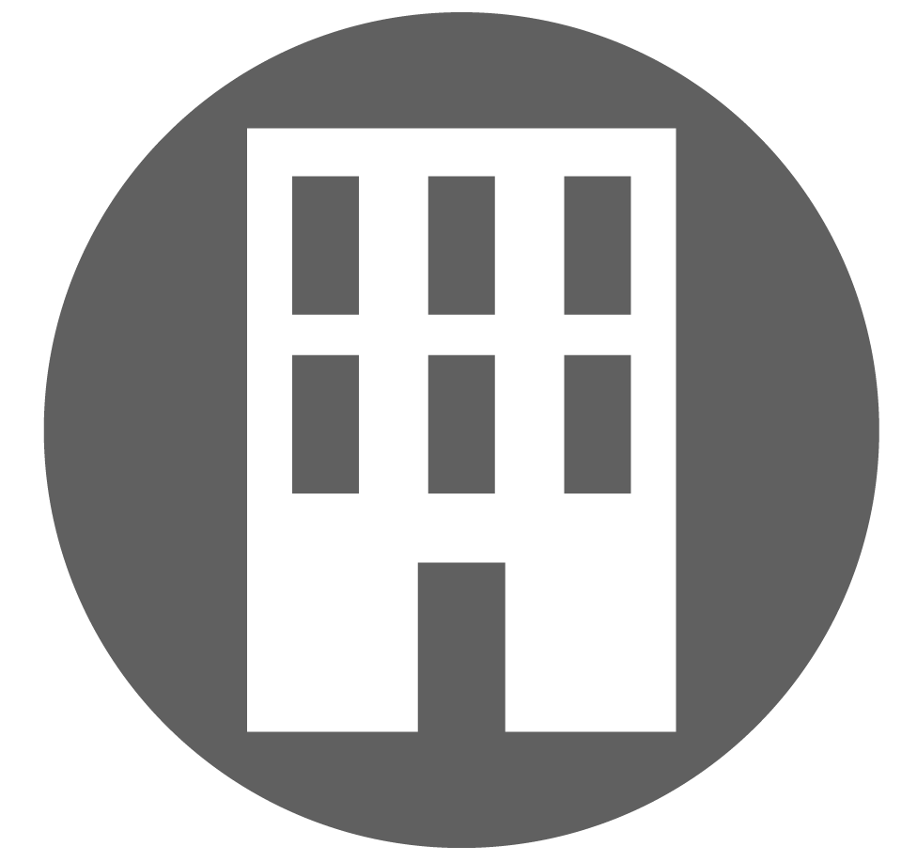
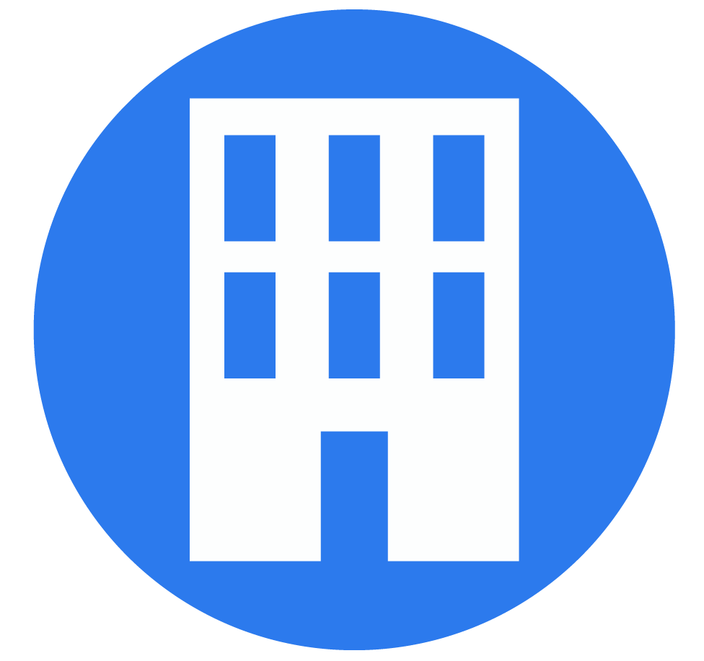
Milano e Torino progettate per scenari di business continuity e disaster recovery
Latenza ridotta dell’80%
zone a
Private backbone
zone a
zone b
zone c
zone b
zone c
Interconnect
Interconnect
~ 130 km
Milan Region
Turin Region
Zones ensure high availability and they are designed such that each has power, cooling, networking and control planes that are isolated from other zones, and single failure events will affect only a single zone.

Slide 4





High Availability & Disaster with Regional and Async PD
Provisioning Flow
DR Test and Recovery Flow
Maximise Availability with Regional Persistent Disks (HA)
Design for cross-regional disaster recovery (DR)
Region A (Milano)
Zona A
Zona B
RePD offers easy to use, durable storage by synchronously replicating data between two zones in a a single GCP region
Provisioning Flow
Consistency Groups
Regional Disks
1
VMs
MAIN
1
RPO=0 for a single failure within a zone e.g., a sustained outage, network interruption
Region B (Torino)
Replica Async
AsyncPD offers easy to use, durable storage by Asynchronously replicating data between two GCP regions (region pairs)
Zona A
Zona B
1
Regional Disks
Zonal Follower Disk
RPO < 1 min (SLO)
Recovery and DR Test Flow
VMs
DR
2
3
4
Zonal Clone Disk

Slide 5
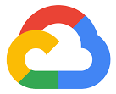
Oltre la protezione dei dati. Indipendenza operazionale e resilienza
La visione di Google per la sovranità digitale va oltre la semplice residenza dei dati e il controllo degli accessi,
ma copre anche chi esegue i carichi di lavoro e quali sono le opzioni in caso di disconnessione.
La visione di Google
sulla sovranità non si limita alla protezione dati
Data sovereignty
You keep control over location, encryption and access to your data
Operational sovereignty
You have visibility and control over provider operations
Software sovereignty
You can run workloads without dependence on provider's software

Slide 6
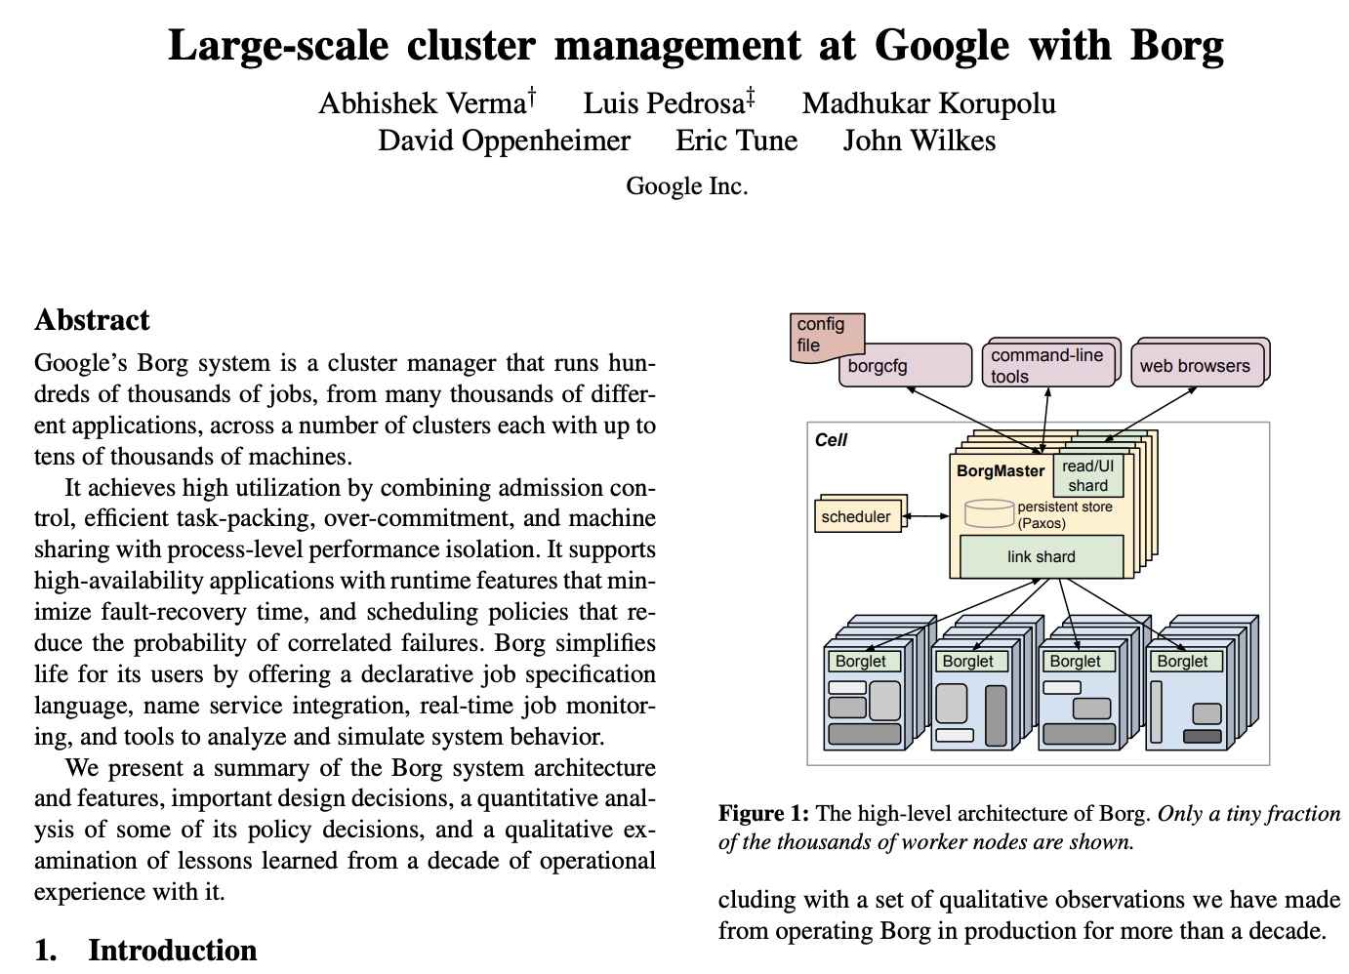
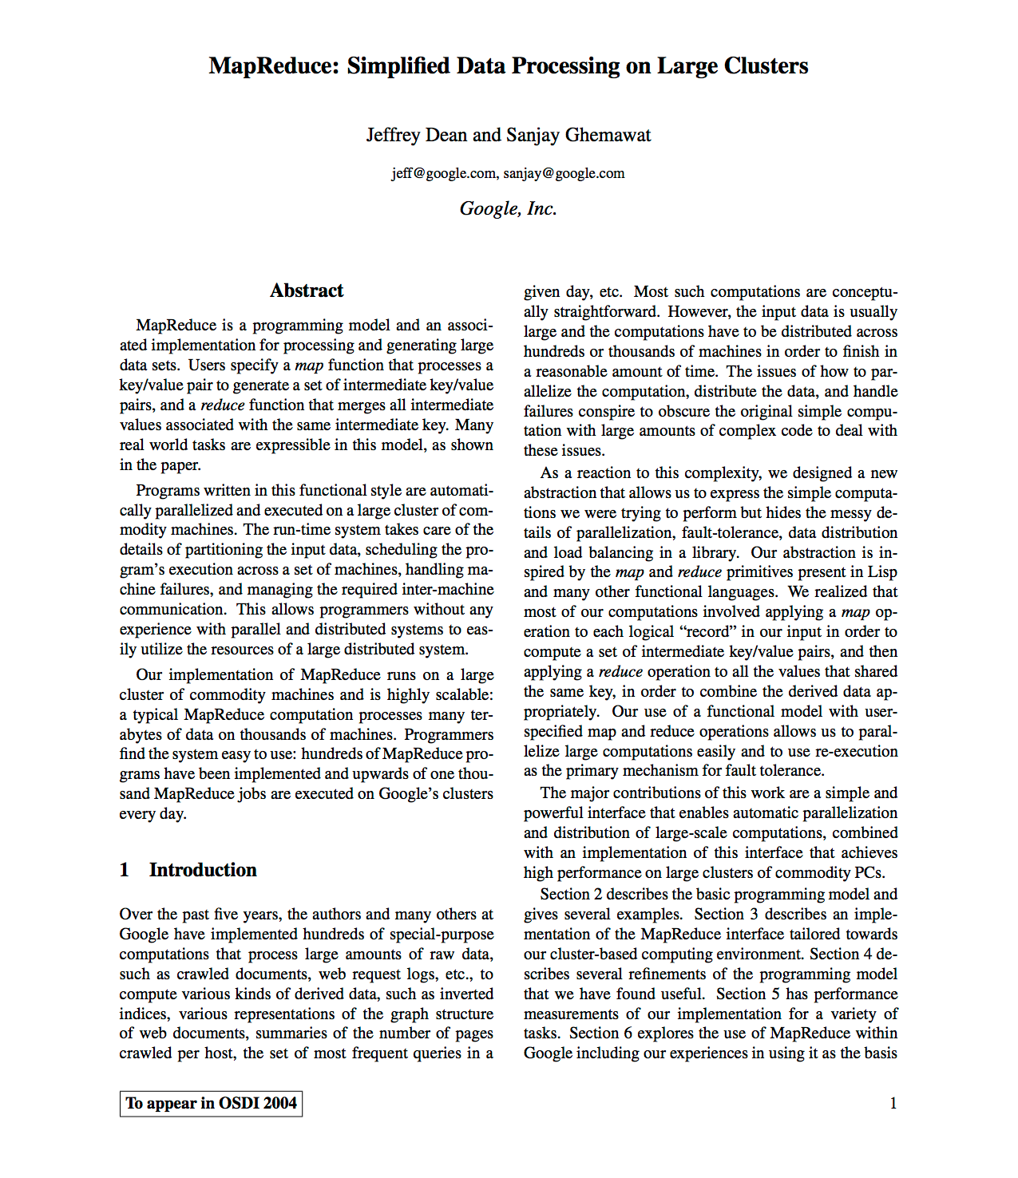
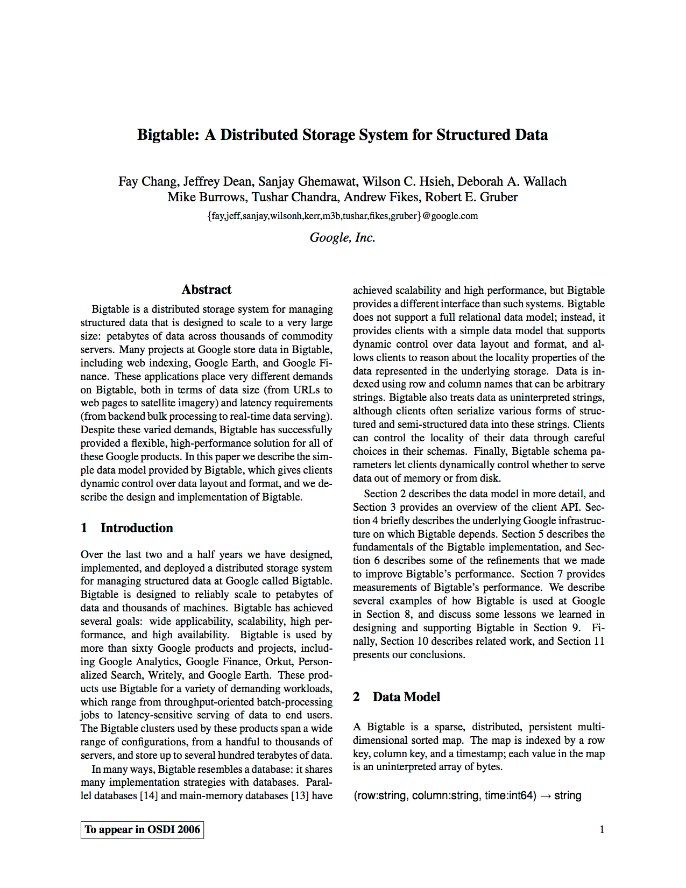
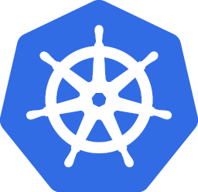


Google is a leader in open source
Kubernetes
2003
2005
2008

Slide 7

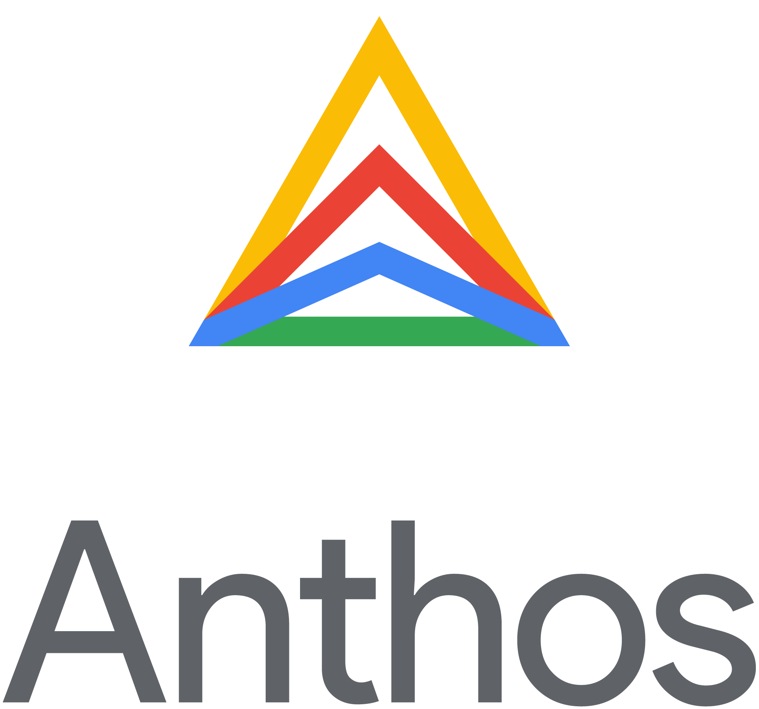
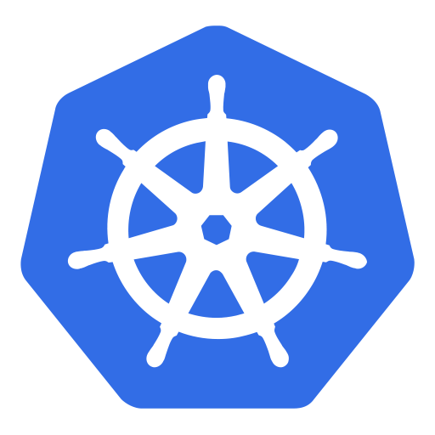
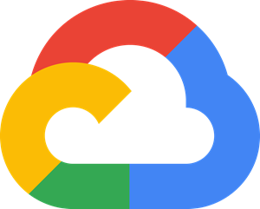
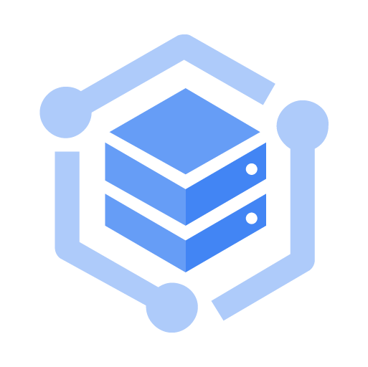
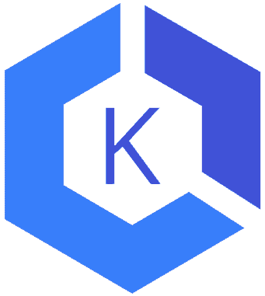
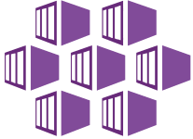
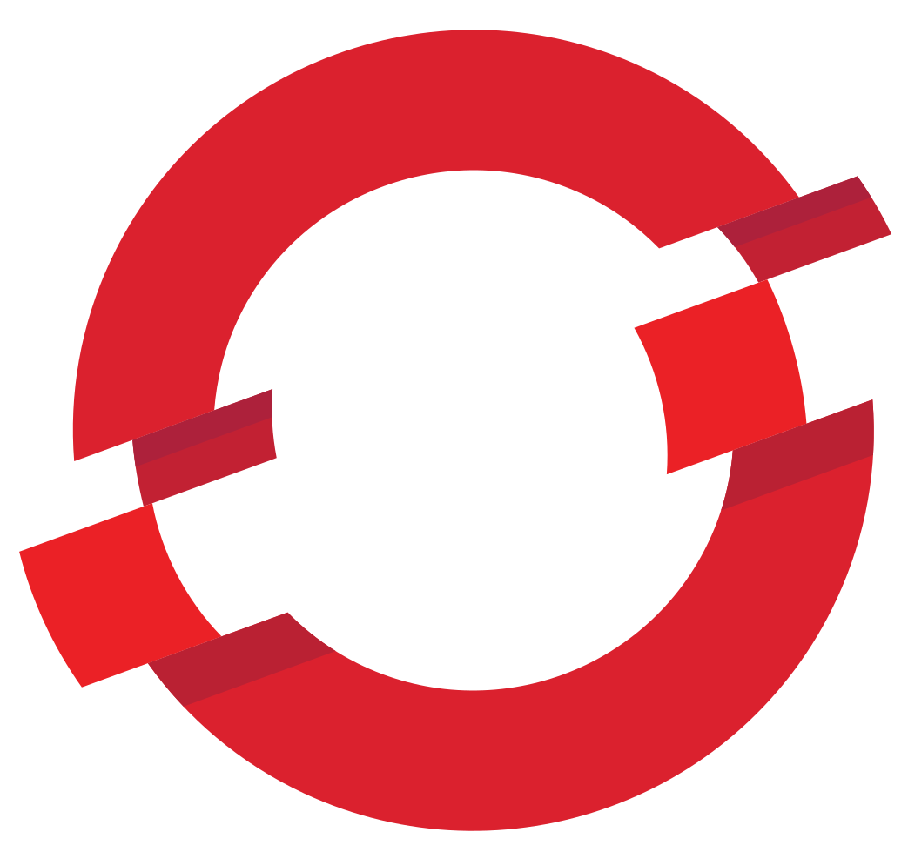
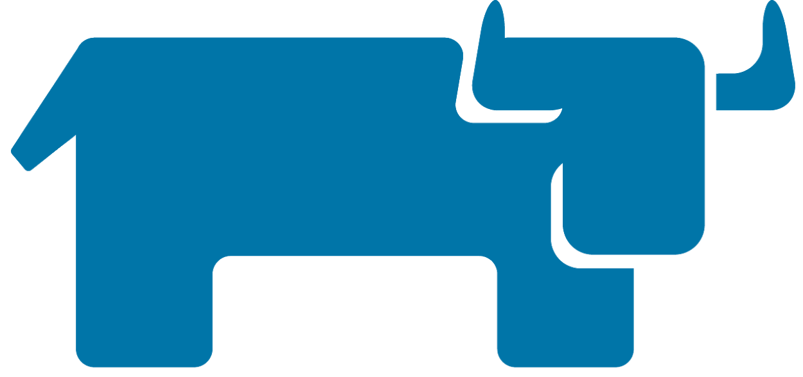
Anthos is a single platform for modernization
Write once, run anywhere
Open - No lock-in
Hybrid - One consistent platform
Automated - Fully managed service mesh
Fast + Secure - Accelerate innovation through mobility
Other Kubernetes
Other Clouds
Google Cloud
Google Edge
Other Edge
On-premises
Anthos attached clusters
Anthos on AWS
Anthos on GCP
Anthos on Bare Metal
Anthos on Azure
Anthos on VMware

Slide 8
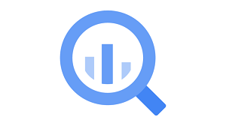

Build your data analytics now with BigQuery Omni
Cross-cloud Analytics
Scalable storage that can reside in Google Cloud or other public clouds
Stateless resilient compute that executes standard SQL queries
Query the data that you have stored in Google Cloud, AWS and Azure without any cross-cloud movement or copies of data
Powered by Anthos which allows you to securely execute queries on other public clouds

Slide 9

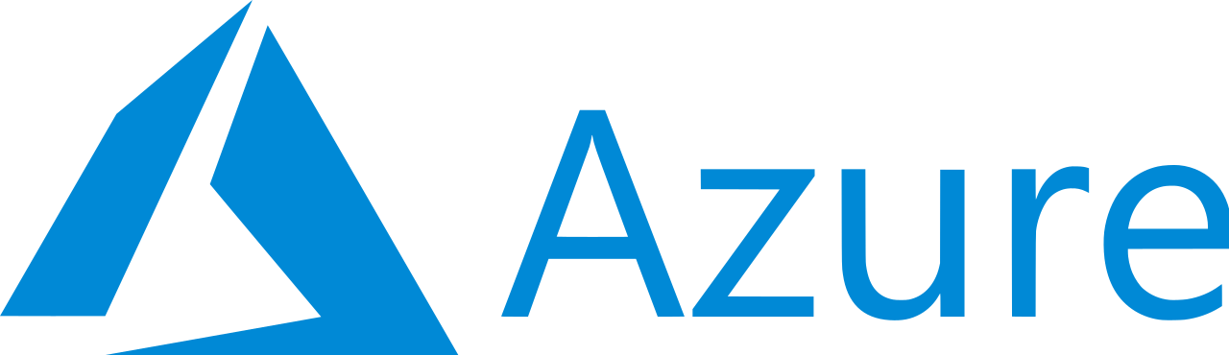
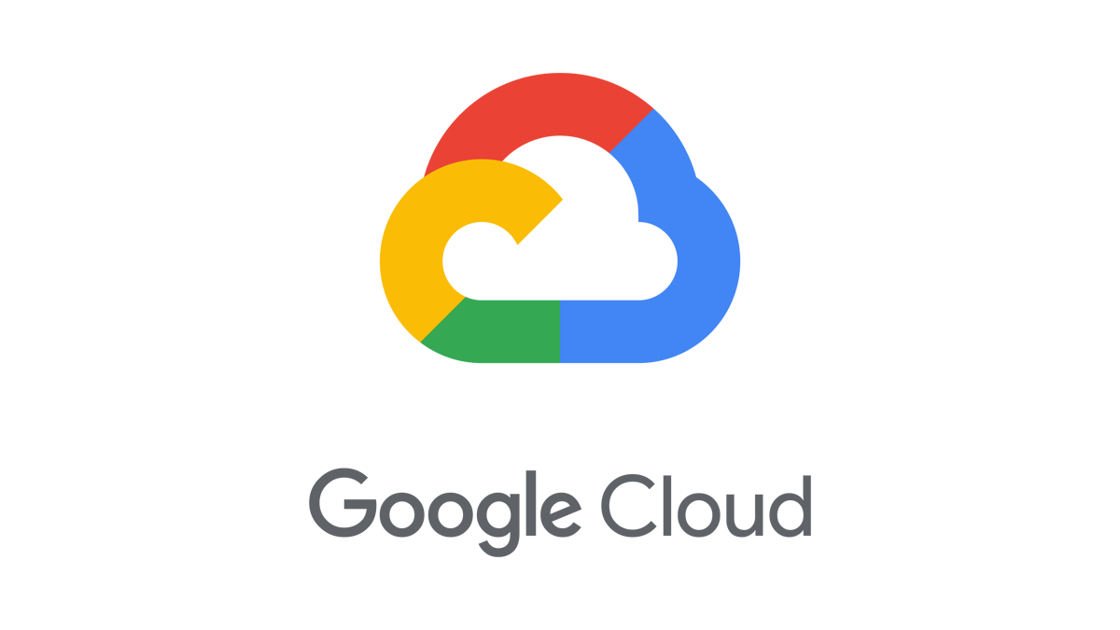
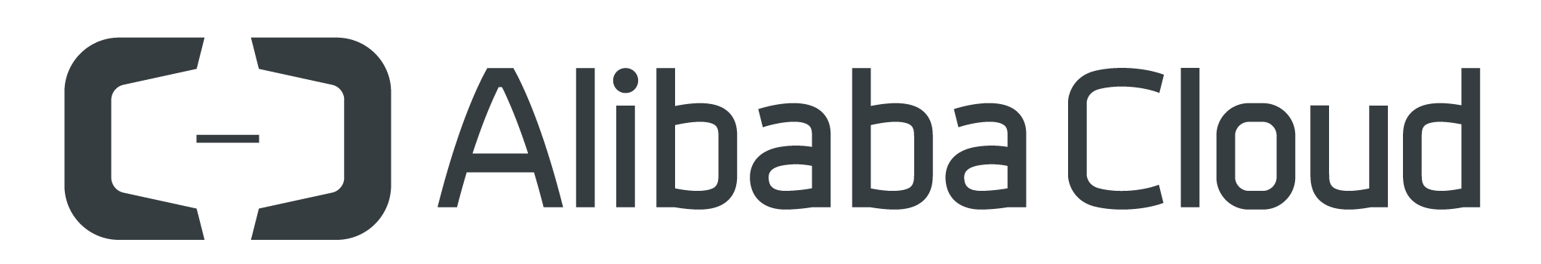
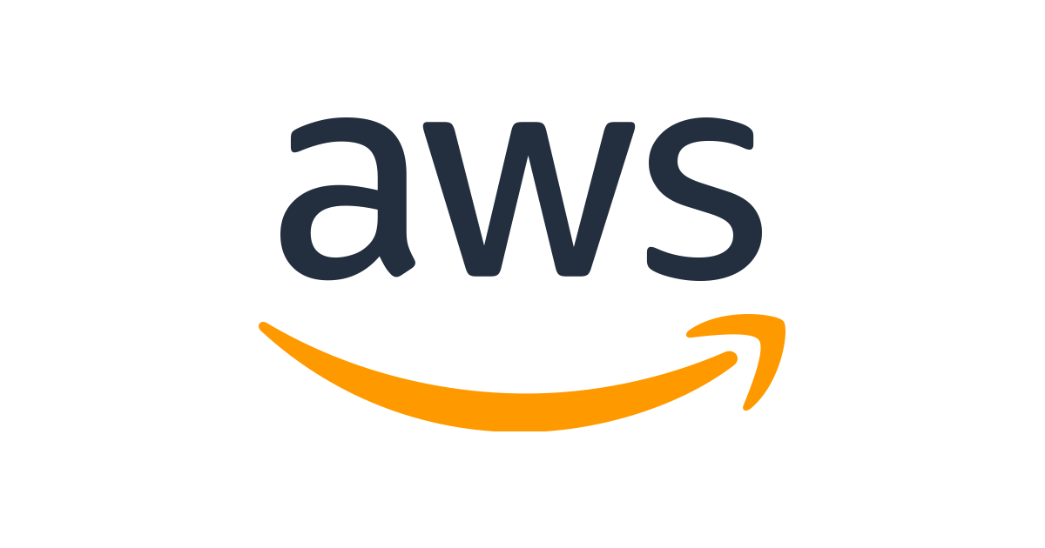
Introducing Cross-Cloud Interconnect
Private , Secure and High throughput multi cloud connectivity without the need for the customer to deploy infrastructure.
Direct Peering with other cloud, No Additional Router required

Slide 10
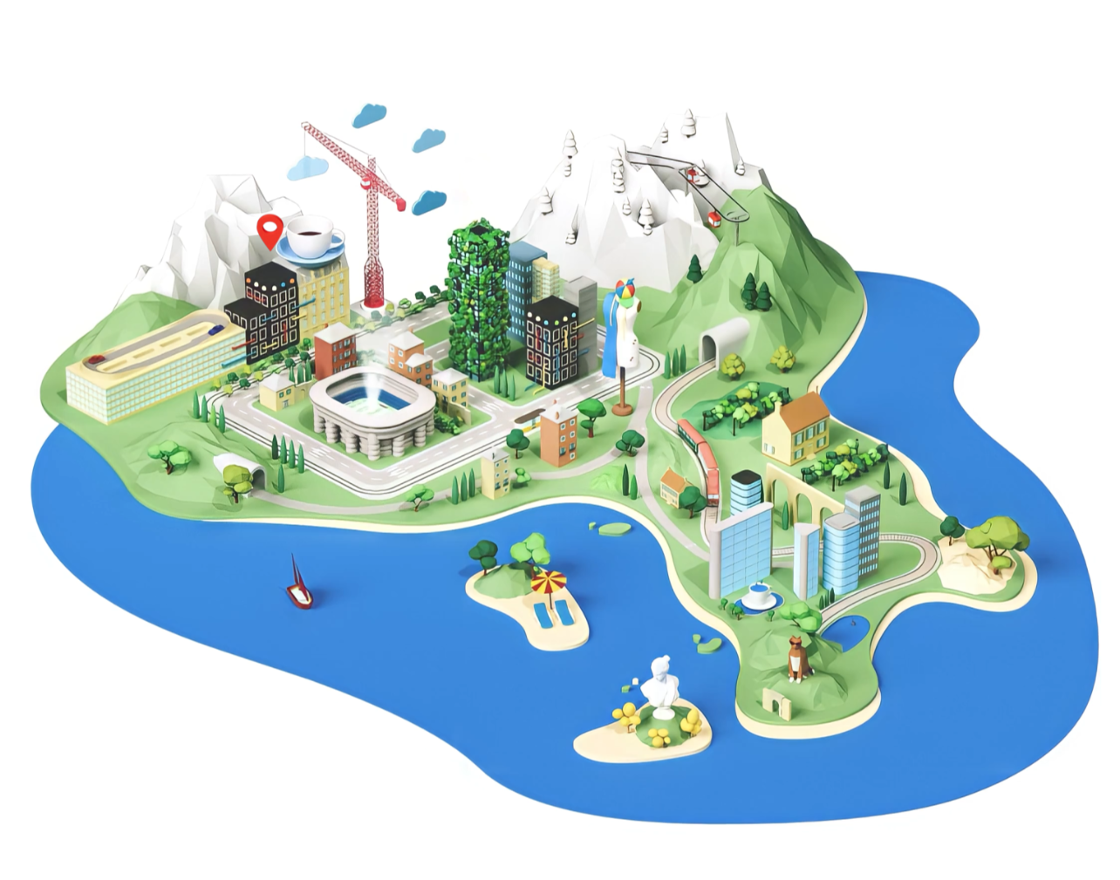
Il cloud.
Pensato per l’Italia.
GRAZIE

