Slide 2
PROJECT PRESENTATION

Slide 3
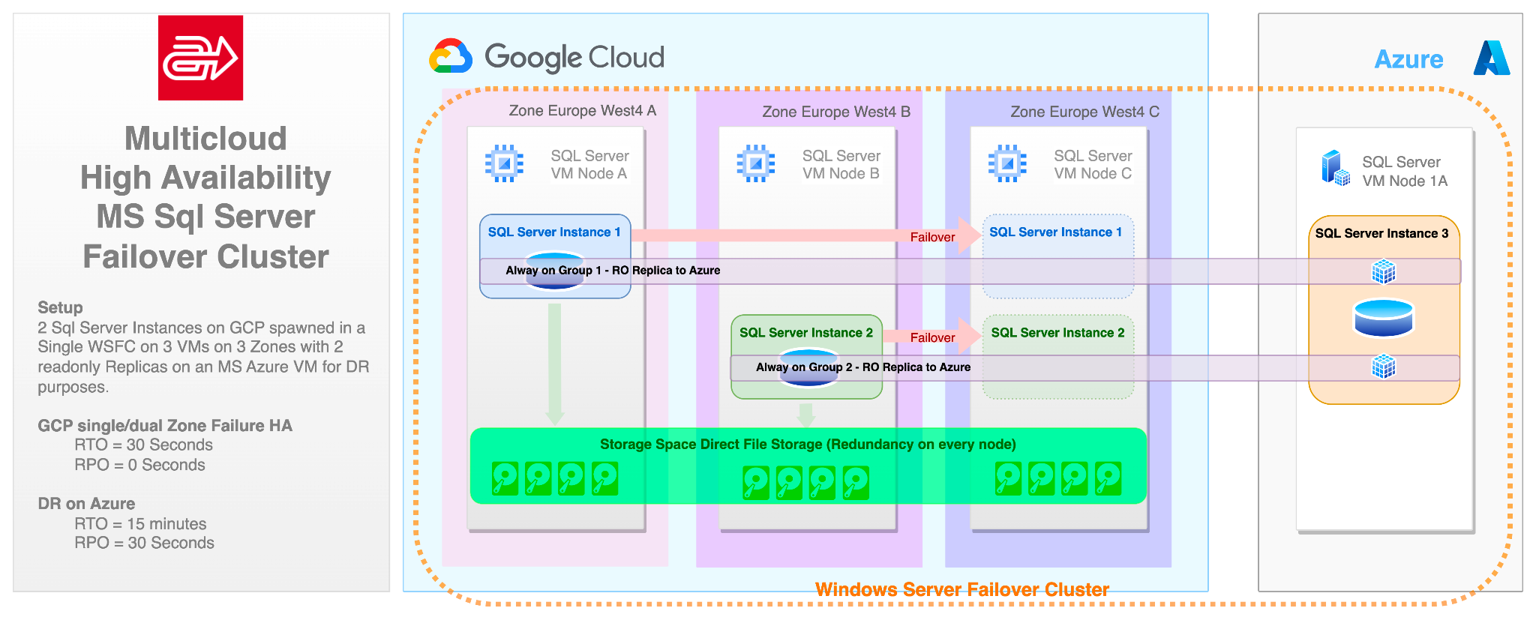
THE PROJECT
ARCESE is a global logistics operator fulfilling customer needs for transport and logistics services, targeting customer excellence through his strategic aims: operational excellence, people, growth and digital thinking.
GO Reply is helping Arcese moving to Google Cloud their entire core business applications and redefining their architectures in order to take benefits from the most innovative design pattern and delivery methodologies like Iac, Sre and Devops.
Arcese’s ICT is following a multi-cloud & hybrid approach, making work jointly Cloud Services and warehouse hardware and leveraging on multi zone HA and multi cloud DR in order to achieve best levels of reliability and performance for their H24x7 business .
1st Worldwide implementation
#Microsoft & Google
#First of his kind
#Core Business

Slide 4
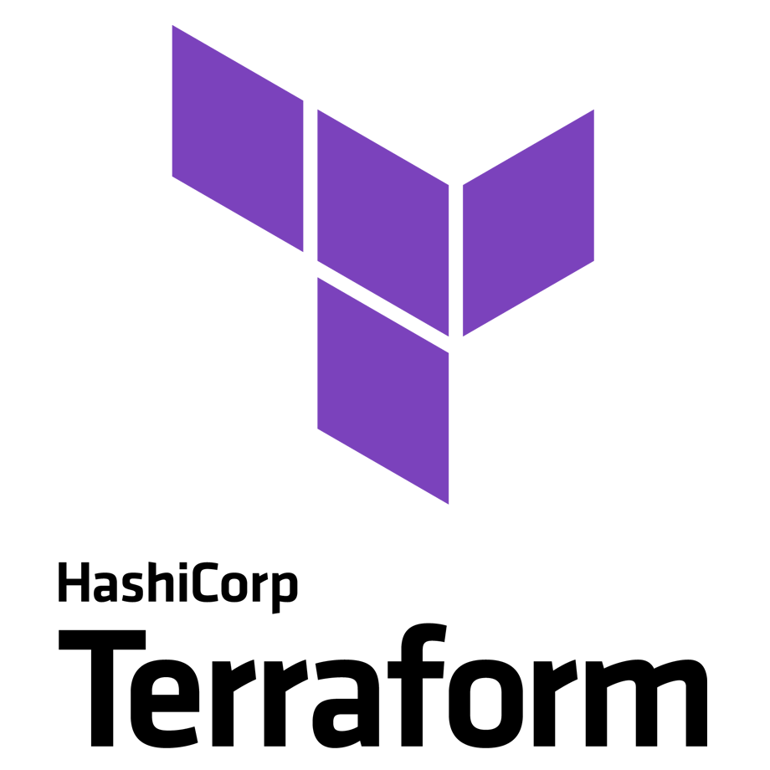
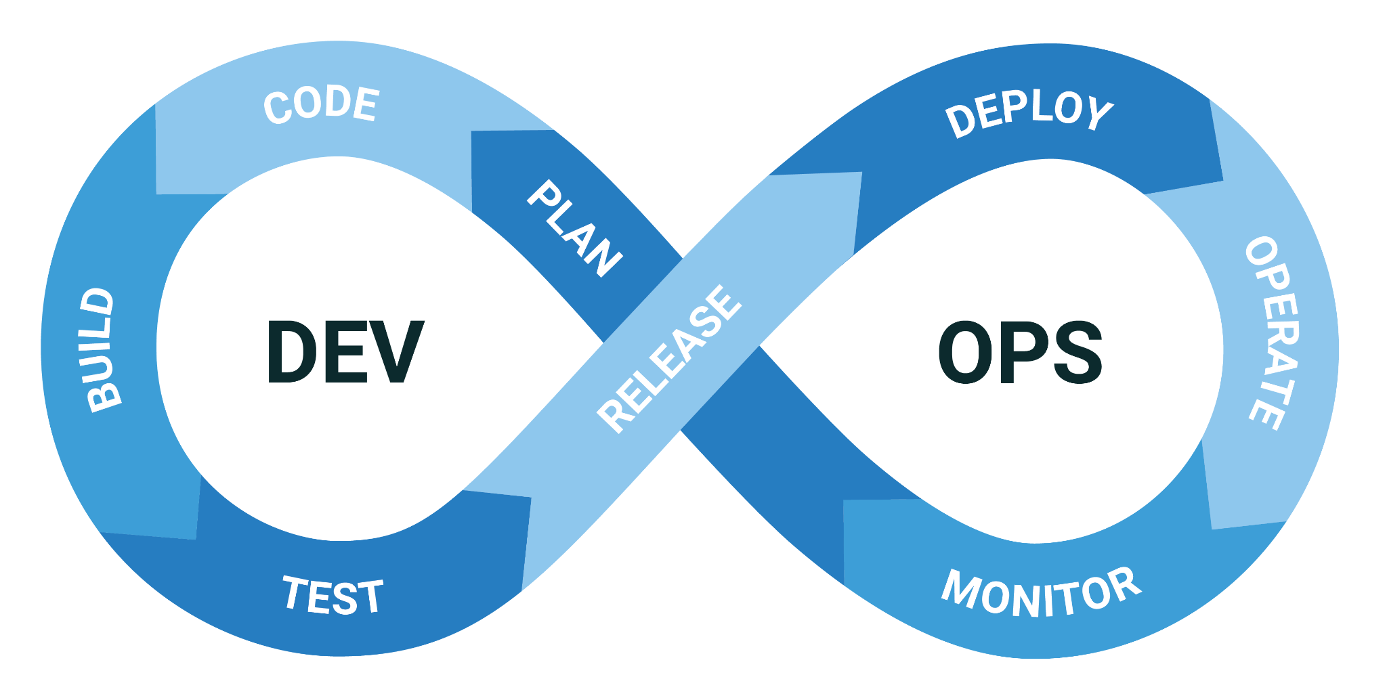
DEVOPS & IAC
The entire implementation process has been performed in order to take benefits from the most innovative design pattern and delivery methodologies like Iac, Sre and Devops.
Infrastructure as code allowed for a quick provisioning and removing of infrastructures: thanks to Terraform we managed to centralize all the changes in one place and create within days hundreds of resources.
DevOps and SREs practices have been used to coordinate and manage the multiple tasks and very strict time requirements the project required.

Slide 5
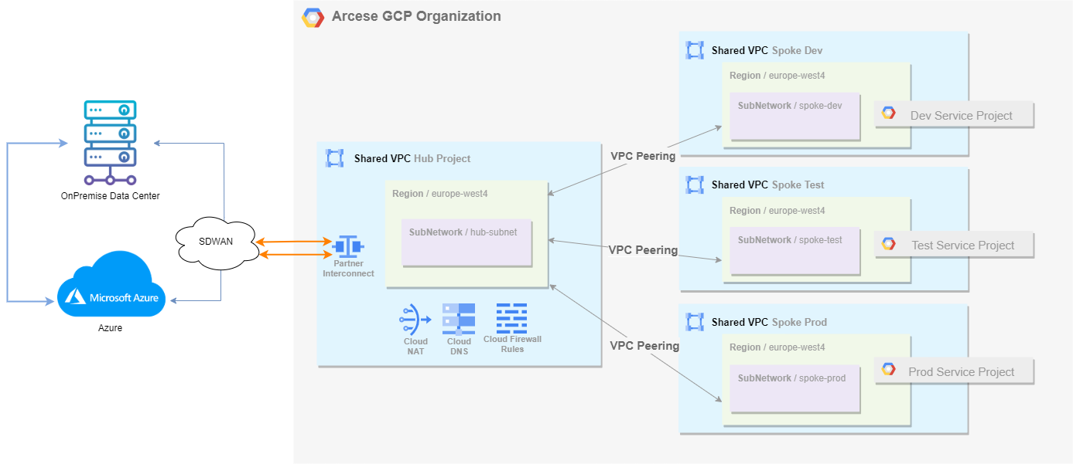
NETWORKING ARCHITECTURE
The Arcese GCP environment uses a Hub&Spoke networking model where every spoke project (one for each environment) hosts a Shared VPC where application service projects are attached.
The connection between GCP and the on-premise and Azure environments is managed through a SD-WAN architecture, which is translated into a Partner Interconnect configuration in GCP.

Slide 6
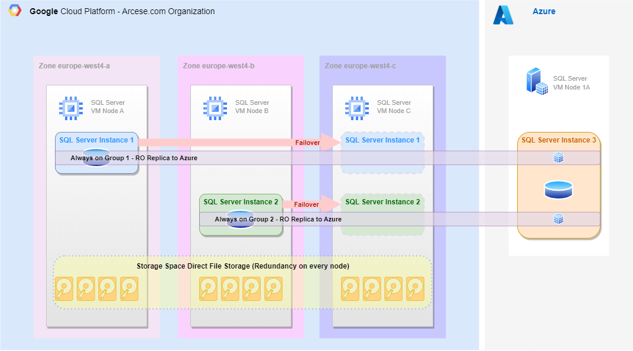
ARCESE MS SQL GCP-AZURE
The current architecture leverages on multi zone HA and multi-cloud DR in order to achieve the best levels of reliability and performance for their H24x7 business.
3 nodes → 3 zones
Same set of data in synched array of disks
2 GCP SQL Instances
1 Azure SQL Instance
10 sec RTO

Slide 7
FAILOVER SCENARIO

Slide 8
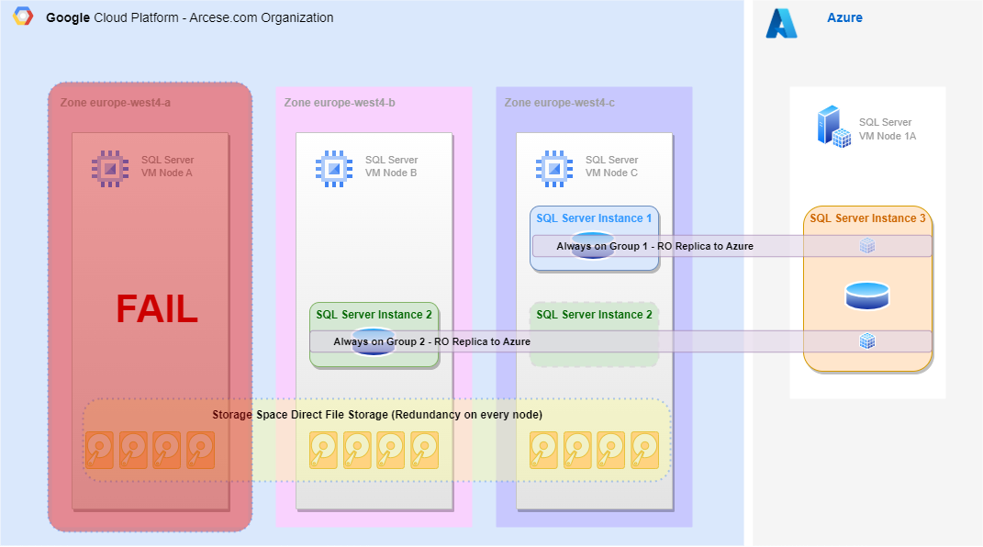
FAILOVER SCENARIO

Slide 9
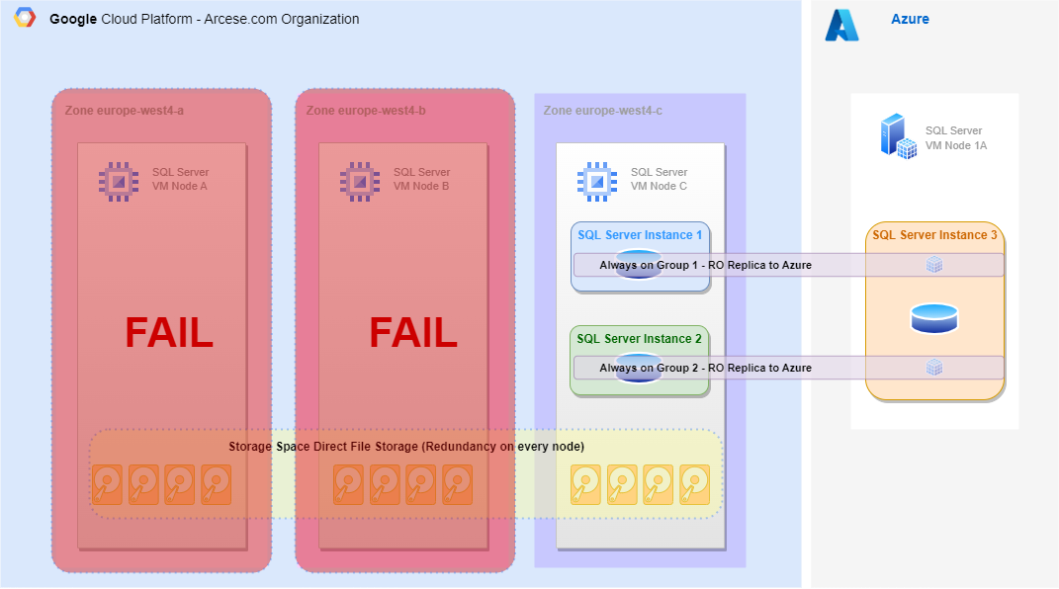
FAILOVER SCENARIO

Slide 10
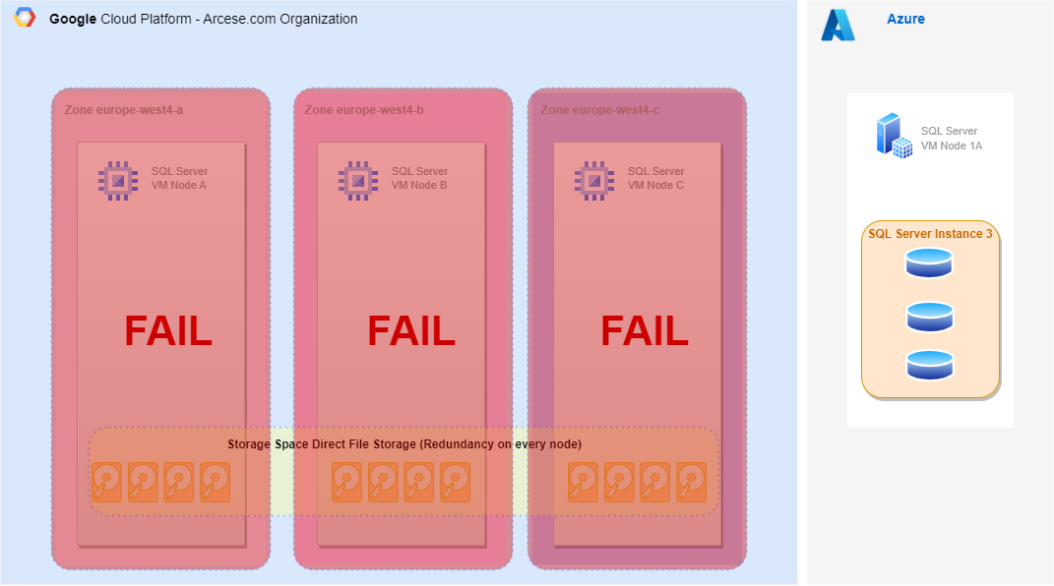
FAILOVER SCENARIO

Slide 11
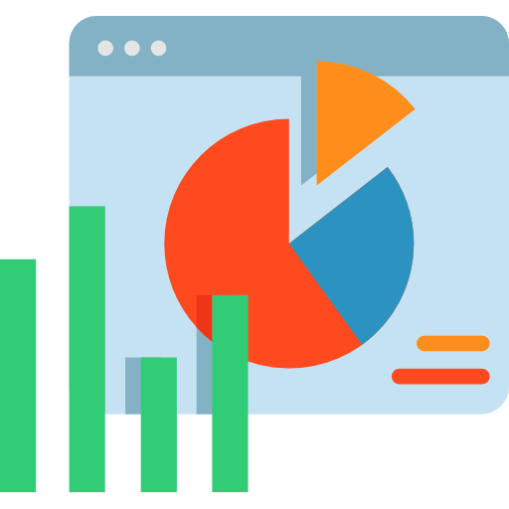
RESULTS
Thanks to the architecture just described we managed to reach:
Recovery Time Objective (RTO) of 10 seconds: the time it takes to switch a database from GCP to Azure in case of a regional outage (worst-case scenario).
Recovery Point Objective (RPO) of 0 seconds: no loss of data in case of nodes fault.
A 99,95% Service Level Objective (SLO): database erogation on a monthly basis.
The optimization of systems also managed to reach -20% of usage on processors.

Slide 12
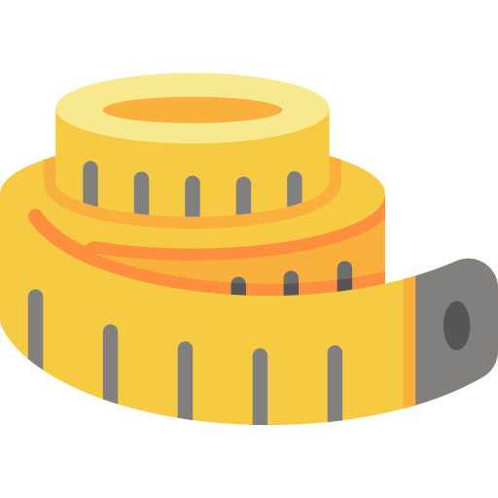


FINOPS
After the migration process was completed, FinOps best practices were addressed to optimize the GCP environment.
Rightsizing activities were performed thanks to the monitoring and usage data acquired.
Committed Usage Discounts were activated to leverage on the required usage of the VMs.
The entire architecture was analyzed and optimized to reduce useless expenses.

Slide 13
THANK YOU
www.reply.com

