Slide 1

ARCESE GROUP

Slide 2


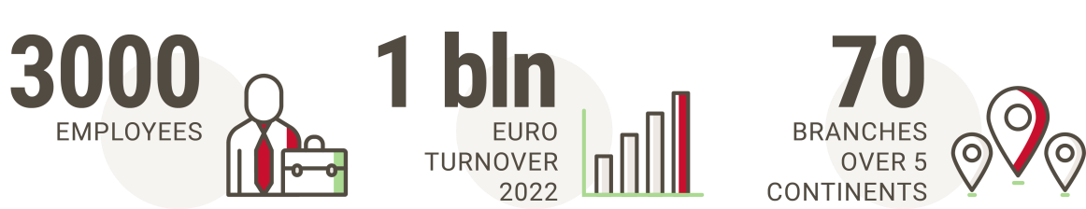
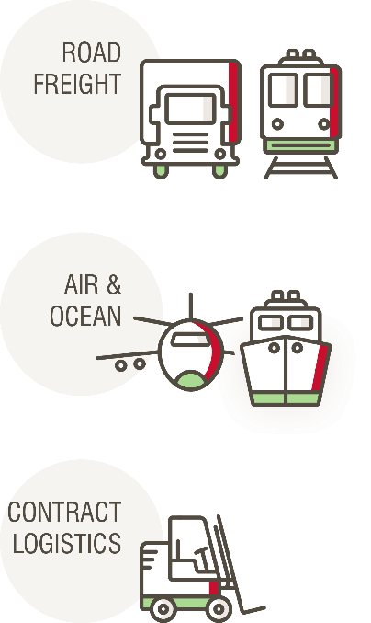

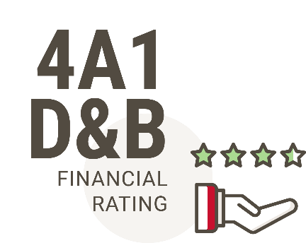


ARCESE GROUP
GLOBAL LOGISTICS OPERATOR
HIGHLIGHTS
Guided by
UN Global Compact & SDG
(Sustainable Development Goals)

Slide 3



ARCESE CLOUD EVOLUTION
2010
Two main proprietary datacenter
2011
Datacenter outsourcing
2015
First cloud workload
2016
Hybrid-cloud setup
2023
Full multi-cloud

Slide 4






GOOGLE CLOUD FROM ARCESE PROSPECTIVE
Latency
Data analytics and storage
Open Source Integration Cost-effective pricing.
Fast I/O

Slide 5










ARCESE MULTICLOUD STRATEGY
Avoid vendor lock-in
Leverage innovative technologies
Increase infrastructure performance Cut IT-related costs.
Business resilience, DR

Slide 6







CHALLENGES
Cloud it’s not a place to host VMs (from IAAS to PAAS or
SAAS)
Simple lift and shift doesn’t work.
FINOPS service with global overview.
Security
IAC practice.
Internal teams reskilling.

Slide 7
THANKS FOR YOUR ATTENTION

