Slide 1

Supercharging Customer Service with AI-Powered Agents
Kate Engels
Tribe Lead Customer Interaction Platforms & Automation
December 4, 2024

Slide 2
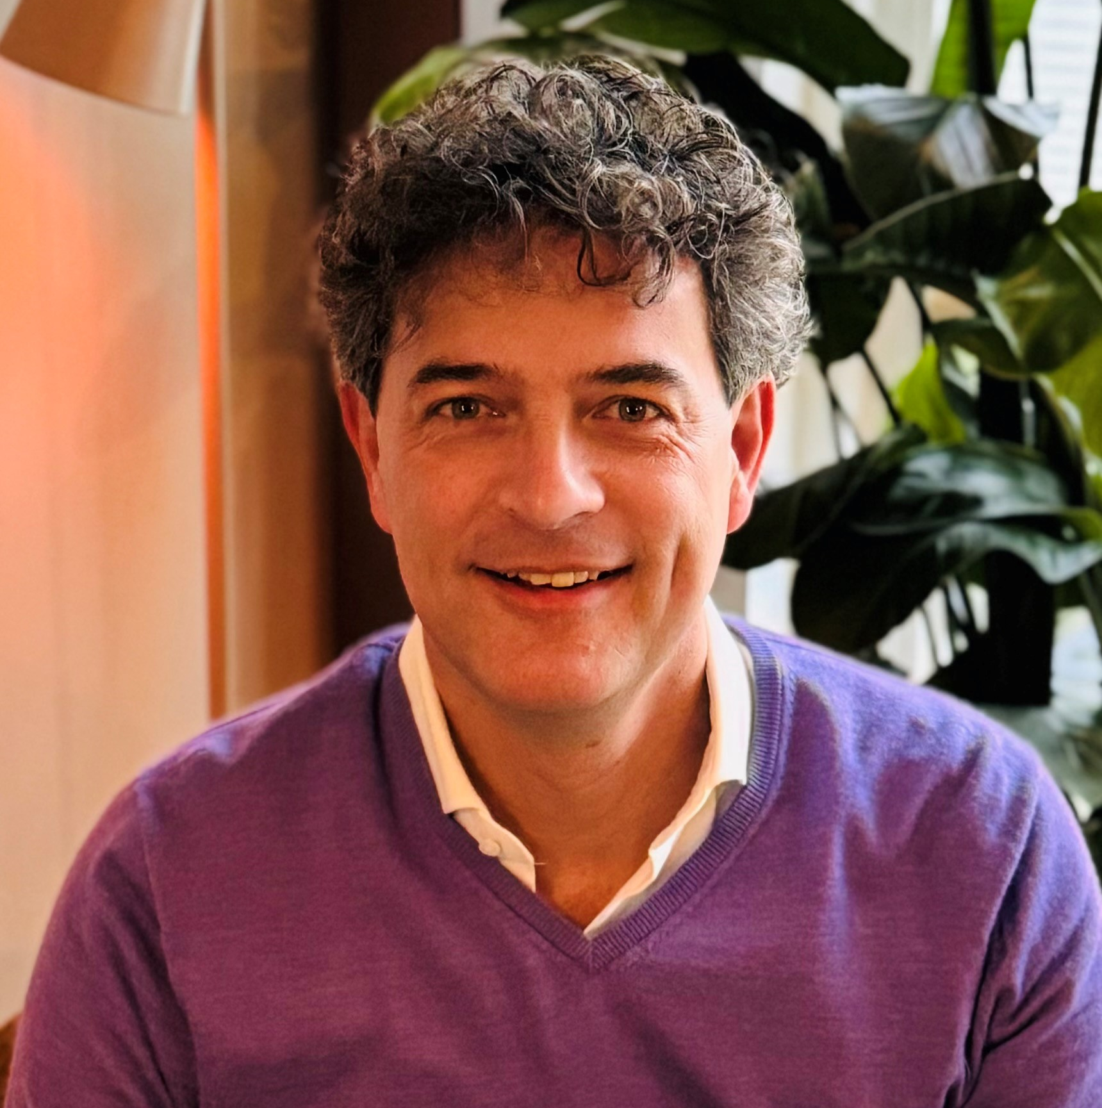
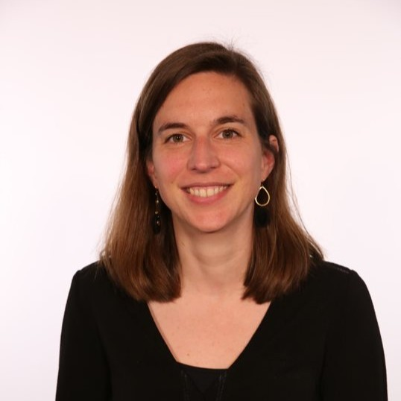
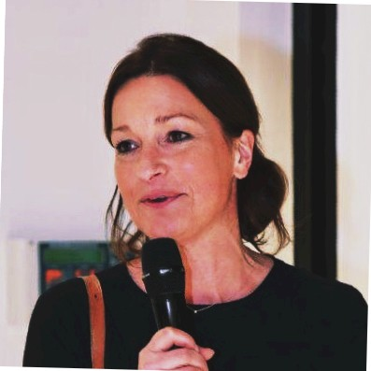
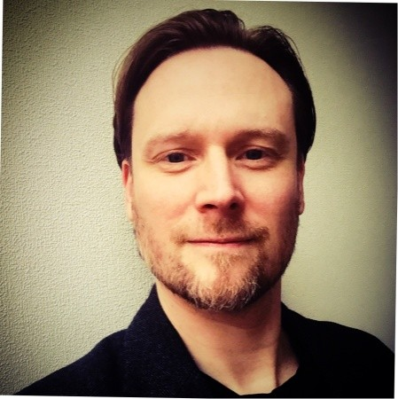
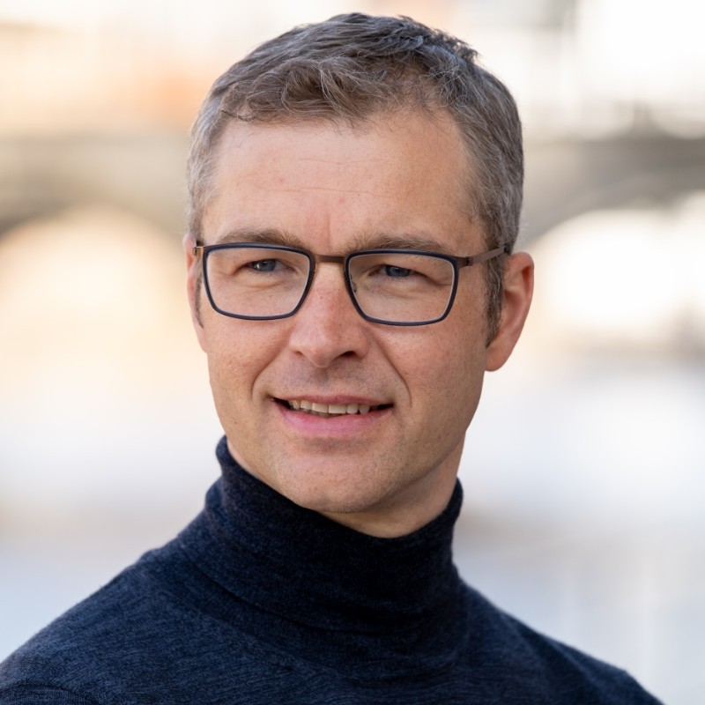
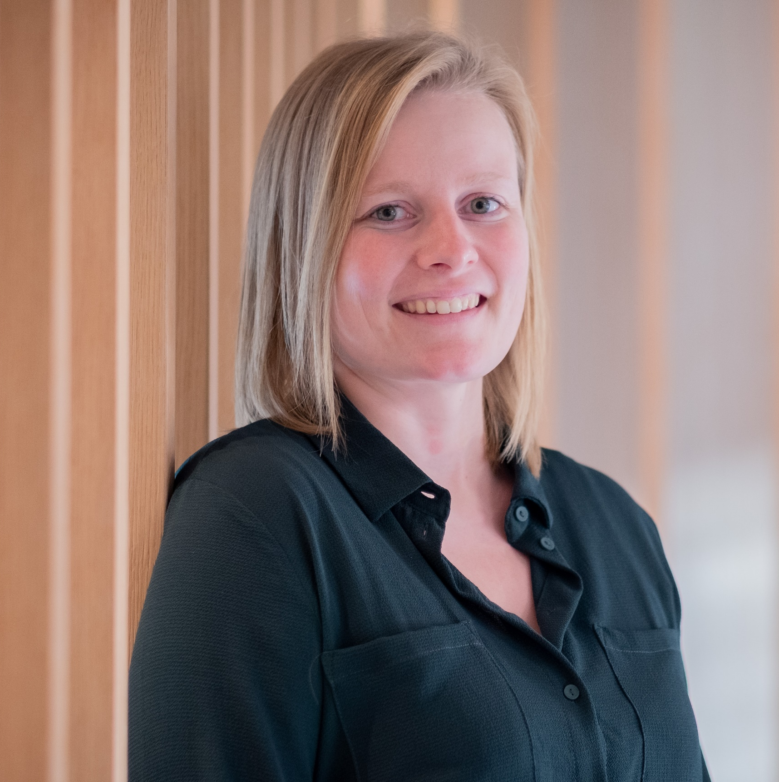
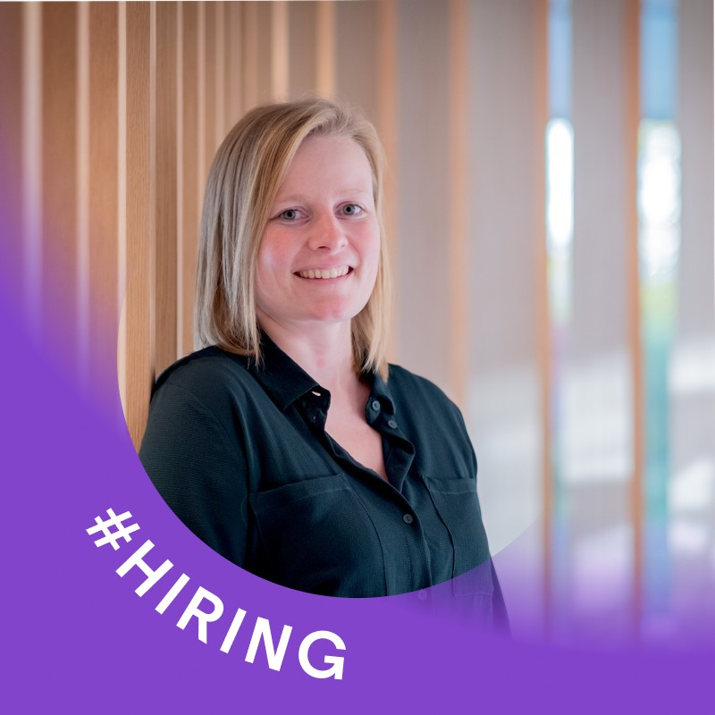
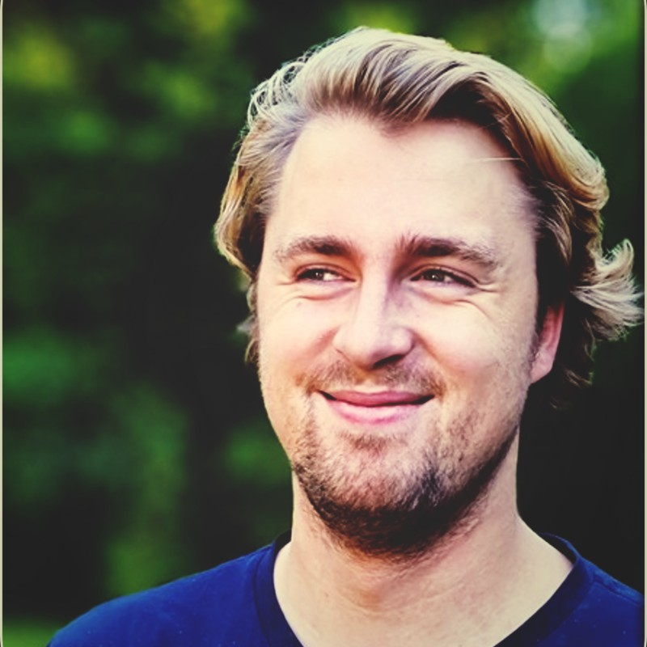
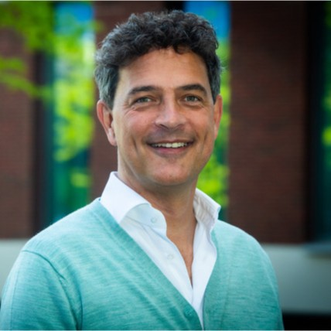
Our Customer Operations Circle has six tribes who together run our operations
Customer Operations Telenet Tribe
Jurriaan Leijder
Customer Operations BASE Tribe
Elke De Meue
Customer Operations Back Office Tribe
Peter Meynckens
Billing Experience Tribe
Johan Morel
Chief Customer Operations Officer
Benedikte Paulissen
Customer Interaction Platforms & Automation Tribe
Kate Engels
Customer Operations Steering Tribe
David van der Laan​

Slide 3







AI has been the silent revolutionizer
In our daily lives
… and at Telenet
So1
IHC
VBN
under the hood
Predictive AI

Slide 4
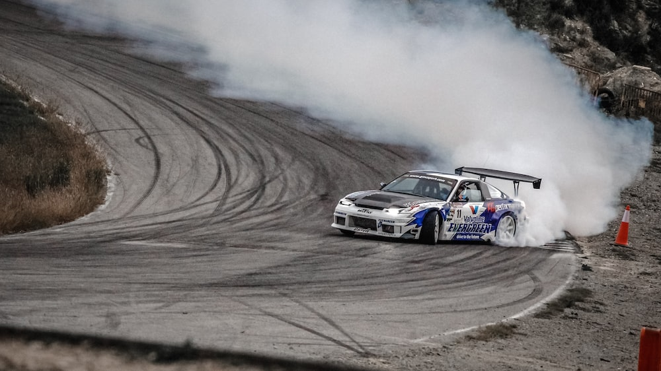


ChatGPT
TOOK THE WORLD BY STORM
Generative AI

Slide 5


The world we know
The new world
Predictive AI
Generative AI
Make predictions
Create new content
vs
Unstructured data
Structured data
Automated decisioning
Conversational

Slide 6
At Telenet group…
We have been exploiting Predictive AI for a while…
… but Generative AI has us exploring a new world
The world we know
The new world

Slide 7
At Telenet group…
We have been exploiting Predictive AI for a while…
… but Generative AI has us exploring a new world
The world we know
The new world

Slide 8
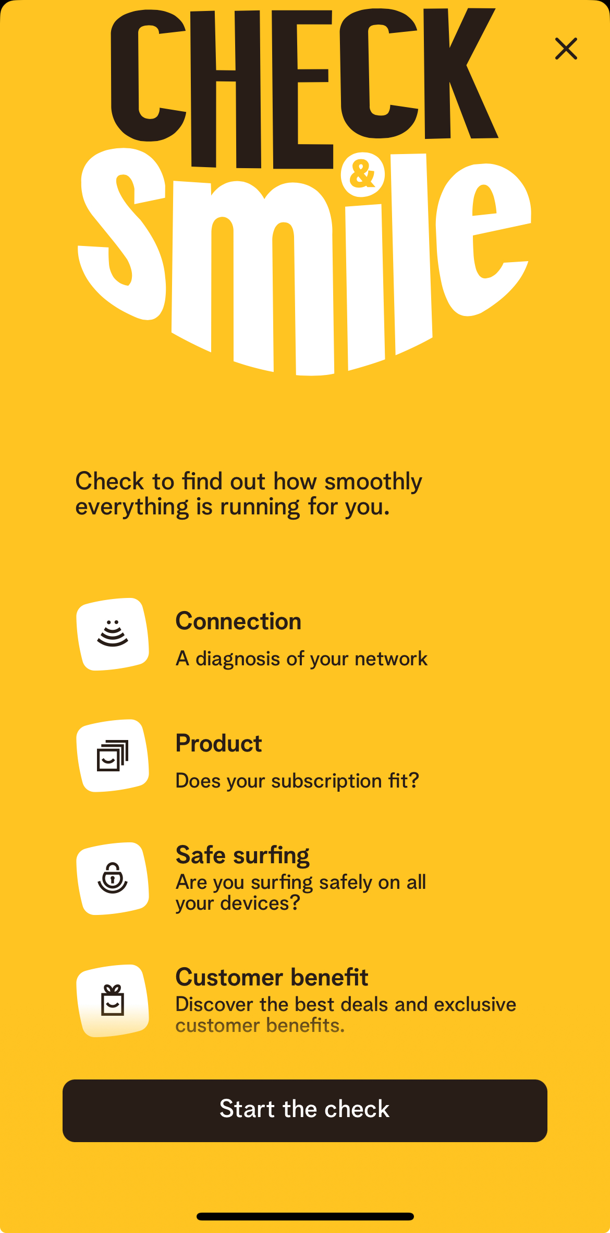


Slide 9
At Telenet group…
We have been exploiting Predictive AI for a while…
… but Generative AI has us exploring a new world
The world we know
The new world

Slide 10
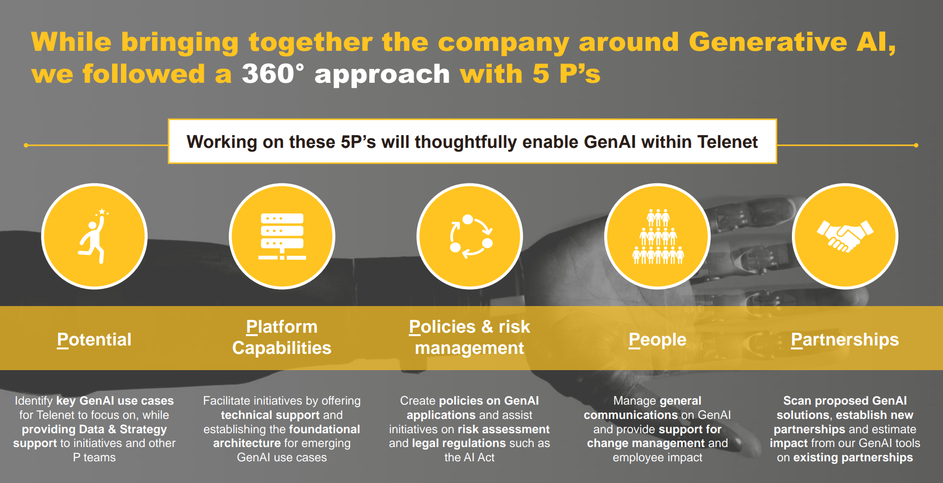

Slide 11





Give customer agents a second brain
Boost efficiency
AI Product
Agent Assist
Increase support quality
… raises the bar for
customer service
Improve agent satisfaction

Slide 12



Agent Assist – use cases
Before interaction
During interaction
After
interaction
Reduce time to find the customer and call context
Reduce time to diagnose & solve issues, and improve support quality
Reduce time to summarize customer conversation

Slide 13



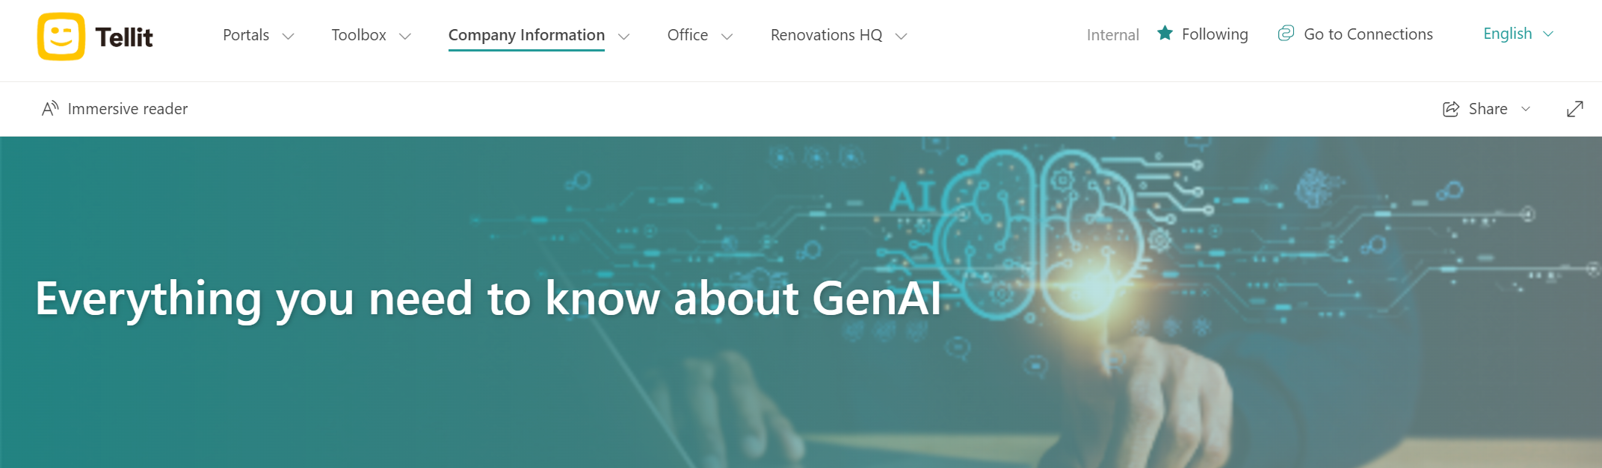
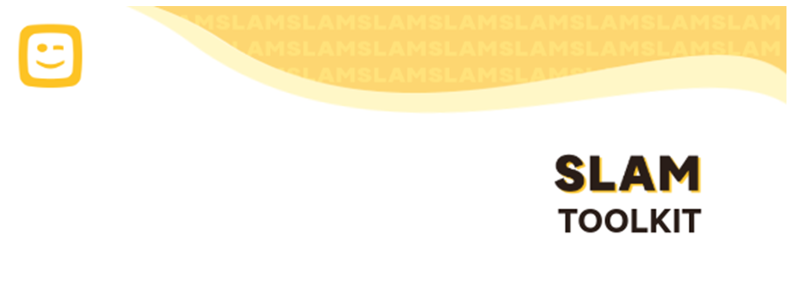
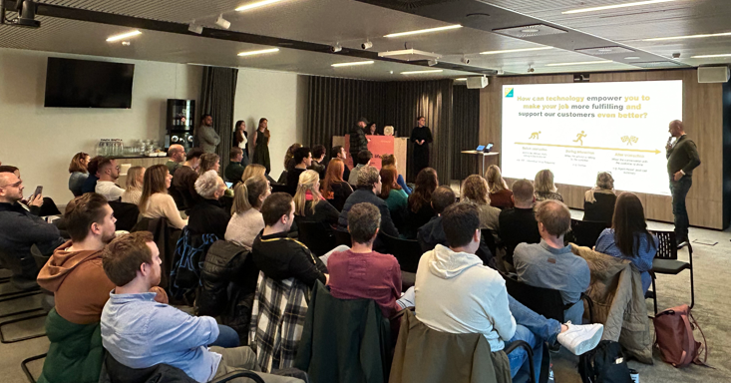
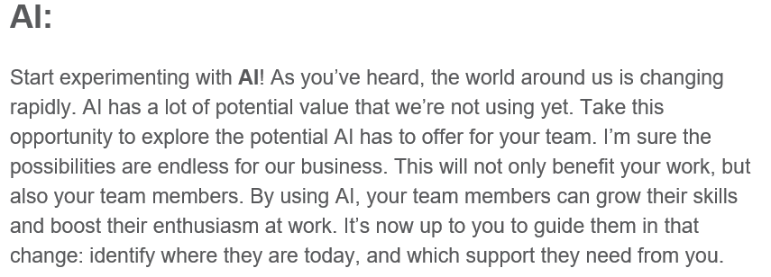
A
D
K
A
R
Awareness
Desire
Knowledge
Ability
Reinforcement
It’s about our people!

