Slide 1

Fragility as a chance
A text-based adventure
START

Slide 2
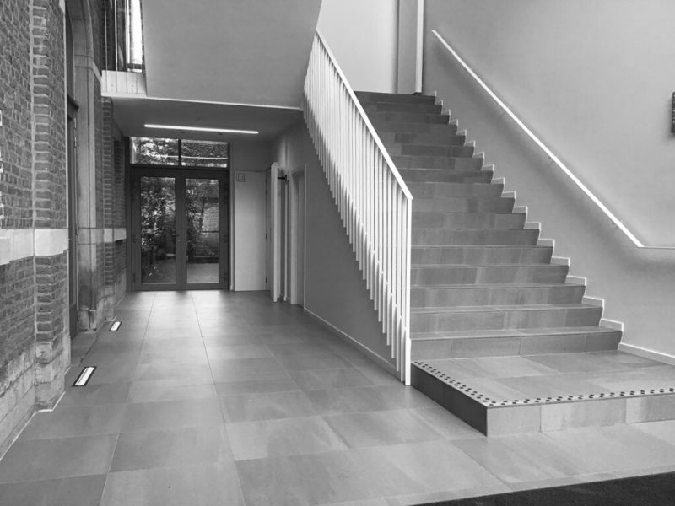
You are standing in front of the Social Sciences Building, a bit early for your appointment with the manager of the KU Leuven Digital Society Institute.
Quite typically, it begins raining.
The building in front of you seems to offer the shelter you need. You enter it, and the warm smell of coffee and croissants reminds you that you had to skip breakfast. Instinctively, you follow the smell.
Climb the stairs

Slide 3
Coffee and croissants are indeed available. You help yourself.
Your basic needs satisfied, you have a look at the room.
At four tables, groups of adults are busy with markers for kids, pencils, and colored stickers, sketching a collective fresco on a large sheet of paper. They seem to exchange about the further development of their sketch, at times laughing, at times shouting in excitement. The language is English, yet you can hear accents from different countries. You feel intrigued.
Come closer

Slide 4



You come closer to one of the tables, and hear a woman’s exclamation: “The doctor must be in the balloon!” and immediately her seatmate’s response: “No, he must be holding the rope ladder, trying to get into the balloon”. On the opposite side, a man asserts: “I’ll give him a handsaw, that’s how you recognize a surgeon!”. A fourth participant holds a printed text and warns everyone: “We should not forget to sketch a big smartphone, it’s very important!”.
At that point, you hesitate. What do you do?
A. Run away from this madness
B. They seem to have fun. Join them

Slide 5
You come closer to one of the tables, and hear a woman’s exclamation: “The doctor must be in the balloon!” and immediately her seatmate’s response: “No, he must be holding the rope ladder, trying to get into the balloon”. On the opposite side, a man asserts: “I’ll give him a handsaw, that’s how you recognize a surgeon!”. A fourth participant holds a printed text and warns everyone: “We should not forget to sketch a big smartphone, it’s very important!”.
At that point, you hesitate. What do you do?
You take a free seat, grab a pen and markers, and wait for the group to inspire you.
Congratulations!
You are participating in a Responsible Research and Innovation Workshop (RRI)
(El Hadj et al., 2024)
A. Run away from this madness
B. They seem to have fun. Join them
How it works

Slide 6
How it works
Bruno Dupont, KU Leuven Digital Society Institute, 4 Dec 2024
Fears and hopes
Worst-case or best-case scenarios about future use
Ethical questions, pitfalls, opportunities
….
RRI workshops gather (potential) stakeholders of stakeholders of a practically used technology
Example: the use of predictive AI in customer service
Several rounds of guided discussions and creative sessions
development of the specific technology
guidelines or frameworks for ethical design of technology in general

Slide 7
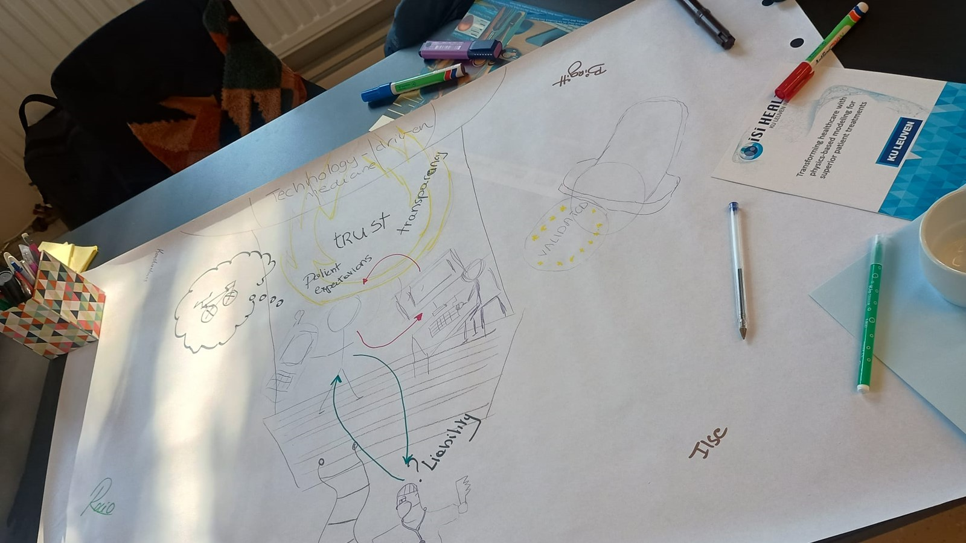
A surgeon on a ladder rope…
Bruno Dupont, KU Leuven Digital Society Institute, 4 Dec 2024

Slide 8
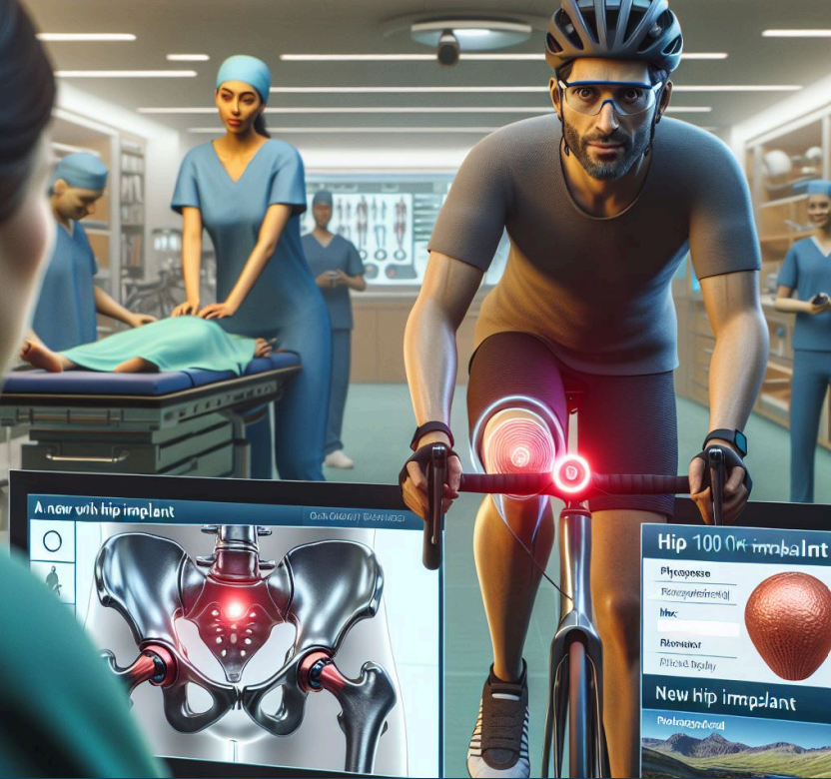
1. Draws on “sociotechnical imaginaries”
(Janasoff & Kim, 2015)
Bruno Dupont, KU Leuven Digital Society Institute, 4 Dec 2024
Why it works

Slide 9
2. Against the tickbox approach to ethics
Bruno Dupont, KU Leuven Digital Society Institute, 4 Dec 2024
Why it works

Slide 10

Value-centered design (Cawthorne & van Wynsberghe-Robbins 2020)
Bruno Dupont, KU Leuven Digital Society Institute, 4 Dec 2024
Value discovery
  Making explicit the intended values as conceived by engineers and designers
  Scrutinizing these values by illustrating value conflicts and trade-offs
  Comparing intended values with the ethics literature
    Translating values into design requirements
      Value conceptualization
      describing the disconnect between intended and realized values by speculating unintended uses and contexts of the artifact
      exploring the translation / specification of value into design requirements

Slide 11
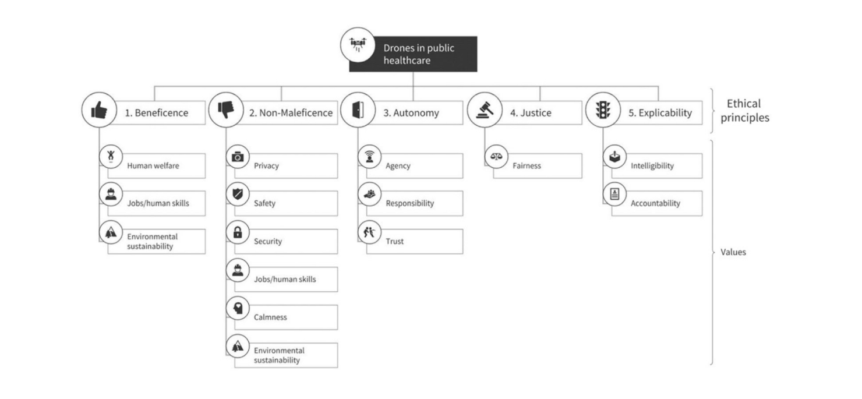
Bruno Dupont, KU Leuven Digital Society Institute, 4 Dec 2024
Derive ethical principles from values, not the other way around
(Cawthorne & van Wynsberghe-Robbins, 2013)

Slide 12

Involving all stakeholders, really?
Bruno Dupont, KU Leuven Digital Society Institute, 4 Dec 2024
Biases and dead angles
we invite people
positive about our project
who look like us physically or socially
we forget people
with a “passive” role in favor of “actors”
we do not know that some people exist
because we just do not know them
because we never thought they would use our technology
Being John Malkovitch, Spike Jonze (dir.), 1999

Slide 13
Bruno Dupont, KU Leuven Digital Society Institute, 4 Dec 2024
We tend to reproduce existing power dynamics
Designers vs. users
Western men vs. non-western, non-male
No one-size-fits-all solution…
Inclusive design = a series of choices
Goal: sharing the power

Slide 14
Pick an inclusive design framework that…
Bruno Dupont, KU Leuven Digital Society Institute, 4 Dec 2024
Links inclusive design process
with inclusive design outcomes
Makes visible the step-by-step character
from total exclusion to total inclusion
Share the power
Identify progress
and room for improvemnt

Slide 15
Bruno Dupont, KU Leuven Digital Society Institute, 4 Dec 2024
(Lee & Cassim, 2009)
Medical Model of Disability >>>>>>>>>>>>>>>>>>>>>>>>>>>>>>>>>>>>>> Social Model of Disability
EXCLUSION> | Distinction between three approaches to disability by Richard Rieser
 | SEGREGATION> | <INTEGRATION | <INCLUSION
(Tends to emphasise)
Discrimination | Services to Disabled People | Needs of Disabled People | Rights of Disabled People
Isolating Disabled People | Categorising Disabled People | Changing Disabled People | Changing the environments and designs
No consideration | ‘Special’/ different treatment | Equal treatment | Equality – each person receives support they need to thrive & achieve their potential
Ignore disability | Disability is a problem to be fixed (in a special place) | Disability is a problem to be fixed | Everyone has gifts to bring
No Service | Services available in segregated setting | Benefits to disabled person of being integrated | Benefits to everyone, including all
Professional/experts | Professional/experts | Professional/experts | Political struggle, friends & support
NIL | ‘Special’ therapies | Technique | Power of ordinary experience
 | Competition for parts of Disabled Person (only) | Technical Interventions | Transforming power of relationship
 | Stress on inputs | Stress on process | Stress on outcomes; have a dream
 | Integration ‘for some’ is not desirable | Integration can be delivered | Inclusion must be struggled for

Slide 16


Our mission is to
define a solid path towards a
positive digital future
by understanding, designing, developing and critically reflecting
on (new) interactions between people and digitally driven technology

Slide 17
Conclusion: Fragility as a chance
Bruno Dupont, KU Leuven Digital Society Institute, 4 Dec 2024
RRI workshops are not only about the pitfalls, dangers, and dystopic sides of technology.
    also envisioning how technology can contribute to a better society
Fragility of human-centered design (Steen, 2008)
Reach out to us!
Ethical & inclusive design are a reflective process and a gradual striving towards an ideal

Slide 18


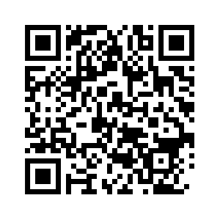
Bruno Dupont, KU Leuven Digital Society Institute, 4 Dec 2024
Institute manager: Bruno.dupont@kuleuven.be
@KULeuvenDigiSoc
http://www.kuleuven.be/digisoc
Subscribe to our newsletter
Notes:
We nodigen u uit om samen met ons deze uitdaging aan te gaan, meer informatie vindt u op onze website en Mastodon account.
We invite you to join us in this challenge, more information can be found on our website and twitter account.

Slide 19
References
Bruno Dupont, KU Leuven Digital Society Institute, 4 Dec 2024
Cawthorne, D., Robbins-van Wynsberghe, A. (2020).An Ethical Framework for the Design, Development, Implementation, and Assessment of Drones Used in Public Healthcare. Sci Eng Ethics 26, 2867–2891. https://doi.org/10.1007/s11948-020-00233-1
Digital Society Institute [website]. www.kuleuven/digisoc
Elhadj, E., Van Horenbeeck, Z., Lievevrouw, E., & Van Hoyweghen, I. (2024). Brokering responsible research and innovation in in silico medicine. Journal of Responsible Innovation, 11(1), 2414484. https://doi.org/10.1080/23299460.2024.2414484
Elhadj, E., Van Horenbeeck, Z., Lievevrouw, E., Geris, L., Van Hoyweghen, I. (2023).In Silico World WP5 Stakeholder Engagement-Responsible Research and Innovation Workshop Report. https://lirias.kuleuven.be/retrieve/740365
Geerts, D. (2024). Designing Ethical Technology [course slides, Hybrid Course on Digital Ethics].
Jasanoff, S. & Sang-Hyun, K. (2013) Sociotechnical Imaginaries and National Energy Policies, Science as Culture, 22:2, 189-196, DOI: 10.1080/09505431.2013.786990 https://doi.org/10.1080/09505431.2013.786990
Jonze, S. (dir.) (1999). Being John Malkovitch.
Lee, Y., & Cassim, J. (2009). How the inclusive design process enables social inclusion. International Association of Societies of Design Research (IASDR), 1-10.
Lievevrouw, E., Elhadj, E., Van Horenbeeck, Z., Beaucage-Gauvreau, E., Dupont, B., Van Hoyweghen, I., Zaman, B. (2024). iSi Health & DigiSoc workshop Building Trust for In-Silico Medicine. [workshop material]
Steen, M. (2008). The Fragility of Human-Centered Design. Amsterdam: NOS.

