Slide 1
The Composable enterprise:
The Factory line
Jeroen Verbruggen
Proximus IT Lead

Slide 2

Notes:
So basically, the brief for my keynote today was “IT as a factory line”. While I must admit that in the beginning, I was struggling a bit to find the right angle – it actually is a very timely moment to elaborate on that metaphor.
Because IT has long looked a lot like a factory line. We are automating the rest of the business, but in IT each station is staffed by skilled craftspeople: engineers writing code line by line, testers designing test cases by hand, operators sifting through logs to find incidents. This has given us quality and control, but it also has consequences:
Work piles up in front of scarce stations, like architecture or security review.
Quality depends heavily on individual heroics.
Context is lost in handovers, leading to rework and waste.
In factory terms, we have variability, bottlenecks, and too much manual handling. And we ship expensive products – like the Porsche on the picture.
And then AI happened, and especially new models launches like Sonnet & Opus & ChatGPT 5.4 have made certain steps of our factory line much more automated.
But as it happens in a factory line: if you increase productivity in one step, you typically generate bottlenecks in another one.
And this will be subject of my talk: how do we redesign the factory line to produce more with these new robots that just became available.

Slide 3
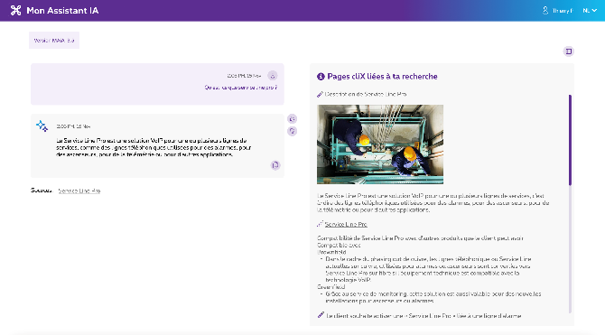
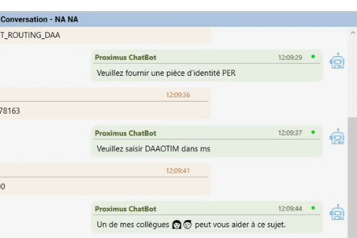
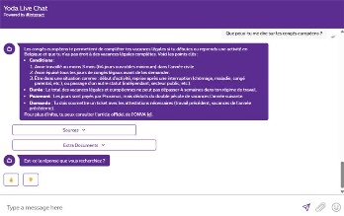
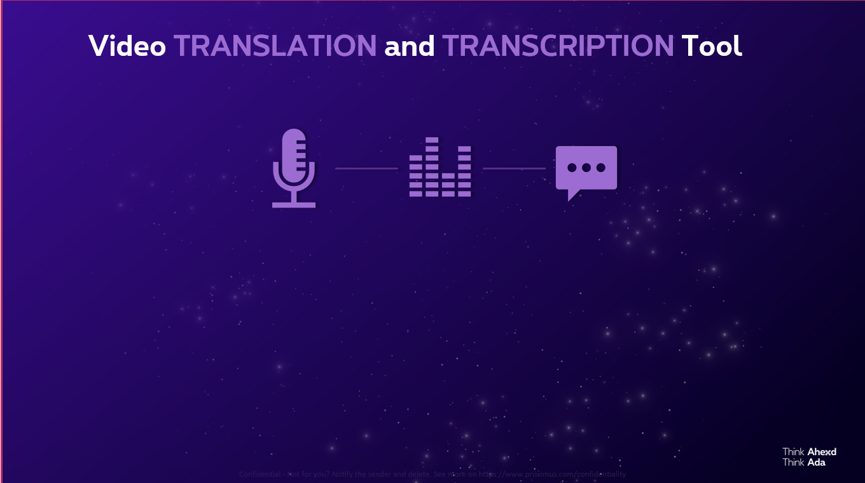
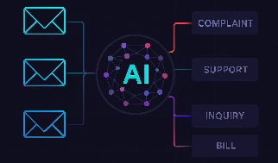
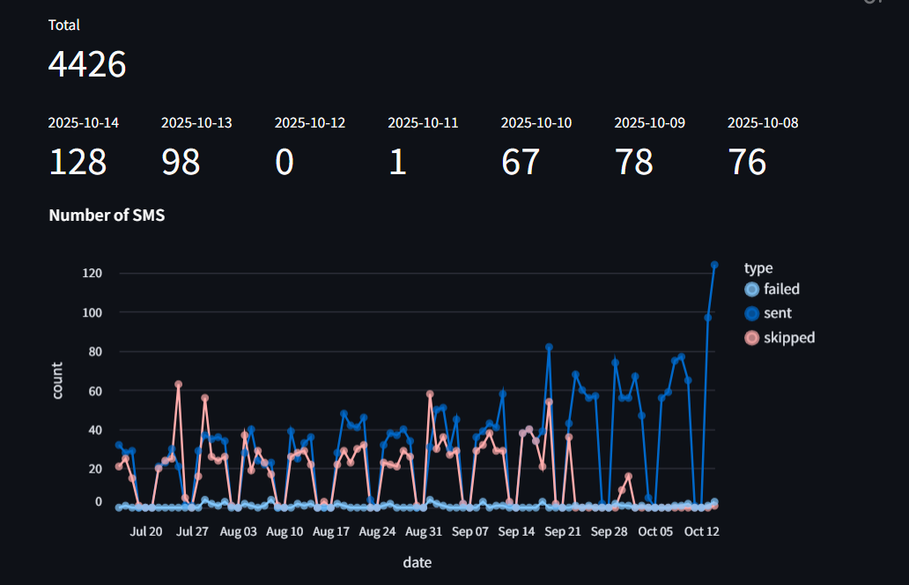
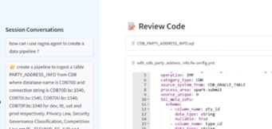
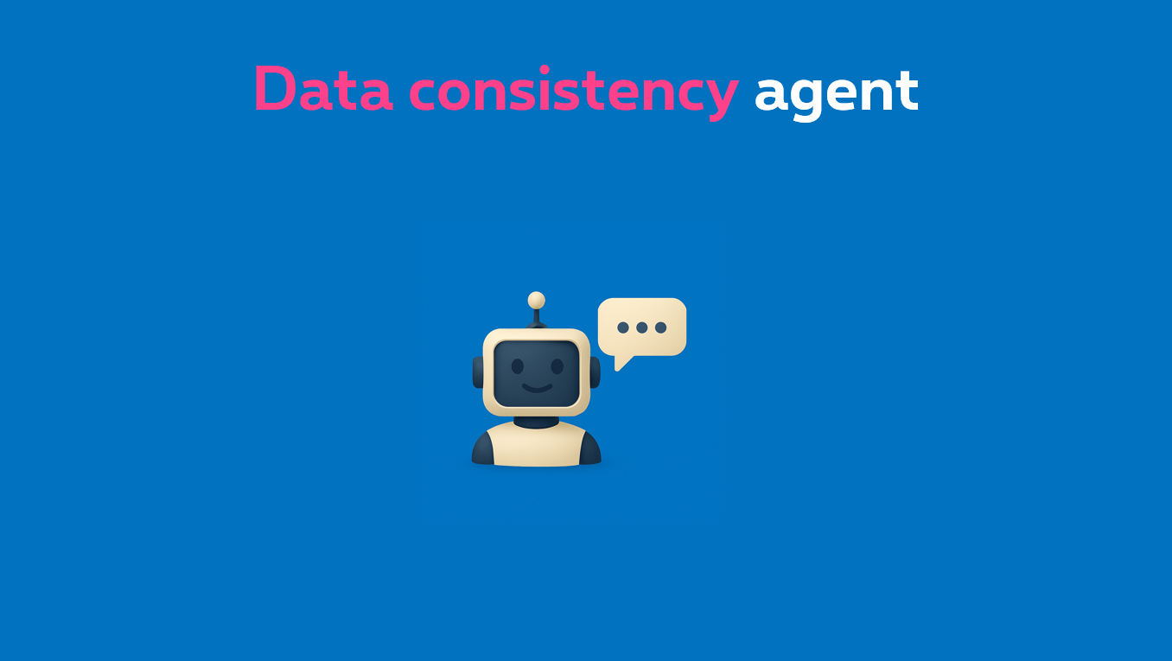
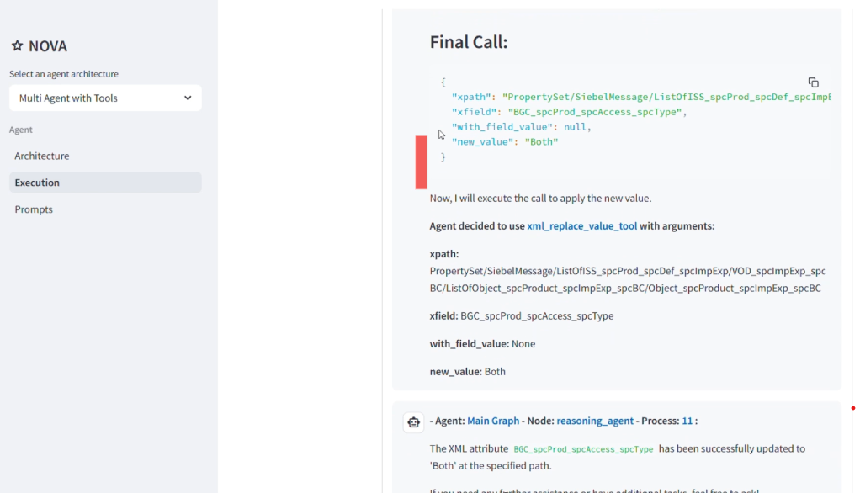
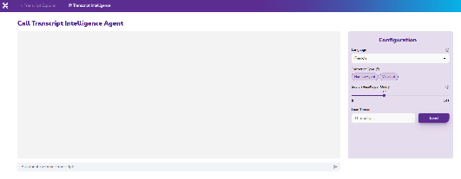
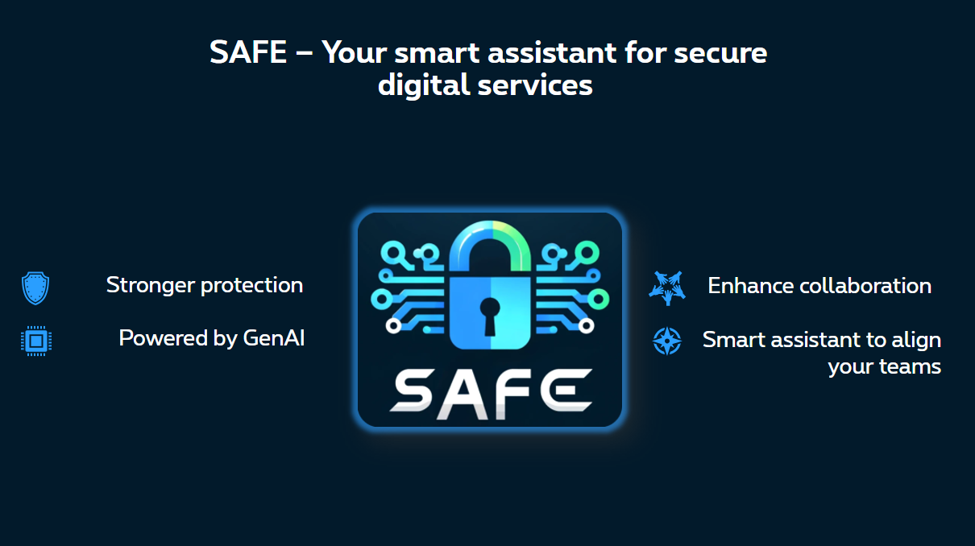

AI has become embedded in most of our business processes – delivering >20M€ of value per year
MAIA
GenAI assistant for sales agents
Writing assistant
GenAI-powered correction & translation
for helpdesk operators
YODA HR
AI-based chatbot solution connected to Proximus official HR documentation.
Transcription/Translation
AI-powered tool for automated video transcription and translation to boost team productivity
Contact Reason Detection
AI-based topic classification on all
voice and chat interactions
Data consistency
AI agent that automates data updates and ensures consistency/compliance across sources
Data Engineering MAS
Automate the creation and maintenance of data pipelines using AI Agents
ACDC Fiber
Real-time avoidance of collateral damages during interventions on the fiber network
SAFE
GenAI-powered smart assistant for secure digital services that strengthens protection
Phishing test
AI-generated phishing simulation and tailored feedback to measure resilience and train teams
Sales catalogue agent
creation and maintenance of data pipelines
Insights
Interactive Gen AI agent to extract insights from customer interactions
Notes:
Let’s first take a step back – and look at AI adoption in recent past. Like many other companies Proximus has adopted AI across most business domains. And they contribute significantly to our bottom-line.
However, most of these cases are based on predictive models, classification, computer vision... and use to some extent LLMs to summarize, assist etc.

Slide 4
FROM
TO
Siloed AI with low reusability and incremental value capture
Agentic AI, LLMs that can execute and orchestrate complex tasks
1
2
3
4
Predictive models
Classification models
Plan
Understand goal and split tasks
Act
Connect to tools to execute tasks
Replan
Optimize the execution of tasks
Learn
Evaluate in real time the result of action
Agents' orchestration
Computer vision
Digital Assistants
Systems
Coding copilot
CRM
Source code mgmt.
Network
HR Systems
Employee copilot
Notes:
These use-cases are somewhat limited as they optimize a step of a process, but don’t fundamentally change it. So the next wave of AI value will be using the advanced reasoning & planning capabilities of LLM to orchestrate and act in e2e processes, aka Agentic AI.

Slide 5



Key focus areas for Agentic AI in Proximus
Customer service
Network
IT development
Delivering superior experiences with high-value human interactions
Building smarter, predictive and self‑optimizing infrastructure
Combining human expertise with AI intelligence
Improve customer issue resolution speed with chatbot & voicebot
Autonomous networks replacing manual operations via zero-touch orchestration
E2E AI-based software development
Elevate digital-human interactions with natural experiences
AI assistant designed to streamline fiber repair operations by providing real-time guidance and automation
Implement AI agents to automate repetitive coding tasks end-to-end
Evolve to unscripted always up-to-date resolution flows driven by self-optimizing AI agents
Ensuring consistent fiber-work quality with image recognition
Increase developer productivity by using GenAI tools (e.g., GitHub Copilot)
Use GenAI to convert legacy code during system outphasing
Notes:
Our focus Areas for agentic AI will be much the same areas: customer services, network design and operations, but this time also IT development itself.
And as CIO I am getting a lot of pressure these days of colleagues that bought a Claude subscription and build some kind of app over the weekend, to manage their groceries, kids’ hobby planning or sth – and then they proudly share the result with me, typically accompanied with a kind of passive aggressive question like “are we using this already in IT”?

Slide 6
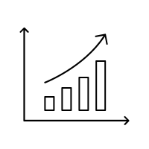



AI is already embedded in e2e software development cycle, but also creating new “productivity paradox”
Strong Adoption
Efficiency gains ≠ step-change in speed
Tangible € savings already visible
Output feels similar, not transformed
Notes:
And I have to admit, I struggle myself with the fact that on the one hand we see strong adoption of AI in IT– but we don’t see or feel a real step-change in e2e speed of delivery.
I don’t have the answer to that question yet. So let me share today on how we try to address it – and happy to engage tonight or later with any of you on how you address it in your organization.

Slide 7
1
Shift focus from ‘adoption’ of AI tools to ‘meaningful use’ – and measure it

Slide 8






Shift focus from ‘adoption’ of AI tools to ‘meaningful use’ – and measure it
Adoption
Meaningful usage?
5-10% users write code almost fully with prompting (measured by token usage)
5-10% users write code almost fully with prompting (measured by token usage)
</>
>70% of code generated by
AI is ‘not accepted’ by user
>70% of code generated by
AI is ‘not accepted’ by user
Saves >30 min / day
Coding time reduced with 30 min / day
(but meeting time didn’t)
Correlation of usage with productivity unknown:
PR cycle time
Code churn
Mean time to repair
Notes:
Many IT departments still report on on Copilot usage, average time saved per day, lines written by code.
But it not about the adoption, it's meaningful usage, and in our case, that means are you actually deploying code to production, and is it actually making it to customers in the form of features.
So we are shifting measurements along three axes in Proximus.
First, intensive usage. If people are not using the tools to shift to true agentic development, transformation will not happen. So we are measuring that through token usage, code generated via completion vs prompting etc... It is like that we discovered only 5-10% of our developers are real intensive users, that basically have all their coding work done by the agent.
Secondly, once you have done that, you can correlate that to throughput and process efficiency. Look at metrics such as pull-request rate, cycle time, and latency. These are not perfect, but they provide a systems-level view on whether development practices are actually changing on the ground. And we find these things to be correlated.
Third, outcomes. Ultimately, it is about whether business objectives are met, such as road map progress, defect rates, and customer impact. These metrics are not different than what we used to track in past.

Slide 9
Cluster users by level of meaningful usage, can help to tailor training and identify ambassadors
P1/P2
Foundation
P3
Minimum Standard
P4
Ambassador
P5
Ninja
.
Training 1
Training 3
CoP Ambassador
Mgmt agreement 20% time
Getting started with Copilot(2h)
Agentic use of Copilot(2h)
Monthly SIM sessions
Enterprise agents & prompts
Training 2
Training 4
Office hours & Internal demos
Cross CoP outreach
Prompt & context engineering(2h)
Copilot features on github.com(2h)
Hackathon 1
Hackathon 2
GH certification
Notes:
Training and changement is of course important as well. Upskilling engineers and product managers to use AI is not as simple as providing them with a tool. Breaking down problems to clearly communicate with a large language model (LLM)—prompt engineering—is just one example of the complexity that requires intensive training to raise the bar.
But at Proximus we think it is important to design training that mirrors real development work—integrating AI into code reviews, sprint planning, and testing cycles—so teams learn to apply AI in live contexts, not simulations. To help personalize learning paths we cluster adoption levels across development teams so we can finetune trainings with focus on on prompt design and model evaluation.
It also helps to identify what we call Ninja-users to help establish internal “AI guilds” or “centers of enablement” that curate new use cases, share best practices, and serve as on-demand mentors for project teams.

Slide 10
1
Shift focus from ‘adoption’ of AI tools to ‘meaningful use’ – and measure it
2
Give AI agents ample context to work with

Slide 11
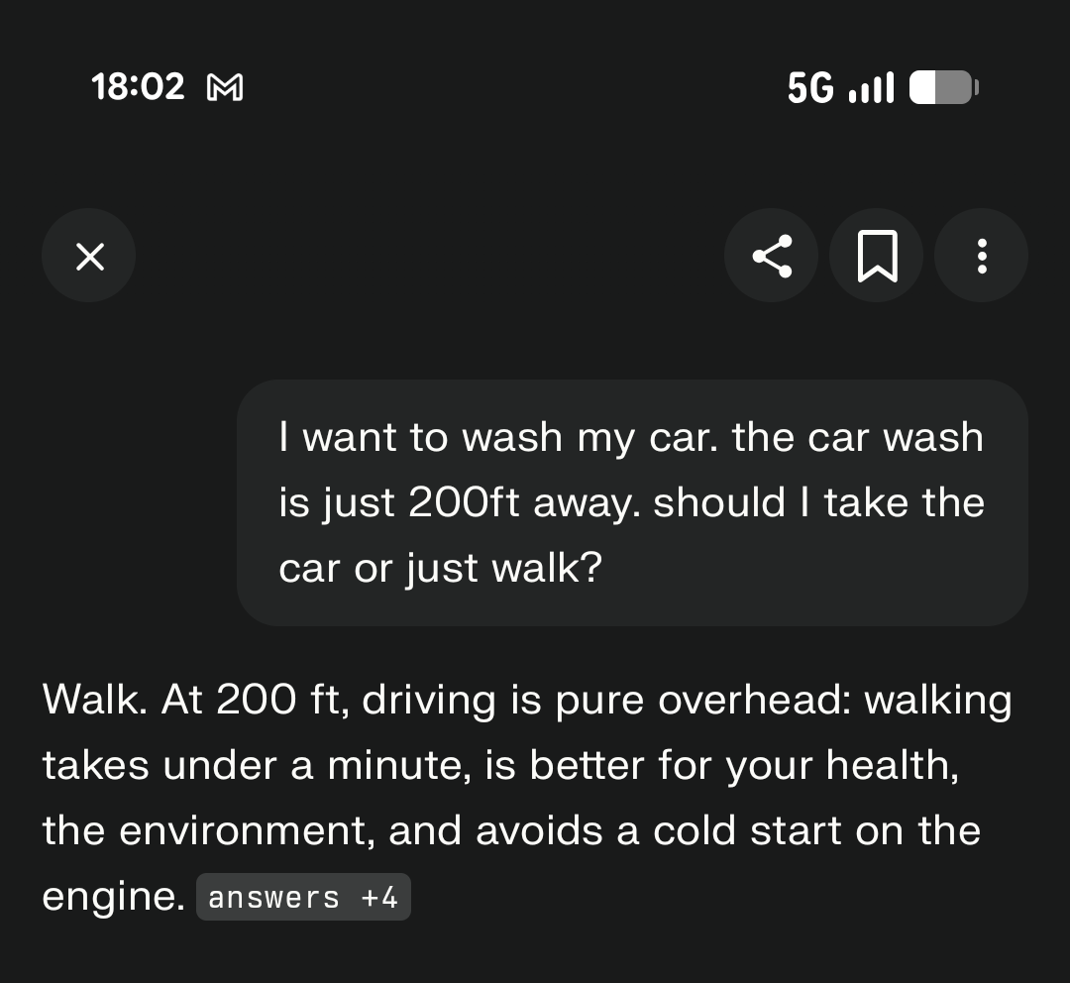
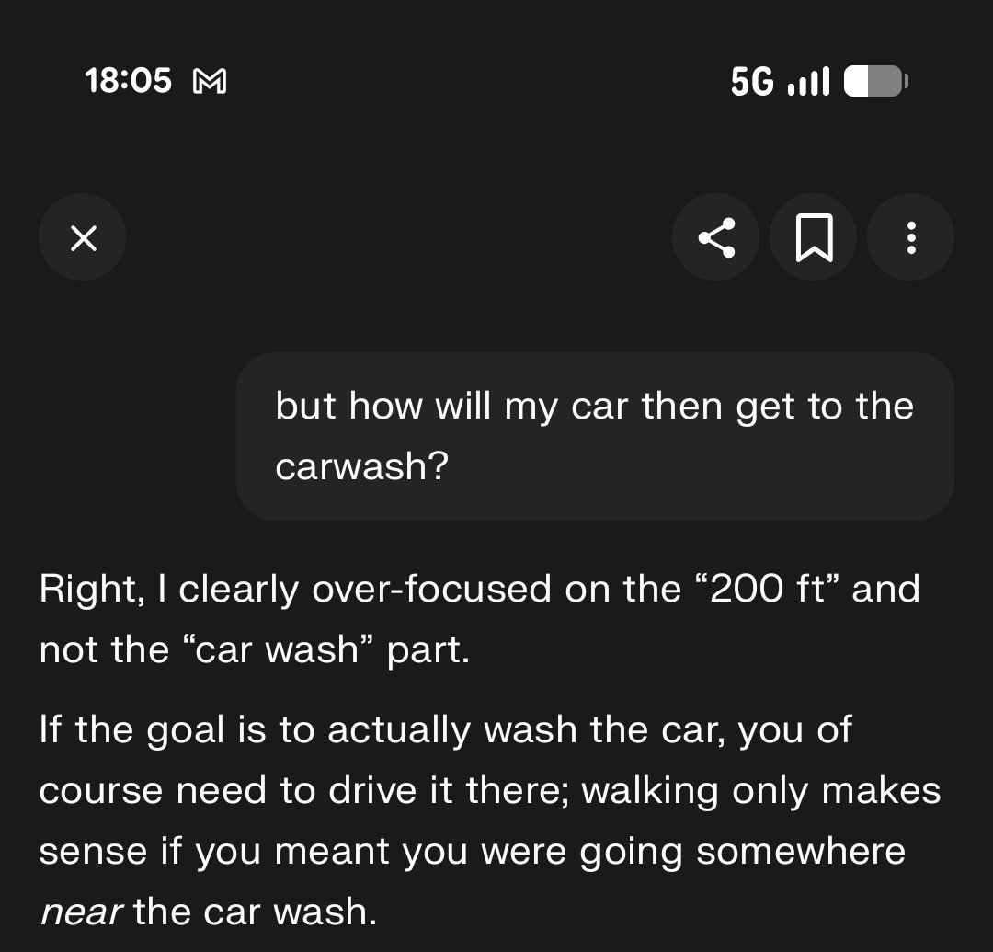
AI without context

Slide 12

AI coding agents need context and instructions to be productive
Agent
Purpose
Time saved
1
Orchestrator Agent
1
Orchestrator Agent
Executes COE standards and enforces quality gates and code reviews
-20% to 25%
On cycle time
2
Code Agent
(TP↔Code + UI)
Transforms TP into code and UI, using shared design patterns
-15% to 20%
On dev time
4
Migration of the SCARLET IT Stack
2
3
Code Agent
Quality Agent
Runtime
Agent
Quality agent
(Unit + INT + Security)
Ensures test coverage, stabilizes integration tests, and supports security checks
-15% to 25%
Testing & compliance
3
Runtime Agent
(Caching + Analytics)
-10% to 20%
On NFR regression
4
Handles caching, performance, storage patterns, and analytics(Adobe)
Notes:
A lot of the current fuzz focuses on “greenfield” examples—start-ups building from scratch on Java based development frameworks. The reality that most of use have to deal with is that we have millions of lines of code already, plus high internal and external compliance standards, integrations. That complexity slows adoption. That is not a failure of technology; it just takes time to integrate these tools.
In tackling this challenge it is interesting to draw a parralel to digital assistant in customer services or internal operations? There effectiveness depends on having a large knowledge base of product pages, methods & procedures... that have been typically written for humans but can easily exposed by RAG.
But many IT organization, us included, don’t have the same level of documentation available to instruct coding Agents. Hence as a result a lot is dependent on the prompt engineering from individual developers.
We tackle this problem at Proximus by creating real coding agents, that have not only access to the code repository, but which we also feed with a lot of documentation on data & functional objects, integrations, functional and non-functional requirements, security guidelines etc.
And we find they work best when they are properly scoped, each focusing on a specific task, just like a normal team, though the function don’t fully align.
For examples, we are refactoring part of our mobile app – lot of the refactoring is done by the coding agent, but we have created two other agents to help developers specifically to harden the code, from a security and observability point of view, as well as unit test generation. An initial code review is also done by an Orchestration agent that review code generated, the feedback loop is not yet implemented.
This set-up already improves productivity by 20% on top of normal Co-pilot usage, even if it essentially uses the same underlying models and code repository.

Slide 13
1
Shift focus from ‘adoption’ of AI tools to ‘meaningful use’ – and measure it
2
Give AI agents ample context to work with
3
Apply AI in e2e software development lifecycle

Slide 14

The bottleneck isn’t only writing code, we have to become more efficient in the e2e cycle

Slide 15







AI could support the full development lifecycle, with the biggest productivity impact in development and testing
Requirements
Design
Development
Testing
Deployment
Monitoring & Ops.
Examples
Draft structured requirements
Produce code for prototypes
Auto‑generate code
Generate test cases
Generate deployment scripts
Analyze system logs
Generate doc
templates
Create mock data
Refactor and optimize
Detect and fix bugs
Validate configurations
Detect anomalies
Provide coding guidelines
Validate design choices
Enforce coding standards
Scan for vulnerabilities
Produce release notes
Recommend optimizations
Build reference datasets
Flag design risks
the codebase
Support code reviews
Optimize test paths
Interpret old syntax/libraries
Code documentation
Notes:
So far we have much focused on development. But in large organization a lot happens before and after development, before the customers actually starts using a new features. And especially a lot happens before development...
By integrating all forms of AI into the end-to-end software product development life cycle (PDLC), we can empower project managers, product managers (PMs), engineers, and their teams to spend more time on higher-value work and less on routine tasks. As part of this broad shift, they can incorporate more robust sources of data and feedback in a new development framework that prioritizes customer-centric solutions.
I will not go into detail – but we are today mainly making progress in development and testing. But we have a target picture, but today it is fair to say we mainly reached significant adoption in coding & testing activities.

Slide 16

AI could bring structured iteration and continuous improvement throughout the development lifecycle
Requirements
Design
Development
Testing
Deployment
Monitoring & Ops.
Requirements refinement
Fast Prototyping
AI-assisted coding
Smart testing
Self-optimized CIDC
Predictive monitoring & maintenance
Architecture adaptation
Continuous governance
continuous feedback and improvement & shared data across all stages
Notes:
We are still very far from a fully agentic e2e softw development cycle. But as we adopt more and more agentic AI, the next frontier should be in my view rather what comes before development the design phase.
This is a highly unstructured phase today. We have some requirements written down, some mainly exhcnaged in meetings. We have some NFR and guidelines, but not complete. We feed developers with a dispersed set of requirements, UX flows, architecture documents, that often require a lot of voice over and meetings to get right.
The goal that we set ourselves now is the following: instead of writing typicaly requirements documents, that then go to design, UX, architecture… we try to have a transversal team actually build an mock front end applications, and actually generate its source code. And hand that over to developers to build it and integrate it. It promises to not only be more efficient. But today a lot of the “art” of our UX teams gets lost in the handover between front-end and developers.
Tools like an MCP server on Figma really help to do so.

Slide 17
1
Shift focus from ‘adoption’ of AI tools to ‘meaningful use’ – and measure it
2
Give AI agents ample context to work with
3
Apply AI in e2e software development lifecycle
4
Pioneer in applying e2e agentic coding for “repetitive” coding practices

Slide 18
1
Shift focus from ‘adoption’ of AI tools to ‘meaningful use’ – and measure it
2
Give AI agents ample context to work with
3
Learn fast by applying it on ‘repetitive development’ processes
4
Apply AI in e2e software development lifecycle
5
Adopt team set-ups ahead of the change

Slide 19


Redesign team set‑ups: from pyramidal to diamond structure
From
To
Notes:
For a long time coding seemed to be the hard part. It turns out describing what to build is harder. Defining the right intent, the “spec,” will be the core human task. That shift changes who adds value in the development process. It rewards clarity, systems thinking, and the ability to guide AI toward the right outcomes.
That also change how teams look like. The pyramid model with few senior developers and lot of juniors, typically offshore, to do the coding work will become less relevant. But of course having teams with only senior engineers also is not effective not future proof. So we will evolve to an engineering team set-up that is more diamond shape, or even just looks like the overall age-pyramid – which is a good thing in an aging world.
Companies should also reflect on the balance between internal vs external engineering and how it will affect their ability to capture the value from AI based coding.
At Proximus we have made that choice and will partially re-internalize development activities in our development centers in Belgium, Serbia and Bangalore.

Slide 20
1
Shift focus from ‘adoption’ of AI tools to ‘meaningful use’ – and measure it
2
Give AI agents ample context to work with
3
Learn fast by applying it on ‘repetitive development’ processes
4
Apply AI in e2e software development lifecycle
5
Adopt team set-ups ahead of the change
6
Focus on few but disruptive use-cases

Slide 21


Focus on a few high‑impact use cases where AI can amplify your team’s capacity
Traditional Automation
Agentic AI
Where can I boost outcomes if I would have more people?
Where can manual work
be avoided /reduced?
And achieve it via humans with AI superpowers
Notes: GCC : Global Competence Centers

Slide 22
From today’s constraints to simpler journeys and smarter operations
From
To
Complex bundled offers and promotions
1
Simple conversational commerce with a streamlined portfolio and pricing
Difficulty reaching customers at the right moment (impacting booking, rebooking, collections, etc.)
2
Contact customers at the right moment, through the right channel
Personalized marketing limited by human capacity
3
E2e agentic marketing from audience selection, A/B testing, content creation
Predictive maintenance relying on complex log analysis
4
Scalable “agents” monitoring components and acting on anomalies
Notes: GCC : Global Competence Centers

