Slide 1
August 27th, 2026

Slide 2
It took the telephone 50 years
to reach 50 million users.

Slide 3
The internet took
seven years

Slide 4
A leading generative AI tool reached
about twice that many in two months.

Slide 5
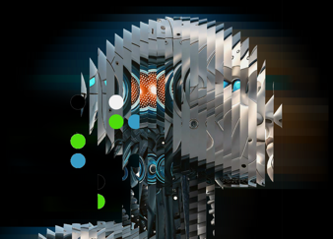

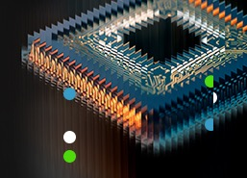
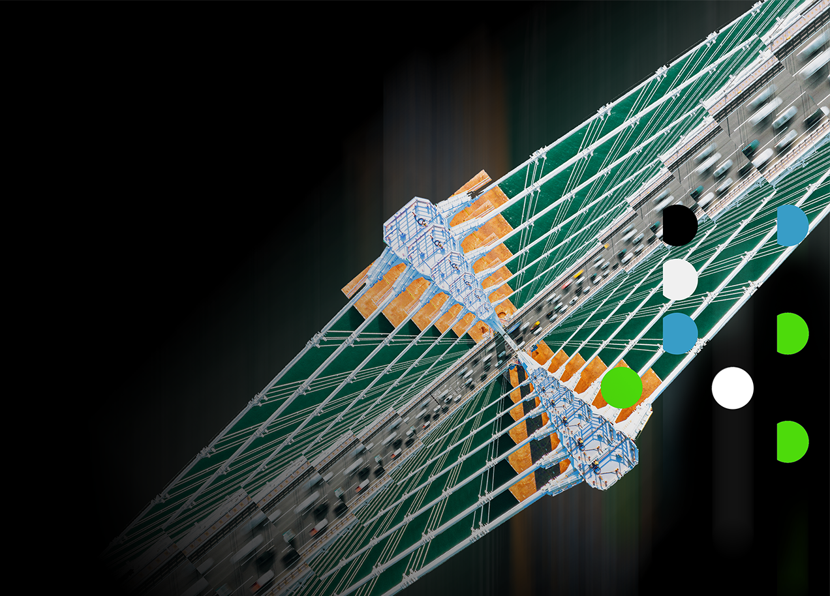

Tech Trends 2026
The AI infrastructure
reckoning
AI goes
physical
The agentic
reality check
The great
rebuild
The AI
dilemma
Navigating the AI and robotics convergence
Preparing for a
silicon-based workforce
Optimizing compute
in the age of inference
Architecting an
AI-native organization
Leveraging AI for
cyber defense

Slide 6
AI goes physical
Navigating the convergence of
AI and robotics
AI-enabled robots are scaling rapidly in smart manufacturing and logistics and are on track to transition from niche to mainstream adoption in the mid-term. The humanoid form factor will be the next frontier.

Slide 7





AI goes physical
Amazon deployed its millionth robot, and its DeepFleet AI coordinates the entire robot fleet, improving travel efficiency within warehouses by 10%
From prototype to production
Converging tech, falling costs, and proven use cases are spurring enterprise adoption
The physical AI inflection point
Exponential growth lies ahead as adoption expands beyond manufacturing into commercial settings
Humanoid robots and beyond
Next frontier spans enterprise to consumer, eventually redefining biological boundaries
10%

Slide 8
The agentic
reality check
Preparing for a silicon-based
workforce
Enterprises are moving beyond the hype to build agent-first architectures. Organizations that succeed will master orchestration frameworks and fundamentally reimagine processes to unlock autonomous AI capabilities.

Slide 9





The agentic reality check
Gartner predicts that over 40% of agentic AI projects will fail by 2027 because legacy systems can't support modern AI execution demands.
The agentic reality check
Agentic AI is a top priority, but many implementations fall short of expectations
The architecture of autonomous operations
Organizations are redesigning processes and systems to manage agents as a silicon workforce
Digital workforce of the future
Human-silicon synergies and strategic task allocation will define competitive advantage
40%
Notes:
Context: Agentic automation is rising rapidly. Organizations are making it a high priority and software vendors adding agentic functionality to all types of tools.
Source: Gartner, Inc., “Gartner predicts over 40% of agentic AI projects will be canceled by end of 2027.”

Slide 10
The AI infrastructure reckoning
Optimizing compute strategy in
the age of inference economics
Existing infrastructure strategies may be misaligned with AI's demands. Enterprises are architecting hybrid AI infrastructure ecosystems that leverage the right compute platform for each specific workload.

Slide 11




The AI infrastructure reckoning
While inference costs have plummeted, dropping 280-fold over the last two years,
enterprises are experiencing explosive growth in overall AI spending.
The inference economics wake up call
Skyrocketing AI costs are forcing enterprises to rethink their infrastructure strategies
The AI-optimized data center
Hybrid ecosystems combining cloud, on-prem, and edge enhance control over AI infrastructure and manage costs
The data center drives toward new frontiers
Emerging paradigms like optical, neuromorphic, and quantum computing may force continued transformation in the compute landscape
Notes:
Enterprises are facing a wake-up call in the economics of AI as rapid increases in AI usage—particularly from agentic AI workloads—outpace reductions in inference costs, resulting in soaring operational expenses.
Source: [1] Stanford Institute for Human-Centered AI, “The 2025 AI index report,” Stanford University, accessed Nov. 12, 2025. [2] Sarah Wang, Shangda Xu, Justin Kahl, and Tugce Erten, “How 100 enterprise CIOs are building and buying gen AI in 2025,” Andreessen Horowitz, June 10, 2025.

Slide 12
The great rebuild
Architecting an AI-native tech
organization
AI is reengineering how technology organizations are structured, governed, and led. While there's no single blueprint for the path forward, organizations are actively taking steps to prepare for our AI-powered future.

Slide 13




The great rebuild
The great rebuild
78% of tech leaders anticipate broad, targeted, or transformational integration of AI agents into architecture workflows over the next five years.
AI is reshaping the tech function
Data reveals AI is fundamentally rearchitecting tech organizations, from priorities and purpose to people
Strategies to prepare for an AI-powered future
Leaders prioritize modular design, human-machine collaboration, and bold ambitions over incremental change
The markers of an AI-powered tech organization
While every organization's AI journey is distinct, there are common characteristics that will define successful AI-driven tech orgs
78%
Notes:
Enterprises are facing a wake-up call in the economics of AI as rapid increases in AI usage—particularly from agentic AI workloads—outpace reductions in inference costs, resulting in soaring operational expenses.
Source: [1] Stanford Institute for Human-Centered AI, “The 2025 AI index report,” Stanford University, accessed Nov. 12, 2025. [2] Sarah Wang, Shangda Xu, Justin Kahl, and Tugce Erten, “How 100 enterprise CIOs are building and buying gen AI in 2025,” Andreessen Horowitz, June 10, 2025.

Slide 14
The AI dilemma
Securing and leveraging AI for
cyber defense
AI is reshaping enterprise cybersecurity, creating both advantages and vulnerabilities. Organizations must address immediate risks while deploying advanced defense strategies for the emerging threats that will define tomorrow's landscape.

Slide 15




The AI dilemma
The AI dilemma
Over the past year, decisions around AI have been focused on effectively integrating it into business workflows and, as AI usage scales across operations, enterprises are discovering that AI adoption creates a new set of security risks.
The enemy within
AI rollout creates new security challenges from internal use and external attacks
Fighting AI with AI
Next-gen safeguards and AI defense systems address multifaceted corporate and national security
AI cyber risks will progress, but so will solutions
Physical systems become attack vectors, impacting corporate and national security
Notes:
Enterprises are facing a wake-up call in the economics of AI as rapid increases in AI usage—particularly from agentic AI workloads—outpace reductions in inference costs, resulting in soaring operational expenses.
Source: [1] Stanford Institute for Human-Centered AI, “The 2025 AI index report,” Stanford University, accessed Nov. 12, 2025. [2] Sarah Wang, Shangda Xu, Justin Kahl, and Tugce Erten, “How 100 enterprise CIOs are building and buying gen AI in 2025,” Andreessen Horowitz, June 10, 2025.

Slide 16



ABOUT DELOITTE
Deloitte refers to one or more of Deloitte Touche Tohmatsu Limited, a UK private company limited by guarantee (“DTTL”), its network of member firms, and their related entities. DTTL and each of its member firms are legally separate and independent entities. DTTL (also referred to as “Deloitte Global”) does not provide services to clients. In the United States, Deloitte refers to one or more of the US member firms of DTTL, their related entities that operate using the “Deloitte” name in the United States and their respective affiliates. Certain services may not be available to attest clients under the rules and regulations of public accounting. Please see www.deloitte.com/about to learn more about our global network of member firms.
Copyright © 2026 Deloitte Development LLC. All rights reserved.

