Slide 1


BACKING
VISIONARY
ENTREPRENEURS

Slide 2



Slide 3






What’s holding back
EUROPEAN INNOVATION?
PERFORMANCE
FUNDING & INVESTMENT
ECOSYSTEM
Strong research performance not translated into innovation
Lack of breakthrough / disruptive innovations that create new markets
Financing gaps
2 “valleys of death”
In Transition from lab to enterprise
Scaling up for high-risk innovative start-ups
Many national & local ecosystems, but fragmented at European level
Need to include all regions and all talent (especially female)

Slide 4
US Venture Capital Investments
4-5 TIMES HIGHER THAN EU
Europe
North America
Asia
Rest of the World
Source: [Invest Europe, Pitchbook]

Slide 5


“You never run as fast as when you have other people to catch up and pass.”

Slide 6
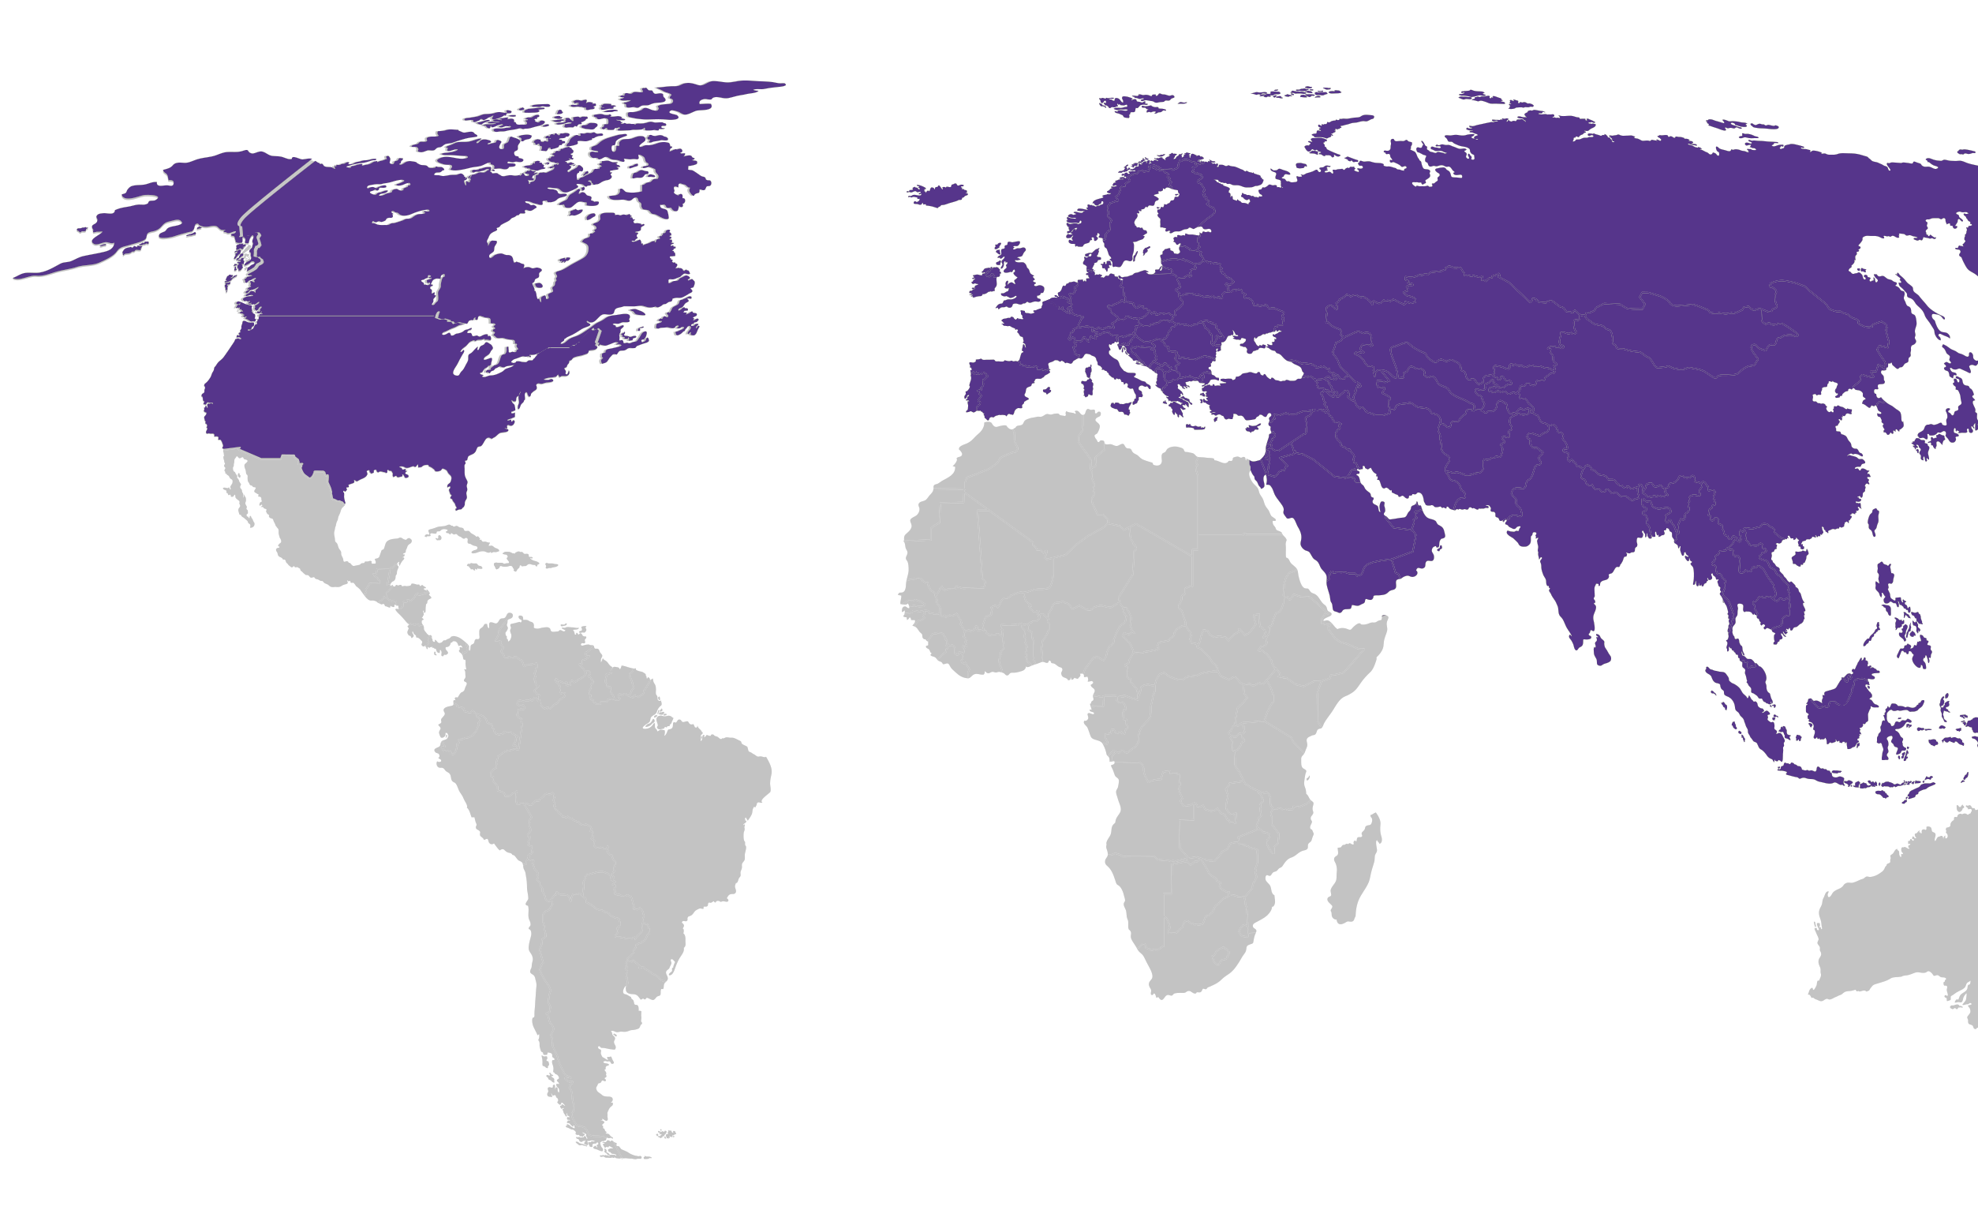


Who will lead the next
STRATEGIC INNOVATIONS?
Who will lead the next
STRATEGIC INNOVATIONS?
PAST
PRESENT
FUTURE
EU & US LEAD
US & ASIA LEAD
Next Leaders ?
Electricity, Car, Synthetic, Chemicals,Barcode, Telecoms, Airplane, Antibiotics, Sea Container, Semi-conductors, PC
GPS, Smart phone, Internet, Social media Artificial Intelligence, 3D Printing, Digital Platforms, The Cloud, Blockchain, Internet of Things
Advanced Semiconductors
Artificial Intelligence
Quantum
Biotechnologies
Advanced Connectivity, Navigation & Digital
Advanced Sensing
Space & propulsion
Energy
Robotics & Autonomous Systems
Advanced Materials, Manufacturing & Recycling

Slide 7

The Innovation Pillar of
HORIZON EUROPE
01.
European Innovation Council
€10.1
BILLION
Support to innovations with breakthrough and market creating potential.
02.
European Institute
of Innovation & Technology
€2.9
BILLION
Bringing key actors (research, education and business) together around a common goal for nurturing innovation
03.
European Innovation Ecosystems
€520
MILLION
Connecting with regional and national innovation actors

Slide 8

What makes EIC UNIQUE?
01. A European DARPA
02. EU Unicorn Factory
Focus on disruptive high risk breakthrough technologies
Innovator friendly: flexibility to apply at any time with a short pitch (video pitch, slide deck, 5-page form)
EIC “Programme Managers” to develop visions, proactively manage projects, steer portfolios (based on experience of DARPA, ARPA-E, BARDA, etc.)
Focus on high risk, disruptive startups
  & SMEs with scale up potential.
EIC Fund set to become largest early stage
VC investor in Europe, crowding in other investors.
Flexible follow up funding (“Transition”) to create
business opportunities out of research results.
03. An upgraded Innovation Community
EIC Community a box full of exciting business acceleration services and an extensive innovation ecosystem is waiting for EIC beneficiary
EIC Forum bringing together innovation ecosystem actors from across Europe
Horizon Europe “innovation ecosystems” program to support networking and joint initiatives between ecosystem actors
Partnerships with European Institute of Innovation & Technology (EIT), European Research Council (ERC) and others.

Slide 9



KEY IMPACTS IN SUPPORT OF DEEP TECH INNOVATION
2021-2025
completed investment
of support to
₇₀₀⁺ startups and
300
€6
rounds
in start-ups and SMEs
~600
research and
60⁺
tech transfer
projects
in 2024 alone
INVESTING IN STRATEGIC TECHNOLOGIES
€725 m
AI
development and applications
€500 m
advanced materials
€700 m
energy generation and storage solutions
€625 m
biotechnology and biomanufacturing
€850 m
quantum and semiconductors [ supporting the Chips Act ]

Slide 10





EMPOWERING WOMEN INNOVATORS
+
30⁺
women-led
female
women scientists and
companies
research project
entrepreneurs
supported in 2024
coordinators and
awarded under
(CEO/CTO/CSO)
participants in 2024
FROM START-UPS TO SCALE-UPS
6
75%
targeting emerging markets
valued above
€500 m
+
100⁺
70⁺
1 350
companies achieved
unique innovations
start-ups
established to commercialise EIC-funded innovations
‘centaur’ valuations
[ €100 m +]
from EIC Pathfinder
and Transition projects

Slide 11

EXTENDED EIC PORTFOLIO*
Companies growth
+
Strengthening Europe’s
innovation ecosystem
50%
+
employment growth
bn
of investment into EIC portfolio companies
mainly from venture capital
billion
55%
€
revenue growth
within 2 years of EIC support
of equity investments involve
non-domestic investors
with a strong presence of
cross-border investments
UNLOCKING OPPORTUNITIES
VCs,
EIC
companies and projects
matched with corporates, procurers, and investors
€4
₊ corporates
and strategic
investors
1 000⁺
bn
in co-investment
Leverage of €3 of additional investment for every euro of EIC equity investment
25
Including Europe’s
25 Largest VCs
230
signed deals
*This includes projects and companies from the pilot phase and Horizon 2020

Slide 12
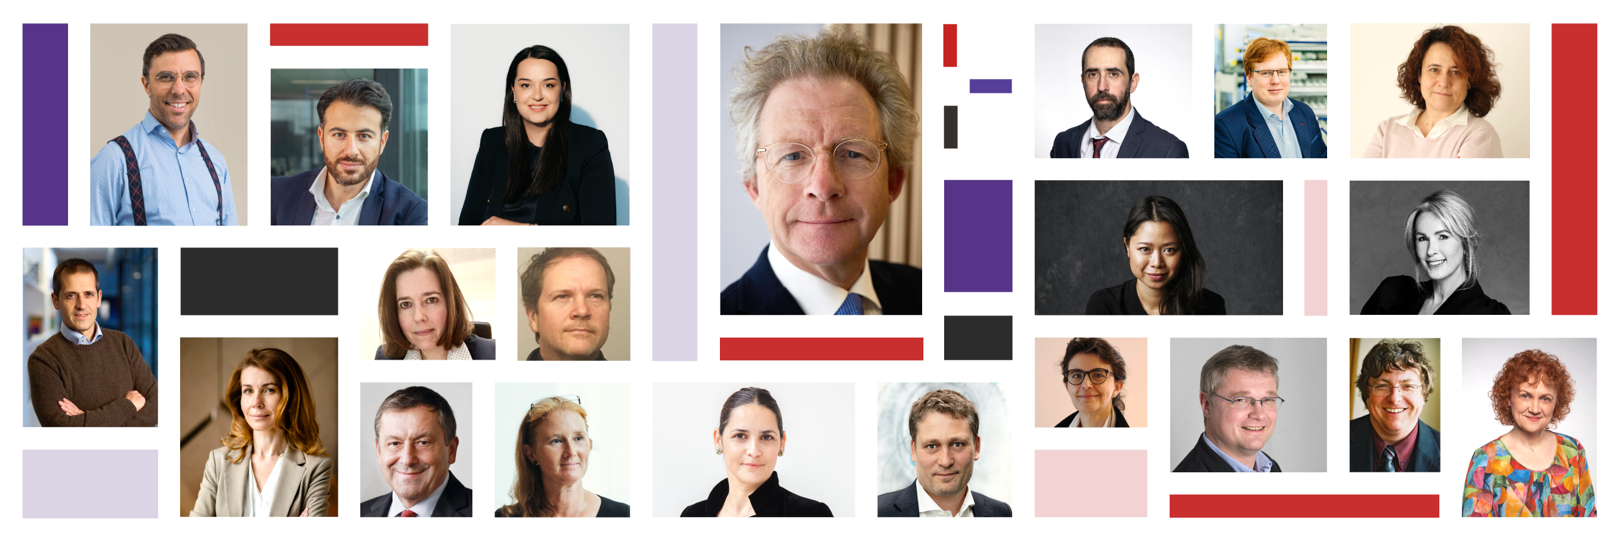
EIC
ROLE TO ADVISE:
EIC strategy
DIVERSE EXPERTISE:
Entrepreneurs, investors, researchers, innovation ecosystem
Gender balance (parity), geographic balance (17 nationalities)
Board
12

Slide 13

EIC Proactive Management
Strategic assessment and clustering of projects
Building of portfolios based on strategic intelligence
Portfolio management (scientific and business advice)
IP management advice (in collaboration with the technology transfer offices)
13

Slide 14






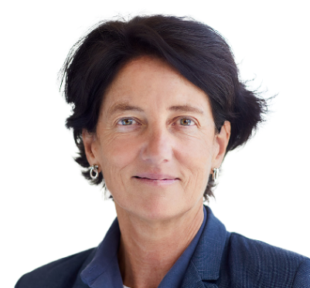



Orsolya Symmons
Federica Zanca
Health and Biotechnology
Medical imaging and AI in healthcare
Hedi Karray
Ivan Stefanic
Artificial Intelligence
Food chain technologies, novel & sustainable food
Stella Tkatchova
Isabel Obieta
EIC
PROGRAMME
MANAGERS
Space systems & technologies
Responsible electronics
Samira Nik
Carina Faber
Quantum tech & electronics
Renewable energy conversion & alternative resource exploitation
Franc Mouwen
Paolo Bondavalli
Architecture engineering
construction technologies​​
Advanced materials for energy

Slide 15

EIC
GOVERNANCE
EIC Board & President
To advice on strategy & implementation
European Commission
To define strategy, adopt the Work Programme & appoint the EIC board
EISMEA
Implementation of EIC, hosting EIC Programme Managers
EIB & AIFM
To manage EIC Fund equity investments

Slide 16





















EIC BUSINESS
ACCELERATION SERVICES
EIC PRIZES
Women innovators
Capital of innovation
Mentors, coaches
Global partners
Innovation ecosystems
EIC Community Platform
SEAL OF EXCELLENCE
Fast track to other funding
EIC STEP
Strategic Technologies
for Europe Platform
Co-investments up to €30 million
Digital, deep tech, biotech, clean tech
EIC ACCELERATOR
For single companies
Grants up to €2.5 million
Equity up to €10 million
To enter the market & scale-up (TRL 6-9)
EIC TRANSITION
EIC PRE-ACCELERATOR
For consortia & single companies
Grants up to €2.5 million
To develop business cases
(TRL 4-6)
For companies from widening countries
Grants between €300k - €500k
To boost deep-tech startup readiness
EIC PROGRAMME MANAGERS
EIC PATHFINDER
In-house leading experts
Identifying potential challenges in
emerging deep tech areas
Pro-actively managing EIC Pathfinder,
Transition and Accelerator portfolios
For consortia
Grants up to €4 million
To research technology breakthroughs (TRL 1-4)

Slide 17



EIC
WHO CAN APPLY & WHAT FOR?
PATHFINDER
Consortia of at least 3 different independent legal entities established in at least 3 different eligible countries. Additionally, single applicants or small consortia (2 partners) for EIC Pathfinder Challenges only.
Grants of up to €3 million (open) or €4 million (challenges), or more if duly justified, to achieve the proof of principle and validate the scientific basis of breakthrough technology (Technology Readiness Levels 1-4)

Slide 18


TRANSITION
Single applicants (SMEs, spin-offs,
start-ups, research organisations, universities) or small consortia
(2 partners) or consortia of 3 to 5 different independent legal entities established in at least 3 different eligible countries. Proposals must build on eligible EU-funded project results.
Grants of up to €2.5 million to validate and demonstrate technology in application-relevant environment (Technology Readiness Levels 4 to 5/6) and develop market readiness.

Slide 19





EIC ACCELERATOR
Grants for up to €2.5 million for developing your innovation (TRL 6 to 8).
Investments of €0.5 up to €10 million in the form of direct equity or convertible loans for scaling up your innovation and attracting co-investors.
Single start-ups and SMEs (including spin-outs), individuals (intending to launch a start-up/SME) and in exceptional cases small mid-caps (fewer than 499 employees)

Slide 20


Co-investments from €10 to €30 million to catalyse major funding rounds
EIC STEP
EIC Strategic Technologies for Europe Platform
For scale up companies (SMEs and small mid-caps) with game-changing innovations in Europe's critical technology areas.

Slide 21



EIC
ACCELERATOR
SELECTION PROCESS
Step 3
PITCH
Step 2
Successful Step 2 applicants will pitch their innovation in front of EIC Jury Members. If selected, applicants will be awarded funding.
If not selected, applicants will be awarded a Seal of Excellence to help you secure funding from other sources as well as get support from EIC Business Acceleration Services.
SUBMISSION
Step 1
Successful step 1 applicants submit their full proposal to regular cut-off deadlines, to be assessed by remote evaluators.
To help you draft your full proposal, you will be entitled to receive 3 days of remote coaching from the EIC Business Acceleration Services.
IDEA PRESENTATION
Applicants have a disruptive / deep tech idea with a potential to scale up. Submissions of short proposals are possible at any time. Evaluation by remote evaluators within 4 weeks.

Slide 22




EIC OPEN & CHALLENGES OVERVIEW 2025
EIC PATHFINDER
EIC TRANSITION
EIC ACCELERATOR
EIC STEP
OPEN
DEADLINES
21 May 2025
17 September 2025
Short Applications: continuous
Full Applications: 12 March 2025; 1 October 2025
Submit application anytime
INDICATIVE BUDGET
€ 142 MILLION
€ 98 MILLION
€ 384 MILLION
€ 300 MILLION
CHALLENGES
DEADLINES/CUT-OFFS
29 October 2025
Short Applications: continuous
Full Applications: 12 March 2025; 1 October 2025
INDICATIVE BUDGET
€ 120 MILLION
€ 250 MILLION
CHALLENGES
Biotech for climate resilient crops and plant-based biomanufacturing
Generative-AI based agents to revolutionise medical diagnosis and treatment of cancer
Towards autonomous robot collectives delivering collaborative tasks in dynamic unstructured construction environments
Waste-to-value devices: circular production of renewable fuels, chemicals and materials
Acceleration of advanced materials development and upscaling along the value chain
Biotechnology driven low emission food and feed production systems
Creating European Champions in Generative AI
Innovative in-space servicing, operations, robotics and technologies for resilient EU space infrastructure
Breakthrough innovations for future mobility

Slide 23


Thank You
FOR MORE INFORMATION,
CONTACT US:
eic.ec.europa.eu
@EUeic #Eueic

