Slide 1

Story to Habit
What would the jedi do?
Michal Paprocki
Chief Information Officer, Euroclear
Notes:
OPEN (≈1 min). Let the title sit for a beat.
"Every strategy starts as a story — a picture of a future we say we want. But a story on a slide changes nothing. It only becomes real when it becomes habit: the small, repeated things we do every single day. Tonight I want to show you the six habits — I call them my Jedi tricks — that turn our strategy into how we actually lead at Euroclear."
DELIVERY: this is the CIO's talk, first person, his journey. Warmth over polish.

Slide 2

Who am I?
What is Euroclear?
I am business by training and technology by profession.
My intrinsic motivation is to connect likeminded people and make the impossible happen.
Currently I run technology at Euroclear: thousands of people, and the systems the financial world quietly leans on.
The infrastructure of global financial markets.
Every day we settle trillions in securities safely, quietly, without anyone noticing.
That means moving GDP of Belgium twice … daily.
We connect the markets to ensure savings flow into investments and generate sustainable growth.
This is the beginning of the story. Now the question is: how can a story turn strategy into reality?
I know a few jedi habits…
Notes:
WHO I AM / EUROCLEAR (≈1.5 min). Keep it tight — this room knows finance.
- Left: say who you are in one honest line, then the human bit. [CIO INPUT: your origin — where you started, the moment or person that shaped how you lead. This earns the room's attention.]
- Right: don't explain Euroclear technically. The "when we do our job right, nothing happens" line lands with a systemic-risk audience — use it.
TRANSITION: "That's the story. Now — how do you make a story real? Six habits. My Jedi tricks."

Slide 3

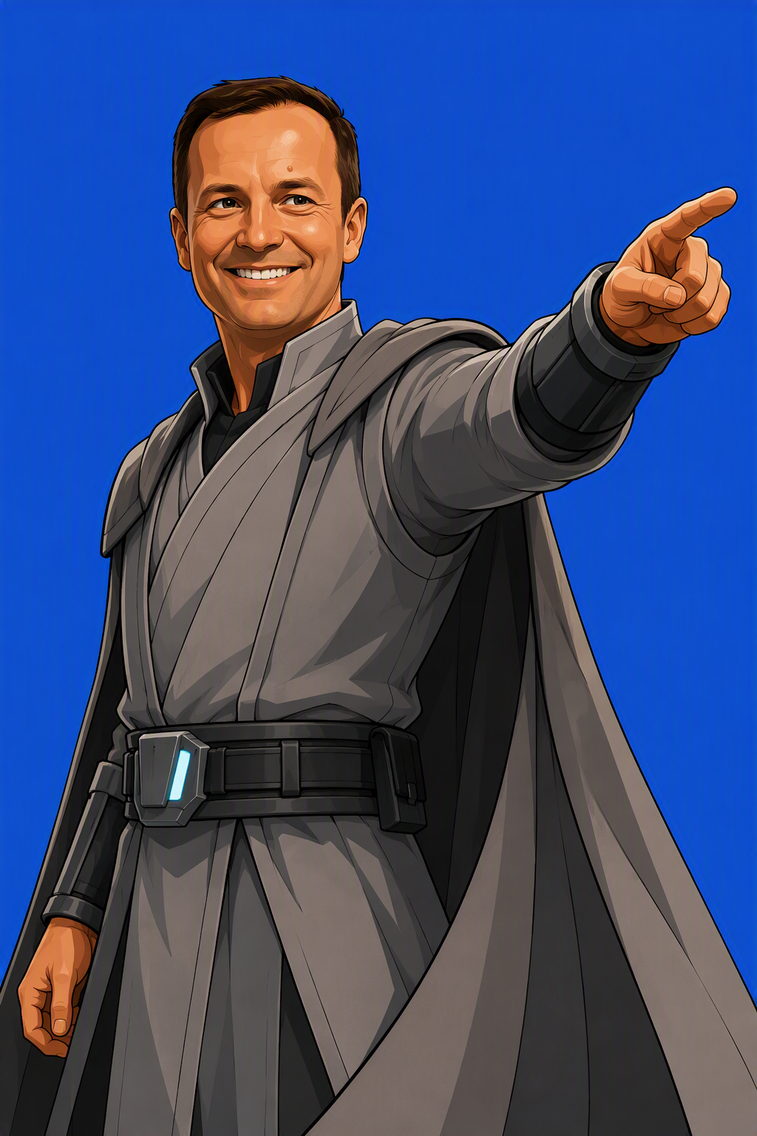
Dot on the horizon
Define an end-state so vivid people can see it.
Then say it again, and again…
Notes:
TRICK 1 — DOT ON THE HORIZON (vision / the "story").
BEAT: "People don't align to a plan. They align to a picture. So my first job is to paint an inspiring end-state — a clear, engaging definition of 'awesome' — so vivid that everyone can see where we're going."
KEY: repetition + a shared vocabulary. Say it the same way every townhall until the words become the team's words.
EUROCLEAR: [name the actual horizon phrase you repeat — the one people quote back to you.]
TRANSITION → "A dot is where we're going. Next: staying on it."

Slide 4


Eye on the ball
At any moment, everyone knows what the big priorities are
Notes:
TRICK 2 — EYE ON THE BALL (focus / execution).
BEAT: "A horizon is useless if we lose the ball at our feet. At any moment, my team can tell you the handful of things that matter most — no more."
EUROCLEAR: shared OneNote of live priorities + regular cadence with all directs. Everyone sees the same short list.
POINT: focus is a discipline, not a memo — it has to be visible and repeated.
TRANSITION → "Focus needs trust. And trust starts with how we talk."

Slide 5

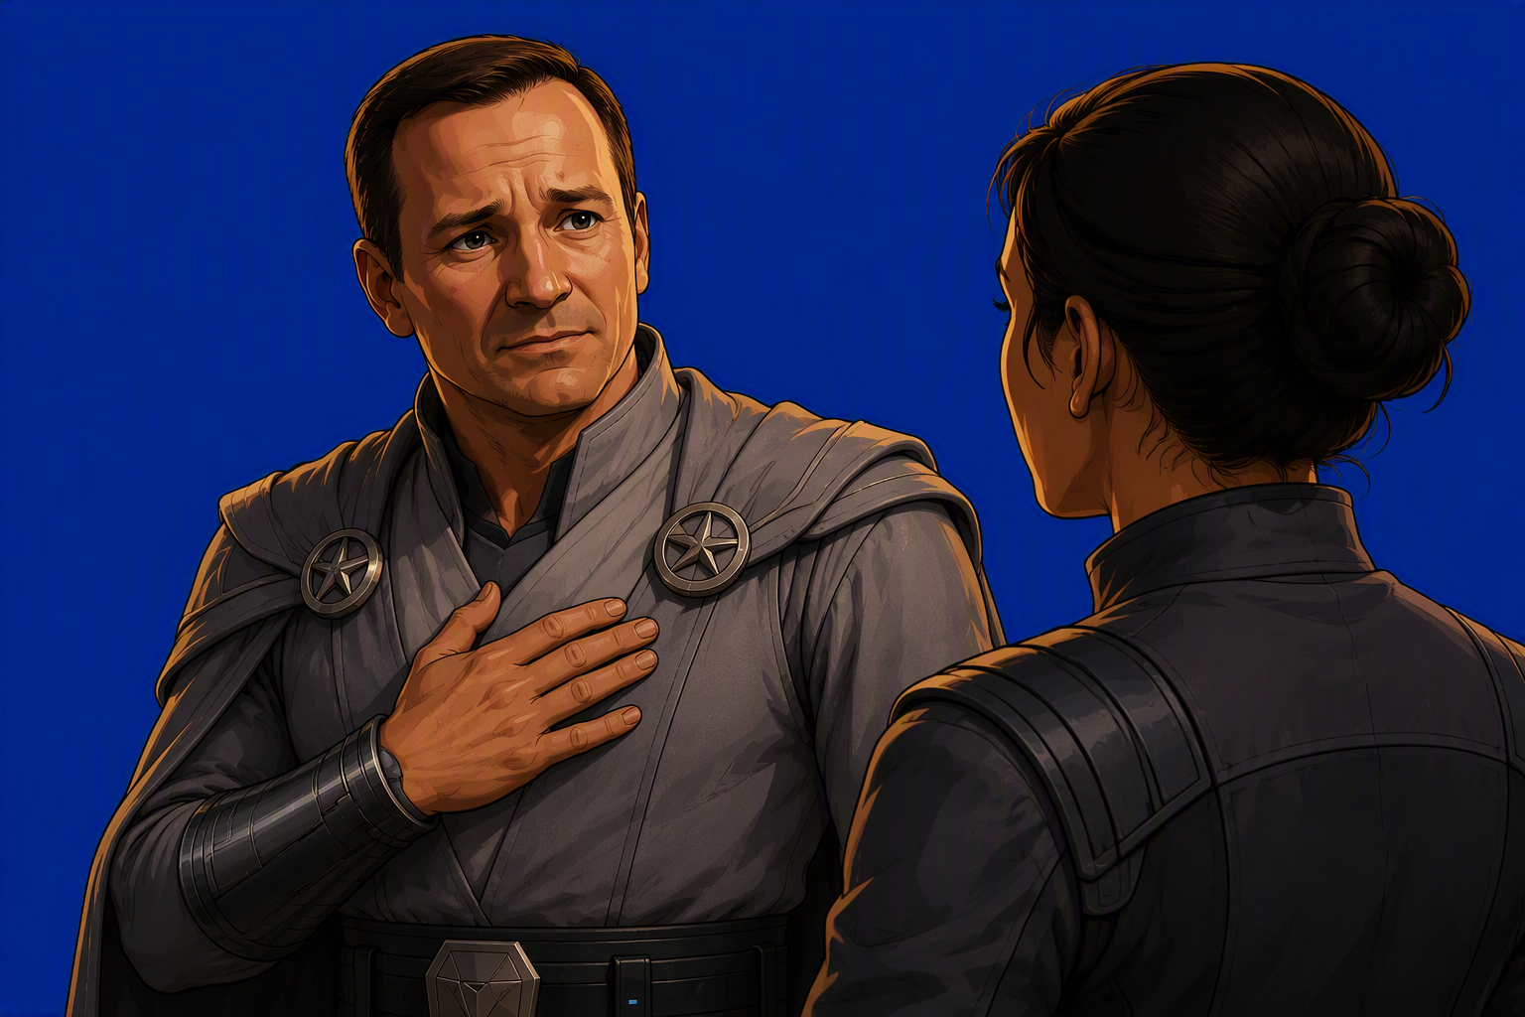
Talk straight
Be simple, clear, and honest. Sometimes leadership is saying "I got this one wrong."
Notes:
TRICK 3 — TALK STRAIGHT (trust / vulnerability). *** THE PEAK OF THE TALK. ***
BEAT: "Simplicity, clarity — and vulnerability. When I own a mistake out loud, I take fear out of the room. People stop hiding problems, and problems surface early enough to fix."
*** CIO INPUT REQUIRED: ONE real, specific decision you got wrong — what you chose, what it cost, and exactly what you told the team. Do NOT use a generic 'I make mistakes too'. The specific scar is what earns the whole trust argument. This is the moment the room remembers. ***
TRANSITION → "Owning it is one thing. Understanding it is another."

Slide 6

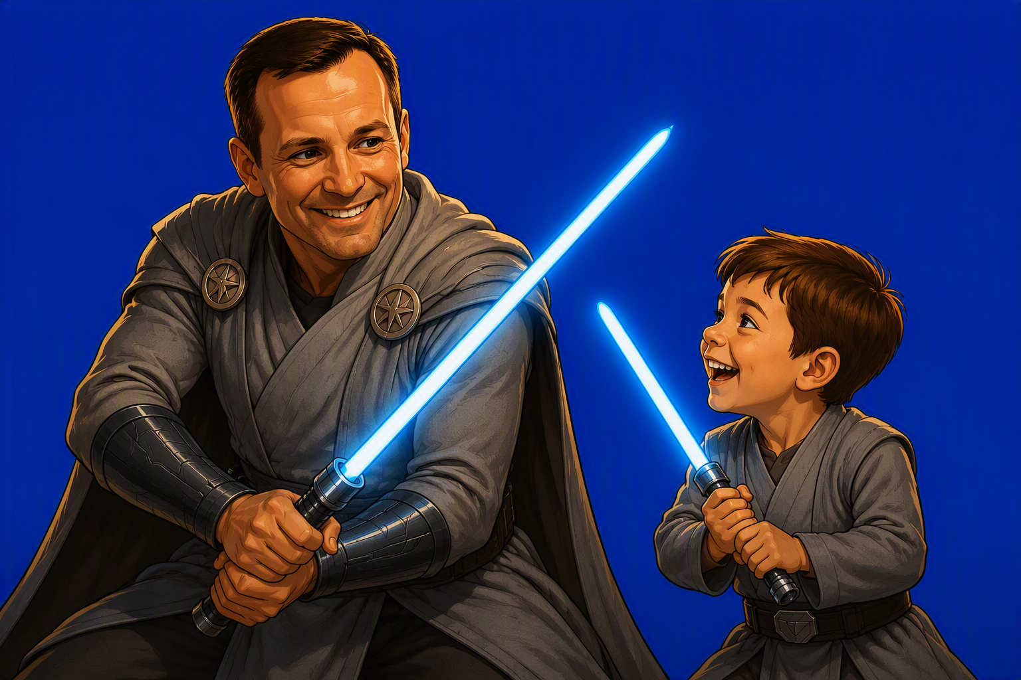
Stay humble
When it’s not going your way, start thinking like a curious child: why is this happening? What is a different way?
Notes:
TRICK 4 — EAGER TO UNDERSTAND (curiosity / "child surprise").
BEAT: "When things aren't going my way, my instinct isn't frustration — it's a child's surprise. Why? Maybe I'm wrong. Maybe someone sees something I don't. Maybe there's a conflict no one has named. I spend my energy up front on the 'why'."
EUROCLEAR: regular informal chats with peers instead of defaulting to meetings and emails — you learn the real story faster.
TRANSITION → "Curiosity inside the team is good. But don't stop at the walls."

Slide 7

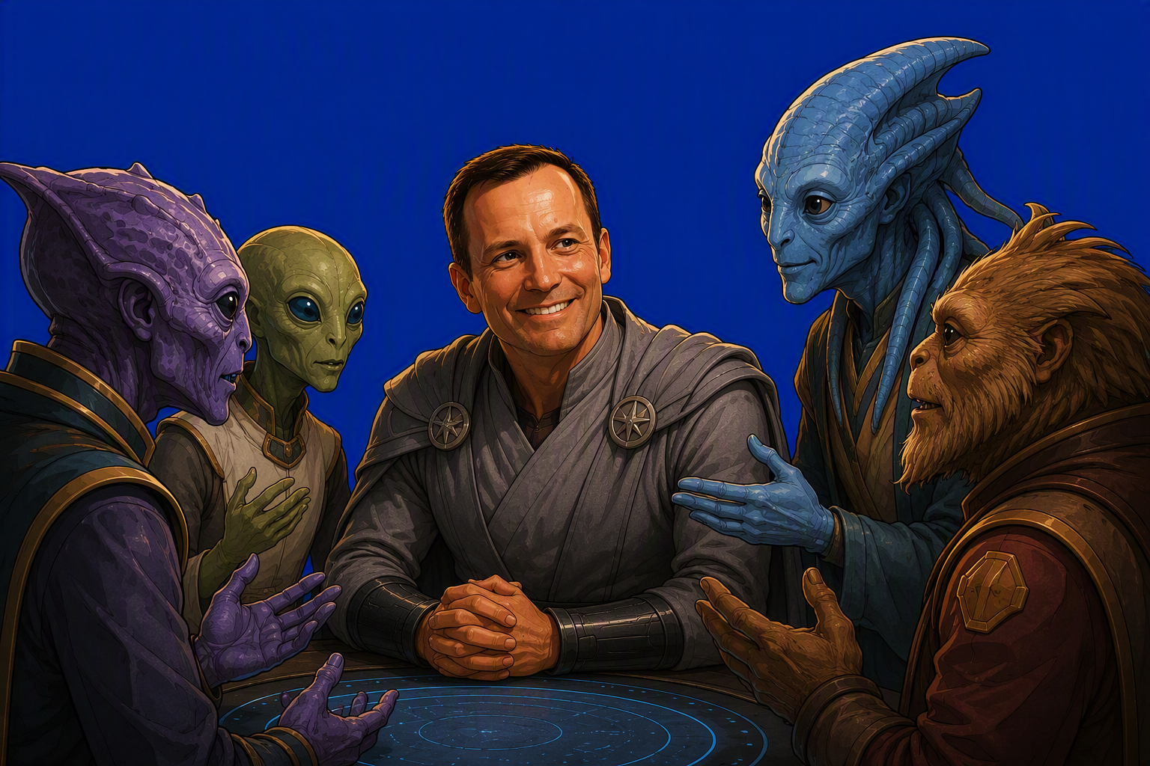
Seek outside
Assume you’re not unique. Someone has solved this already: go and copy it even from another galaxy.
Notes:
TRICK 5 — SEEK OUTSIDE (network / avoid tunnel vision).
BEAT: "The most dangerous assumption in leadership is 'our problem is unique'. It almost never is. Somebody, somewhere, has faced the same thing. So I network relentlessly, and I connect ideas from completely different fields to spot the patterns."
EUROCLEAR: active in CIO NET; deliberately borrowing from other industries to break tunnel vision.
TRANSITION → "And finally — the habit that keeps all the others honest."

Slide 8


Step back
Have a habit to reflect regularly on what works and what doesn’t
Then reinvent yourself
Notes:
TRICK 6 — STEP BACK (renewal / agility).
BEAT: "Twice a year I deliberately stop. What's working? What isn't? Where is my time actually going — and why am I busy, or frustrated? Then I decide what to change. It's a small superpower: the ability to reinvent yourself before you're forced to."
EUROCLEAR: after summer holidays, and after the New Year break — two honest resets a year.
TRANSITION → "Six habits. Now let me tell you why they matter."

Slide 9
From story to habit…
These are my Jedi habits
practised every day
A story you repeat becomes a habit. Habits shape how we lead
Then the strategy comes true.
Notes:
TRICK 6 — STEP BACK (renewal / agility).
BEAT: "Twice a year I deliberately stop. What's working? What isn't? Where is my time actually going — and why am I busy, or frustrated? Then I decide what to change. It's a small superpower: the ability to reinvent yourself before you're forced to."
EUROCLEAR: after summer holidays, and after the New Year break — two honest resets a year.
TRANSITION → "Six habits. Now let me tell you why they matter."

Slide 10
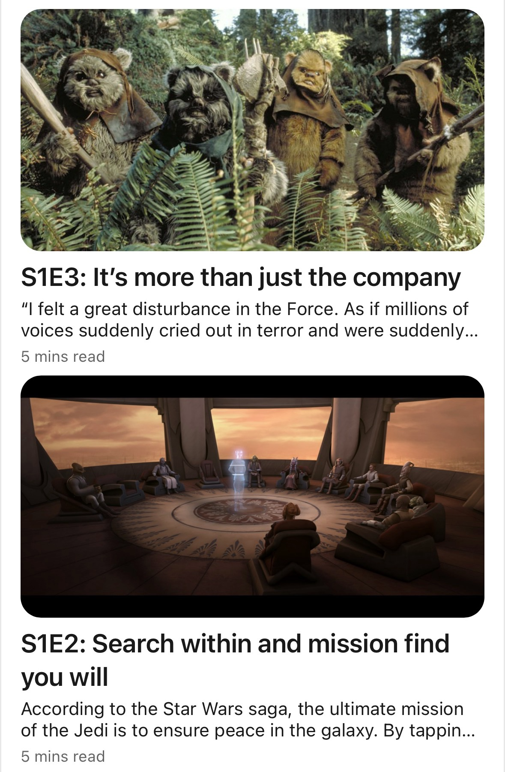
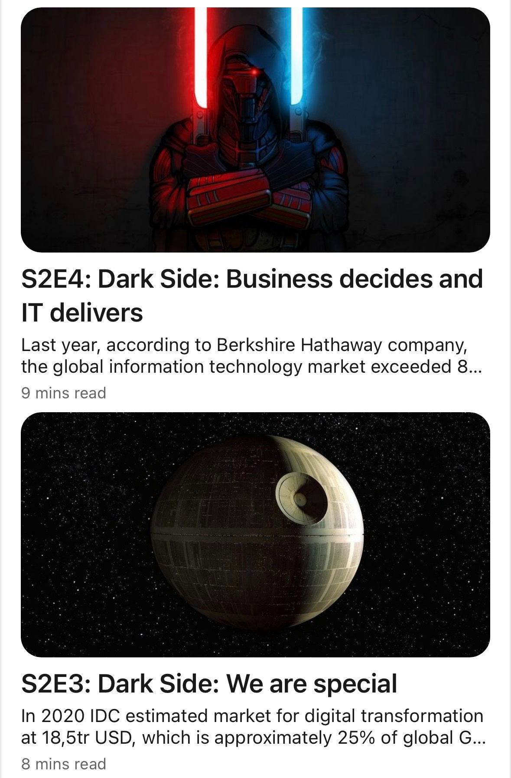
From story to habit…
Thank you
You can find more jedi leadership stories on my LinkedIn profile
https://www.linkedin.com/in/paprocki
Notes:
CLOSE (≈1 min). Slow down. This is the payoff — the "habit" half of the theme.
"None of these are Force powers. They're habits — small things I practise every day. And that's the whole point of tonight's theme: a story you repeat becomes a habit; a habit becomes how we lead; and that is how a strategy stops being a slide and becomes real."
[CIO INPUT: end on ONE line that is genuinely your credo — the sentence you'd want people to quote back. Keep it short.]
Final line optional — a light wink to land the theme, then thank the room.

