Slide 1


JOIN THE CLUB!
Shaping a positive
impact culture
CHRO SD Worx

Slide 2
BUILDING AN IMPACT CULTURE IS LIKE CLIMBING MONT BLANC.
1. YOU NEVER CLIMB ALONE.
2. THE PATH IS NEVER LINEAR.
3. EVERY 1% OF ALTITUDE MATTERS.
© 2026 Join the Club by Bruce Fecheyr-Lippens & Kobe Verdonck. Powered by SD Worx.
2

Slide 3










SIX INGREDIENTS TO AN IMPACT CULTURE
?
CRITICAL FRIENDS
The truth-tellers who care
TRUST GIVERS
Start with trust, not suspicion
THE AIRPORT MODEL
Freedom within a frame
UNLEASHED POTENTIAL
Make people owners of their growth
TOP TEAMS
Culture change starts at the top
© 2026 Join the Club by Bruce Fecheyr-Lippens & Kobe Verdonck. Powered by SD Worx.
3

Slide 4

CULTURE CHANGE STARTS AT THE TOP, OR IT DOESN'T START AT ALL.
Leadership is a mindset, not a title.
We assessed 200+ leaders and spent days with each team.
Team above individuals — speaking the same language.
© 2026 Join the Club by Bruce Fecheyr-Lippens & Kobe Verdonck. Powered by SD Worx.
4

Slide 5
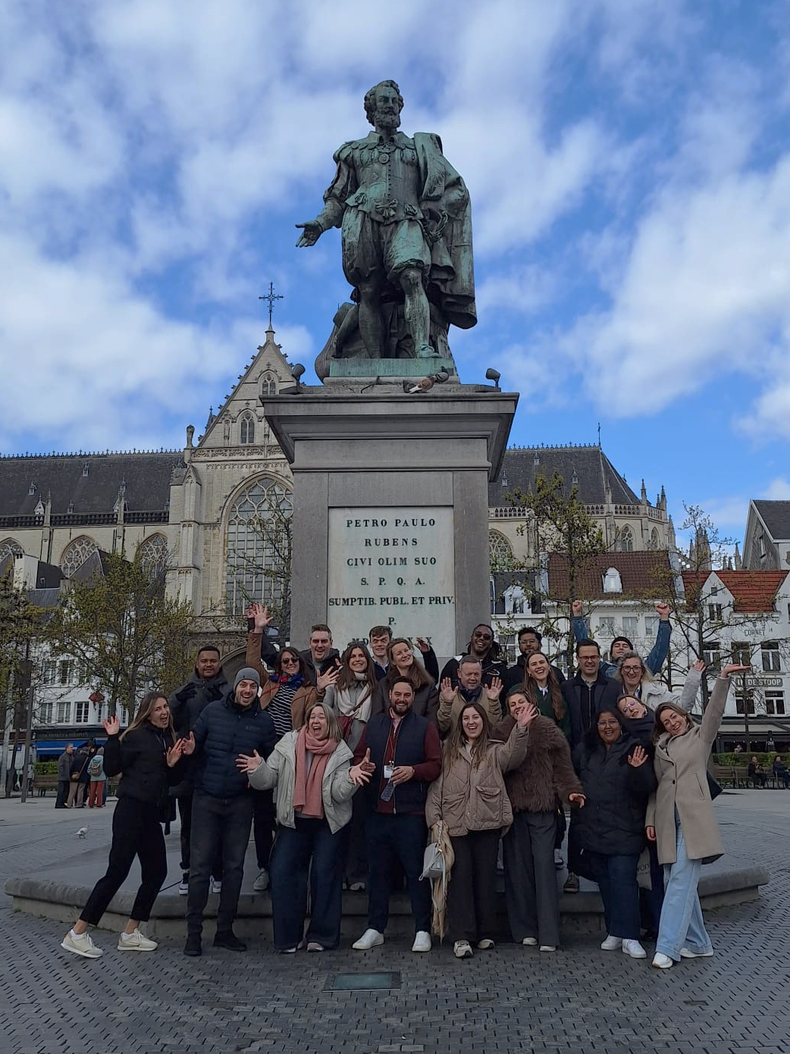
MAKE YOUR PEOPLE OWNERS, AND WATCH WHAT HAPPENS.
MY MOVE
TRIBES
Employees as masters of their own career path.
Agile structure replacing traditional HR hierarchy.
80/20 ROLES
SPARK JOYNERS
Broaden scope, break silos, and encourage exploration.
Communities of purpose driving engagement.
1% BETTER EVERY DAY
Compounding human growth through continuous, incremental improvement.
© 2026 Join the Club by Bruce Fecheyr-Lippens & Kobe Verdonck. Powered by SD Worx.
5

Slide 6
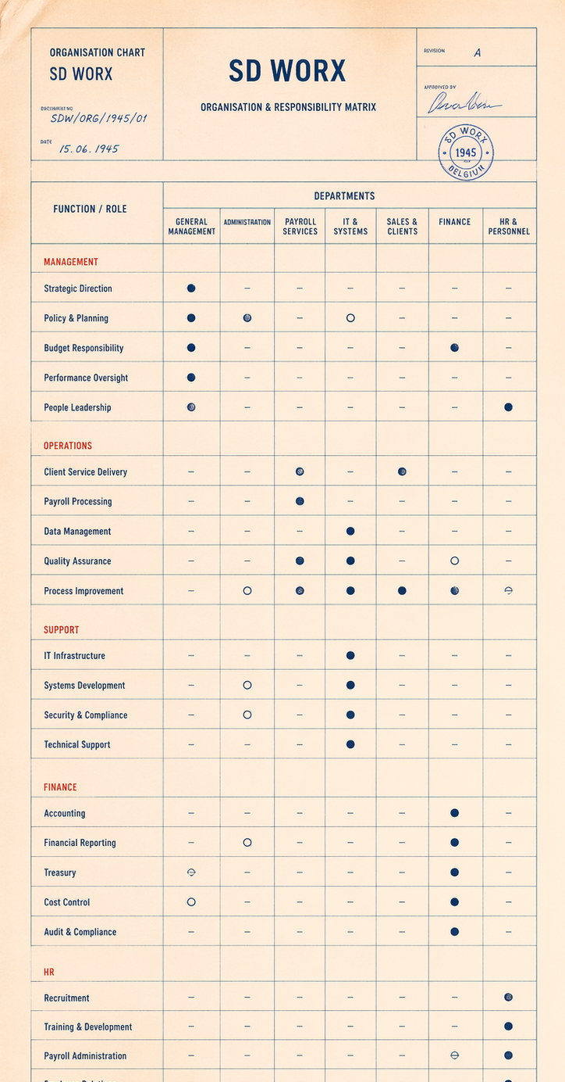



FREEDOM WITHIN A FRAME, THE END OF DECISION PARALYSIS.
THE MATRIX
Two bosses. You don't own it. You don't decide.
THE AGILE TRAP
Self-steering teams.
Nobody owns it. Chaos.
THE RESULT
Decision Paralysis.
6

Slide 7



The Airport Model
It’s time for a model that works.
THE PILOT
CONTROL TOWER
GROUND OPS
Managing Director has full accountability for their flight.
Executive Committee provides oversight and alignment.
Support functions enable the whole system.
© 2026 Join the Club by Bruce Fecheyr-Lippens & Kobe Verdonck. Powered by SD Worx.
7

Slide 8
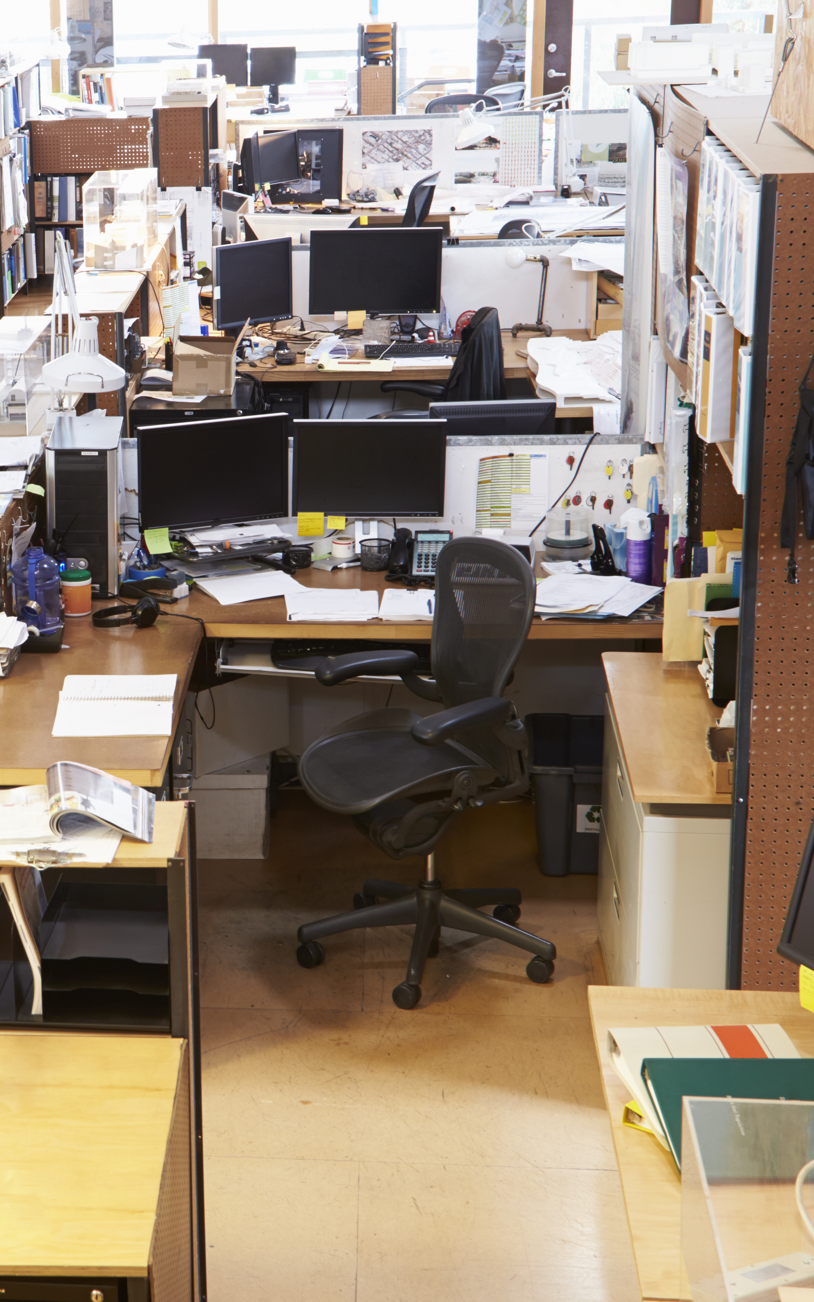
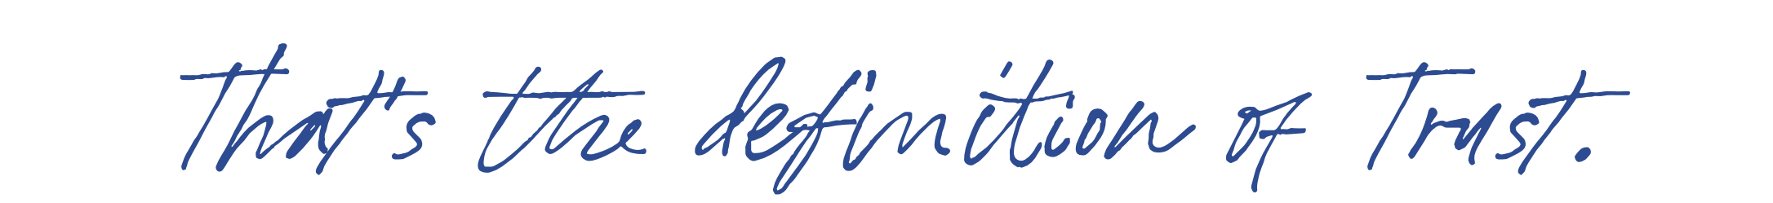
YOU WAKE UP. YOU STEP OUTSIDE. YOU FEEL FRESH AIR. YOU FEEL ENERGIZED.
Do you feel that same fresh air when you walk into your company?
Or is the air polluted, draining your energy?
8

Slide 9


THE TRUST BATTERY: THE INVISIBLE GLUE
TRUST BUILDERS
TRUST GIVERS
You must prove yourself first.
Trust is earned slowly, over months.
One mistake, and the battery drains.
You start with full trust.
“Go for it. I trust you.”
Trust is given, then maintained.
RESULT
RESULT
Slow. Fear. Micromanagement.
Fast. Ownership. Autonomy.
© 2026 Join the Club by Bruce Fecheyr-Lippens & Kobe Verdonck. Powered by SD Worx.
9

Slide 10

FRIENDLY CAMARADERIE IS COMFORTABLE. IT JUST DOESN'T DRIVE GROWTH.
© 2026 Join the Club by Bruce Fecheyr-Lippens & Kobe Verdonck. Powered by SD Worx.
10

Slide 11

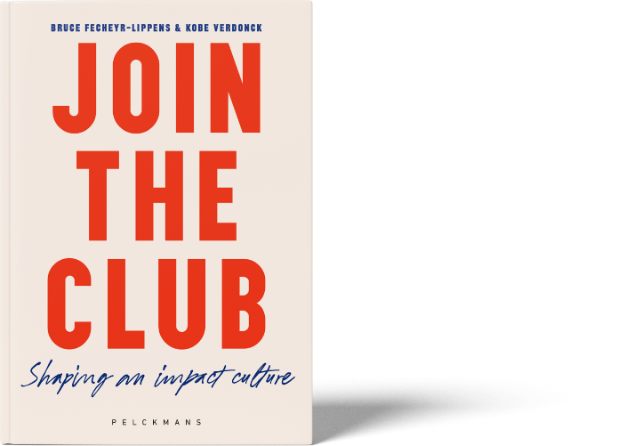
THE CRITICAL FRIEND FRAMEWORK
CRITICAL
THE HARSH ONE
THE CRITICAL FRIEND
“Terrible report, did you even try?”
Your presentation was engaging, but the structure could be better.”
STRANGER
FRIEND
THE INDIFFERENT ONE
THE PERMISSIVE FRIEND
“I don’t care.”
Great job!
(But you don’t mention the deadline missed.)
INDIFFERENT
© 2026 Join the Club by Bruce Fecheyr-Lippens & Kobe Verdonck. Powered by SD Worx.
11

Slide 12

BEFORE YOU CAN BUILD AN IMPACT CULTURE, YOU HAVE TO LOOK IN THE MIRROR.
© 2026 Join the Club by Bruce Fecheyr-Lippens & Kobe Verdonck. Powered by SD Worx.
12

Slide 13
THE MOST IMPORTANT THING IS MISSING
© 2026 Join the Club by Bruce Fecheyr-Lippens & Kobe Verdonck. Powered by SD Worx.
13

Slide 14
YOU IN ACTION
The shift starts with you
© 2026 Join the Club by Bruce Fecheyr-Lippens & Kobe Verdonck. Powered by SD Worx.
14

Slide 15
WHAT HOLDS YOU BACK?
© 2026 Join the Club by Bruce Fecheyr-Lippens & Kobe Verdonck. Powered by SD Worx.
15

Slide 16



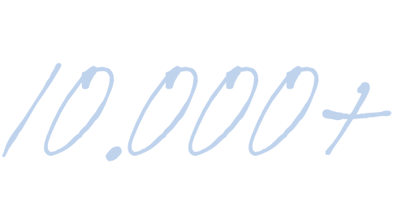
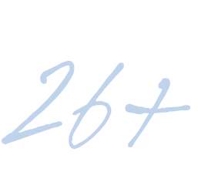


THIS IS NOT A THEORY. THIS IS WHAT HAPPENED.
WORLD-LEADING WOMEN’S CYCLING TEAM
EMPLOYEE ENGAGEMENT MEASURABLY UP
COLLEAGUES
EUROPEAN MARKETS
MULTIPLE ACQUISITIONS INTEGRATED WITHOUT LOSING CULTURE
PAN-EUROPEAN HR LEADER
© 2026 Join the Club by Bruce Fecheyr-Lippens & Kobe Verdonck. Powered by SD Worx.
16

Slide 17
SIX INGREDIENTS TO AN IMPACT CULTURE
YOU IN ACTION
The shift starts with you
CRITICAL FRIENDS
The truth-tellers who care
TRUST GIVERS
Start with trust, not suspicion
THE AIRPORT MODEL
Freedom within a frame
UNLEASHED POTENTIAL
Make people owners of their growth
TOP TEAMS
Culture change starts at the top
© 2026 Join the Club by Bruce Fecheyr-Lippens & Kobe Verdonck. Powered by SD Worx.
17

Slide 18
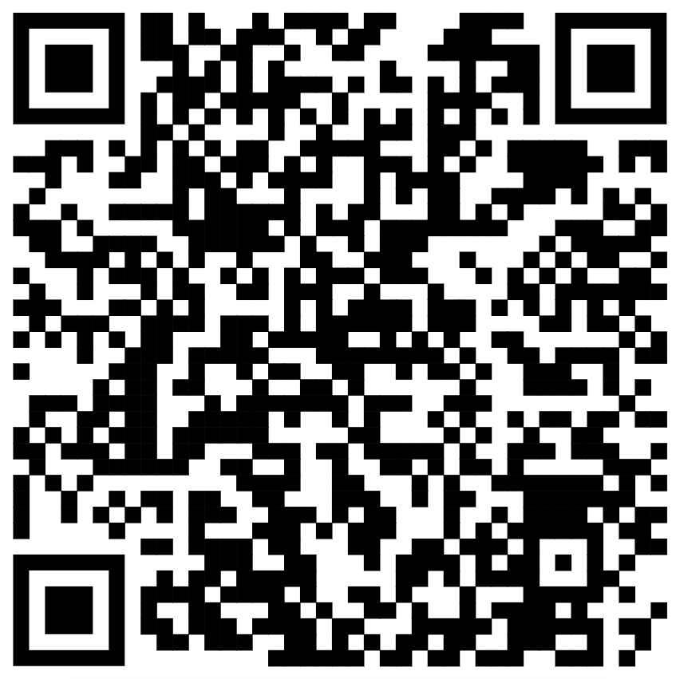
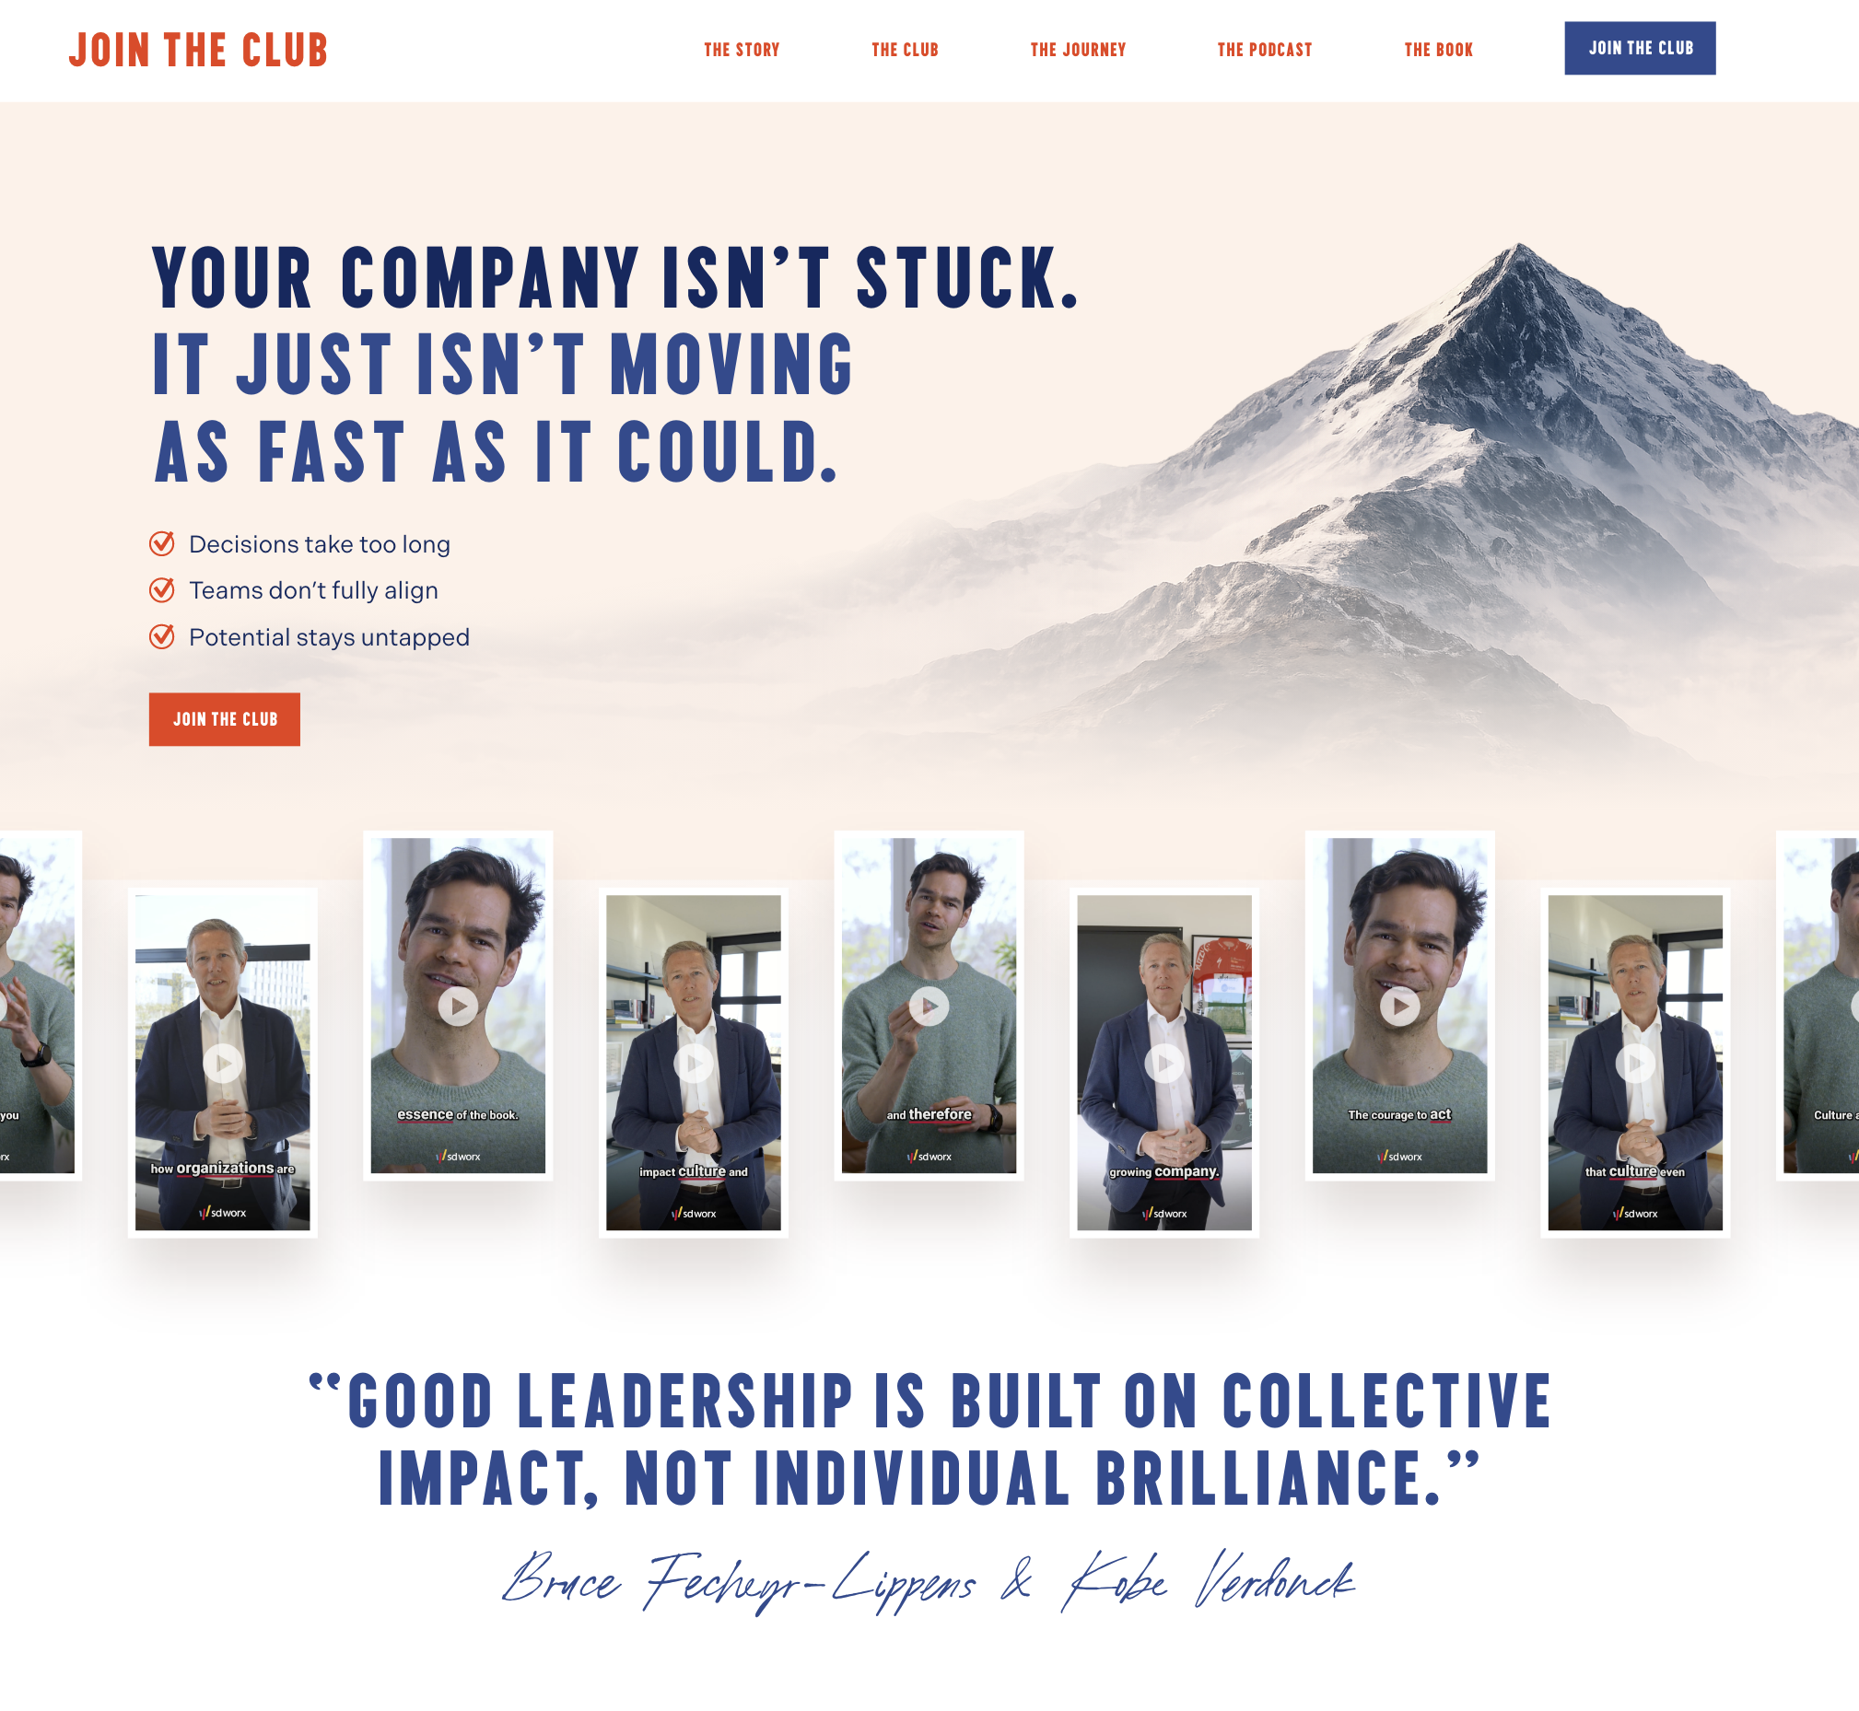

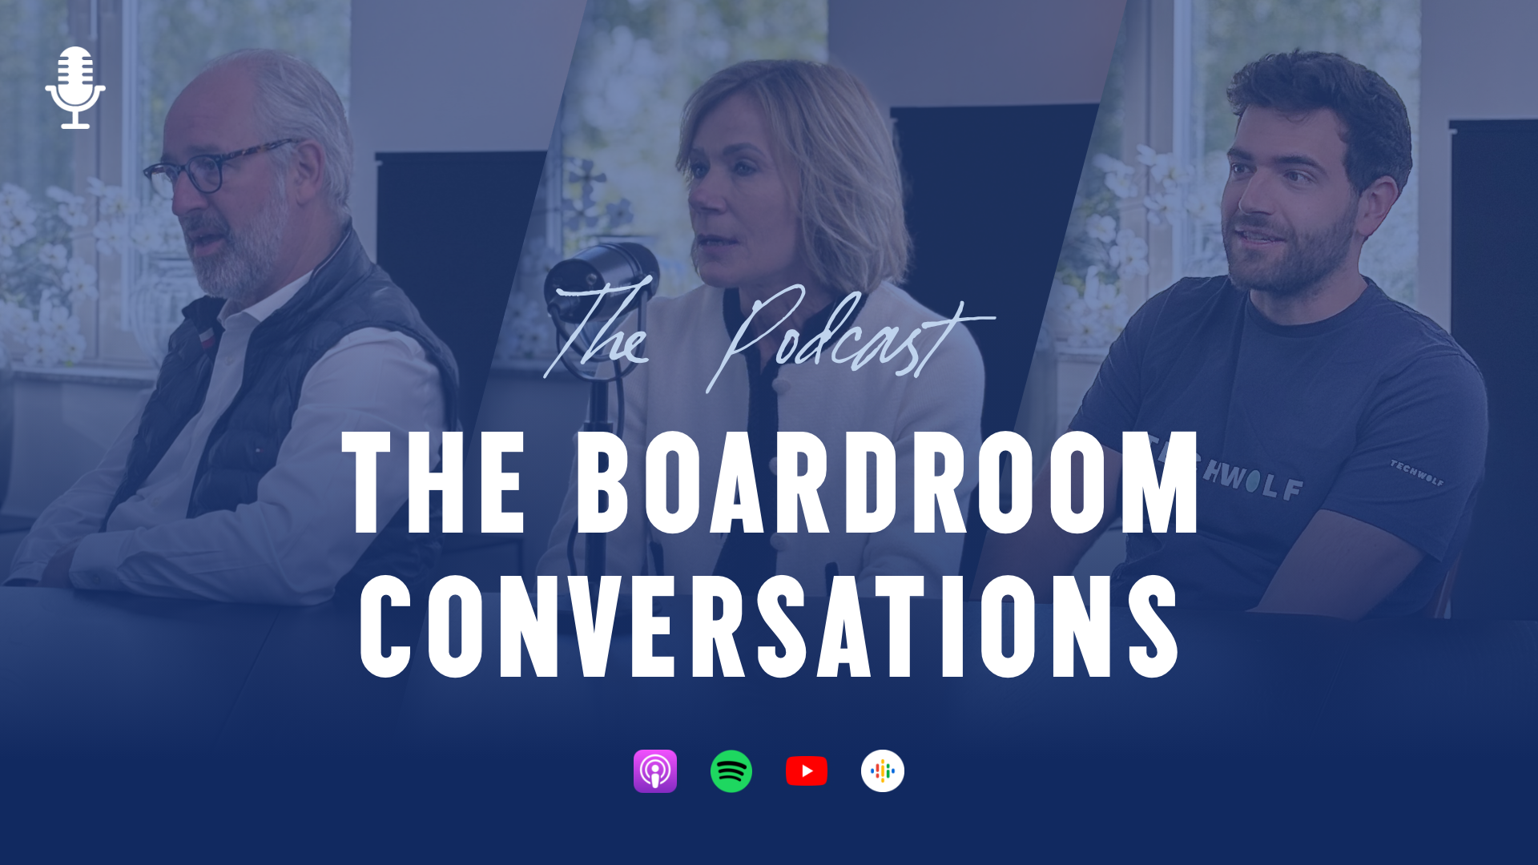
JOIN THE CLUB!
Join the community.
Listen to the podcast.
Read the book.
© 2026 Join the Club by Bruce Fecheyr-Lippens & Kobe Verdonck. Powered by SD Worx.
18

