Slide 1
Deloitte CIONET Summerfest
Notes:
Christian

Slide 2
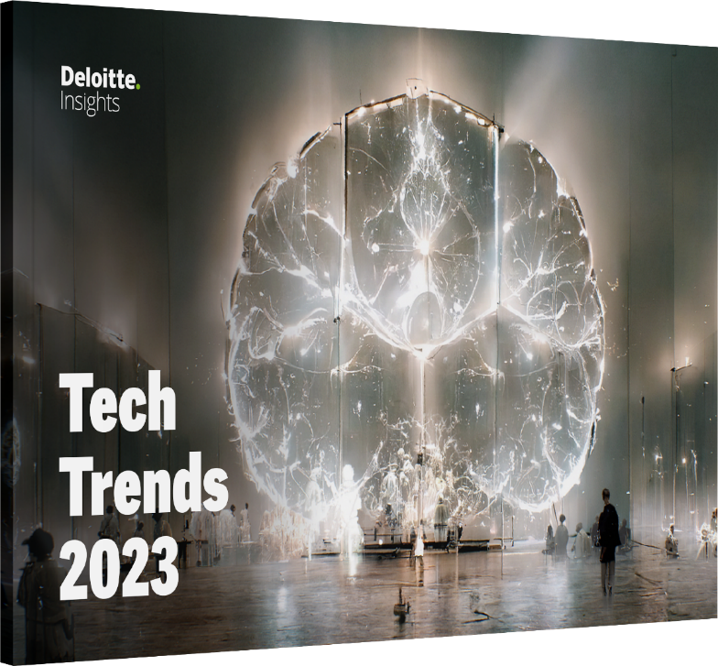
Deloitte’s 14th annual Tech Trends report
Tech Trends chronicles what’s now, what’s new, and what’s next in enterprise technology, shining a light on novel innovations which figure to graduate to normal ways of working for the rest of us in the next 18-24 months.
Our trends are informed by:
Interviews with pioneering organizations at the forefront of technology, shared as vignettes in our Trend Lines collection
Feedback from client executives on current and future priorities
Perspectives and insights from academic and industry luminaries
Road maps and investment priorities from leading startups, venture capitalists, and technology vendors
All Tech Trends reports are available for free download on Deloitte Insights and feature case studies so you can envision the journey for yourself.
Notes:
Christian

Slide 3


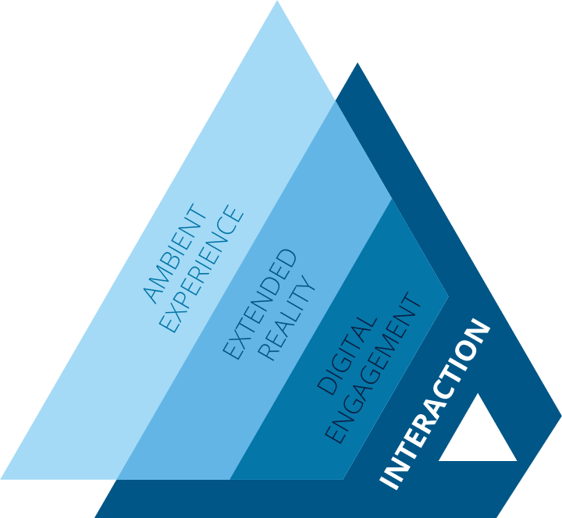


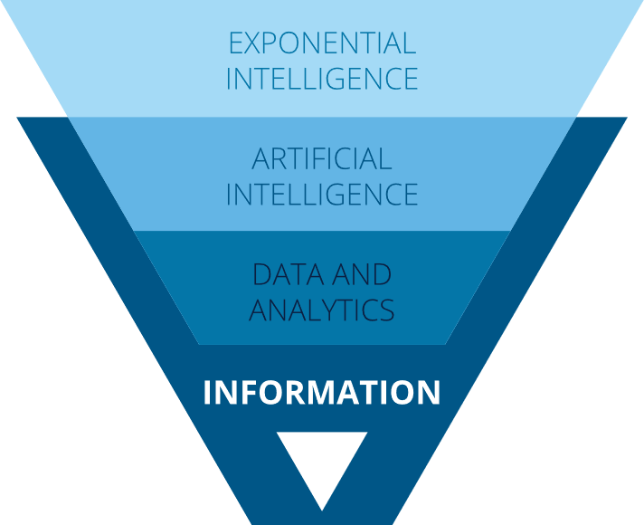


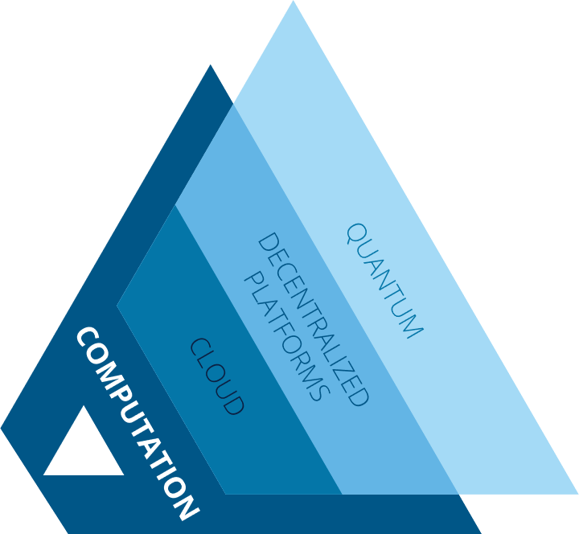


A Brief History of the Future
Eternities
Time (years)
Interaction
Information
Computation
Babbage’s design
t −175 ………..
Reader
Store
Mill
First digital computer
…….…… t −75 …….….….
Punched cards
Arithmetic calculation
Mainframe
Mid 20th century
…….….… t −50 ……….….
Command-line
Relational databases
Minicomputer
Late 20th century
……..…… t −25 ……….….
Graphical user interface (GUI)
Descriptive analytics
Client server
Early 21st century
……..…… t −10 ……….….
Mobile devices
Predictive analytics
Cloud architectures
Endgames
…………… t = ∞
Simplicity
Intelligence
Abundance
?
?
?
?
?
?
?
?
Notes:
Christian

Slide 4
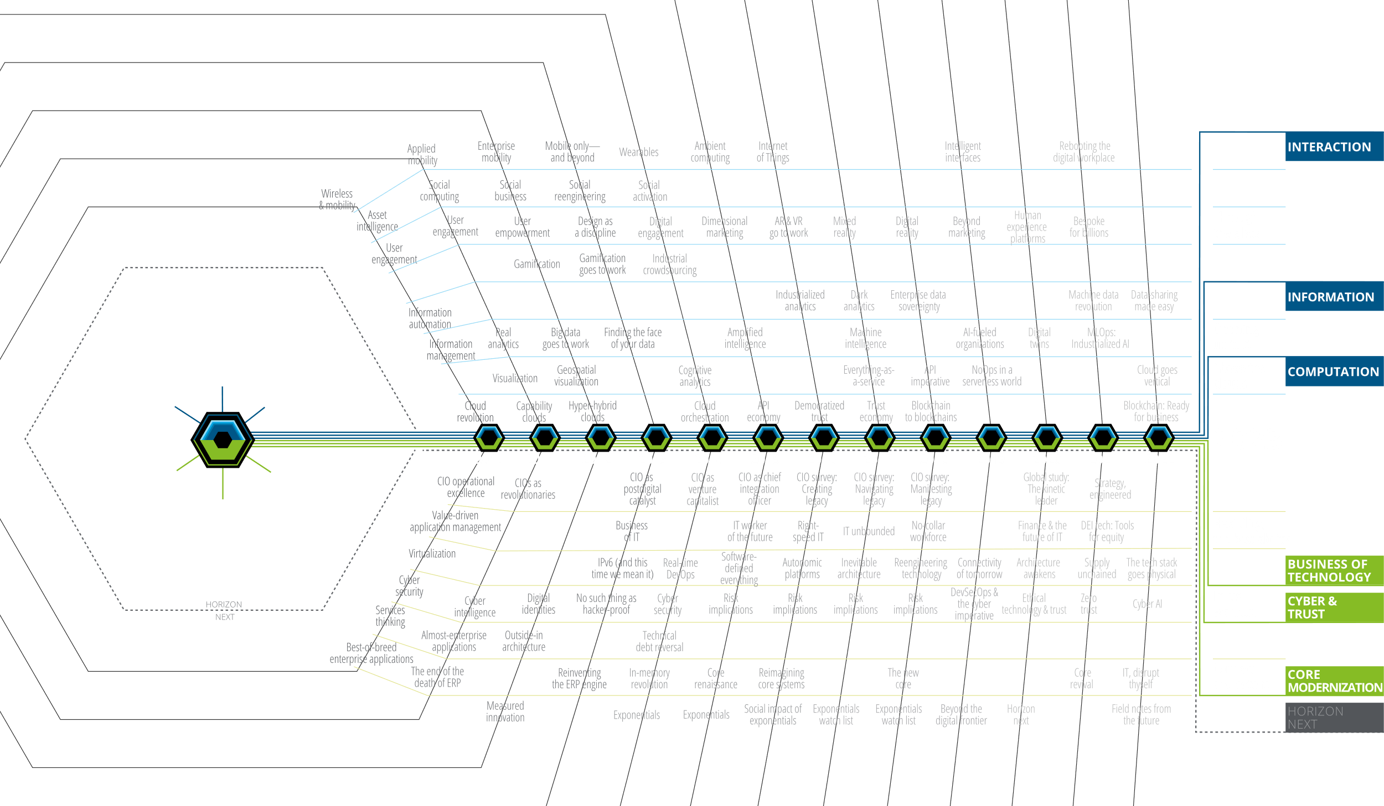
Trending the trends: Fourteen years of research
Notes:
Christian takes blue trends and Thomas takes green

Slide 5
14th edition
Tech Trends 2023
INTERACTION
INFORMATION
COMPUTATION
Through the glass: Immersive internet for the enterprise
Opening up to AI: Learning to trust our AI colleagues
Above the clouds: Taming multicloud chaos
BUSINESS OF
TECHNOLOGY
CYBER & TRUST
CORE
MODERNIZATION
Flexibility, the best ability: Reimagining the tech workforce
In us we trust: Decentralised architectures and ecosystems
Connect & extend: Mainframe modernisation
hits its stride
Copyright © 2023 Deloitte Development LLC. All rights reserved.
Notes:
Christian takes blue Thomas takes green

Slide 6
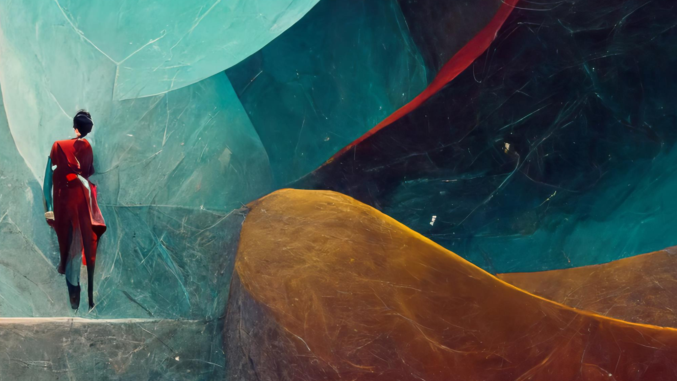

Immersive virtual experiences, including the metaverse, are quickly moving from tech to toy to enterprise tool, as companies grow revenue and streamline operations using the capabilities of an “unlimited reality.”
Trend 1
Through the glass:
Immersive internet for the enterprise
Notes:
Christian

Slide 7
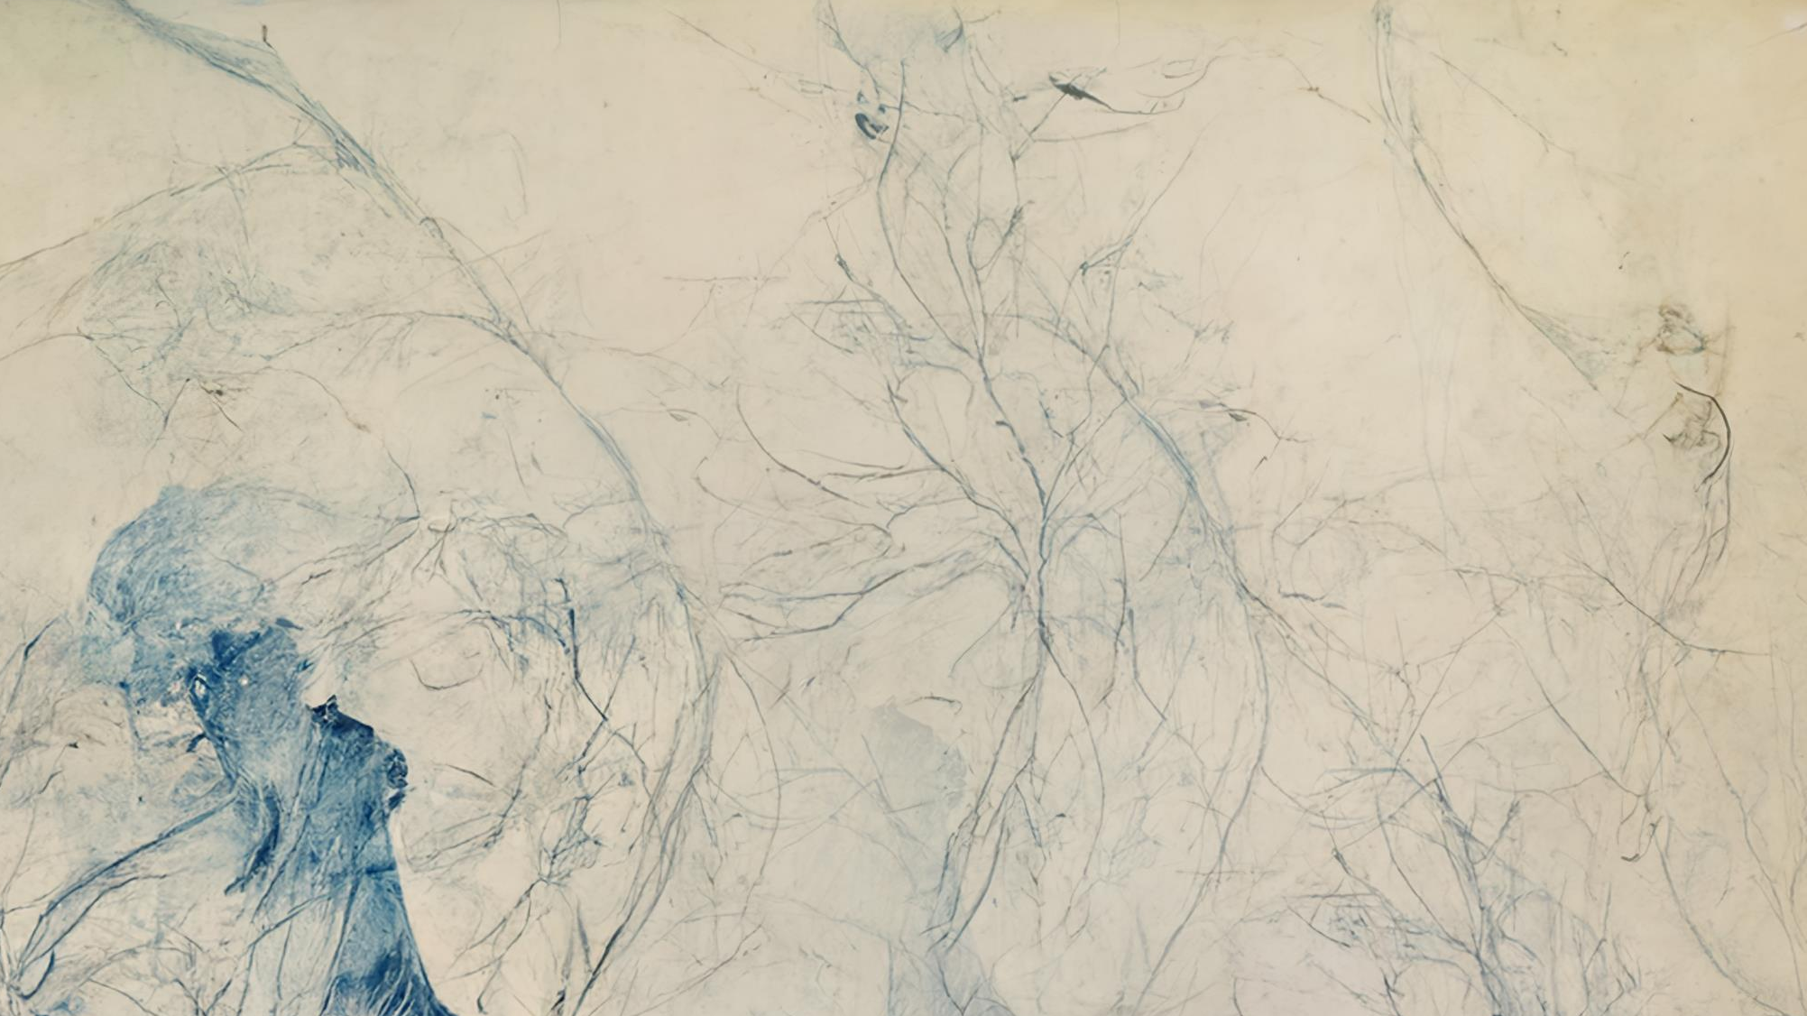

Trust is emerging as a key differentiator in enterprises’ AI aspirations. Businesses that are moving toward becoming AI-fueled organisations are learning that trust may be just as important as the strength of their algorithms.
Trend 2
Opening up to AI:
Learning to trust our AI colleagues
Notes:
Christian

Slide 8
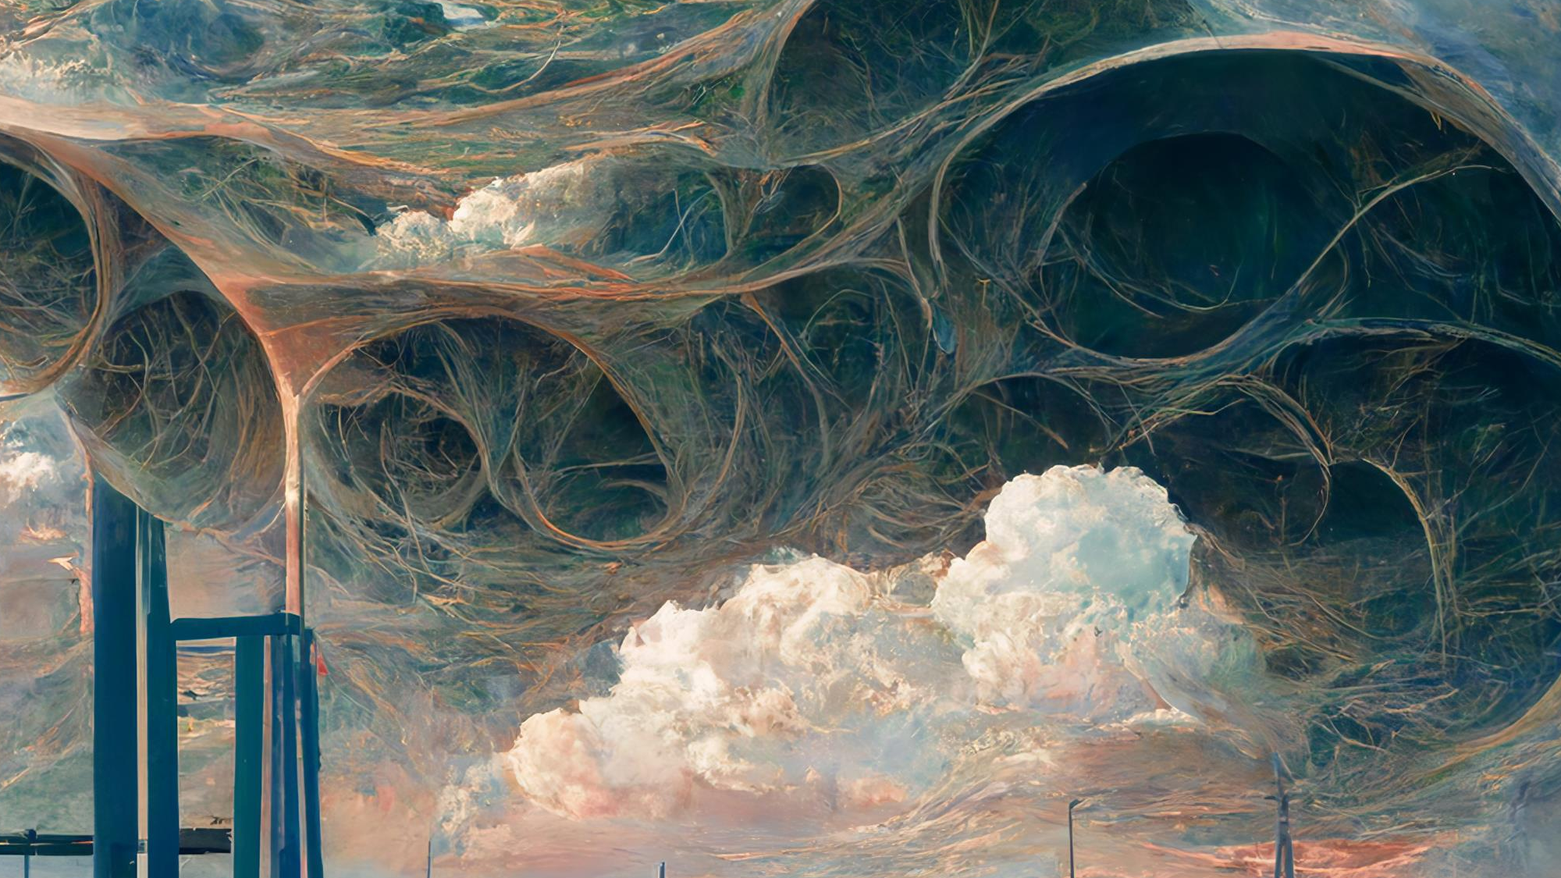

Organizations feeling swamped by multicloud complexity have a new hope on the horizon. Metacloud sits on top of existing clouds and provides a single pane of control for businesses’ various cloud platforms.
Trend 3
Above the clouds:
Taming multicloud chaos
Notes:
Christian

Slide 9
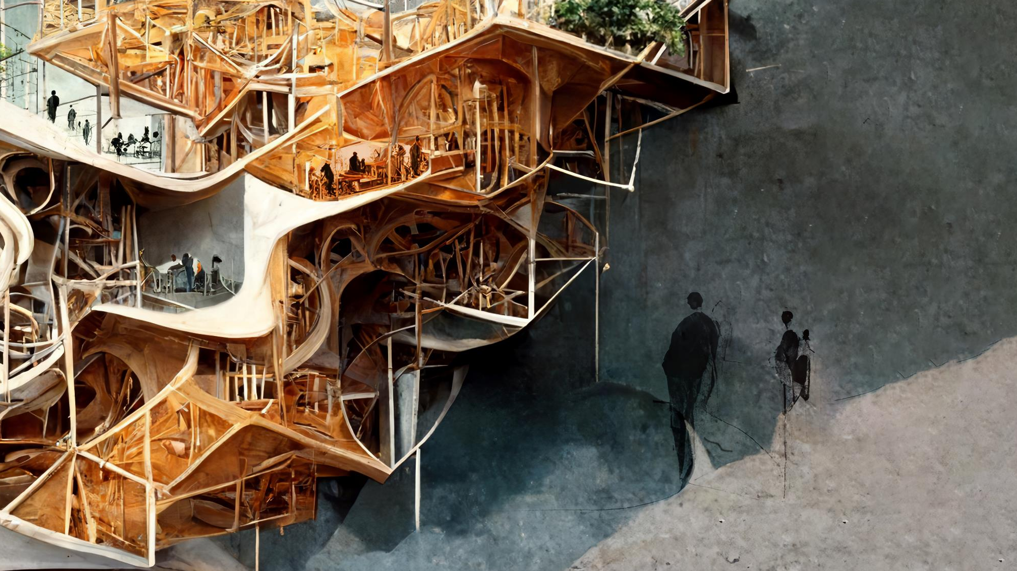

Rather than competing for scarce tech talent, savvy leaders are prizing flexibility in their workforce and finding new methods to create, source, and retain top performers.
Trend 4
Flexibility, the best ability:
Reimagining the tech workforce
Notes:
Thomas

Slide 10
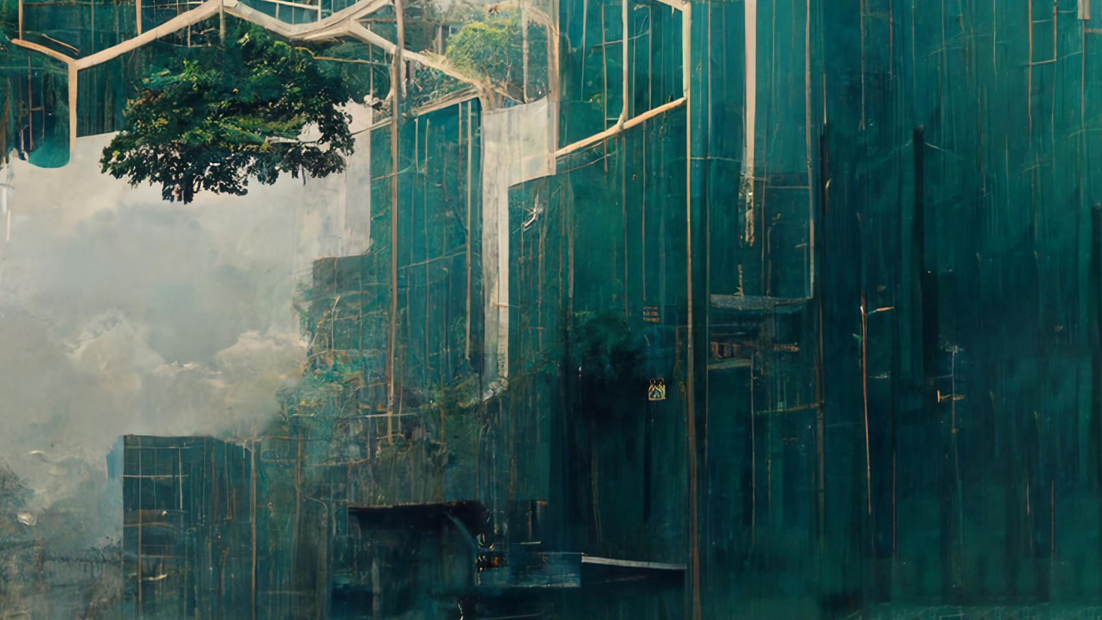

As organisations begin to understand blockchain’s utility, they’re realising that stakeholder trust-building could be a primary benefit. Decentralised architectures and business models demonstrate that none of us is as trustworthy as all of us.
Trend 5
In us we trust:
Decentralised architectures and ecosystems
Notes:
Thomas

Slide 11
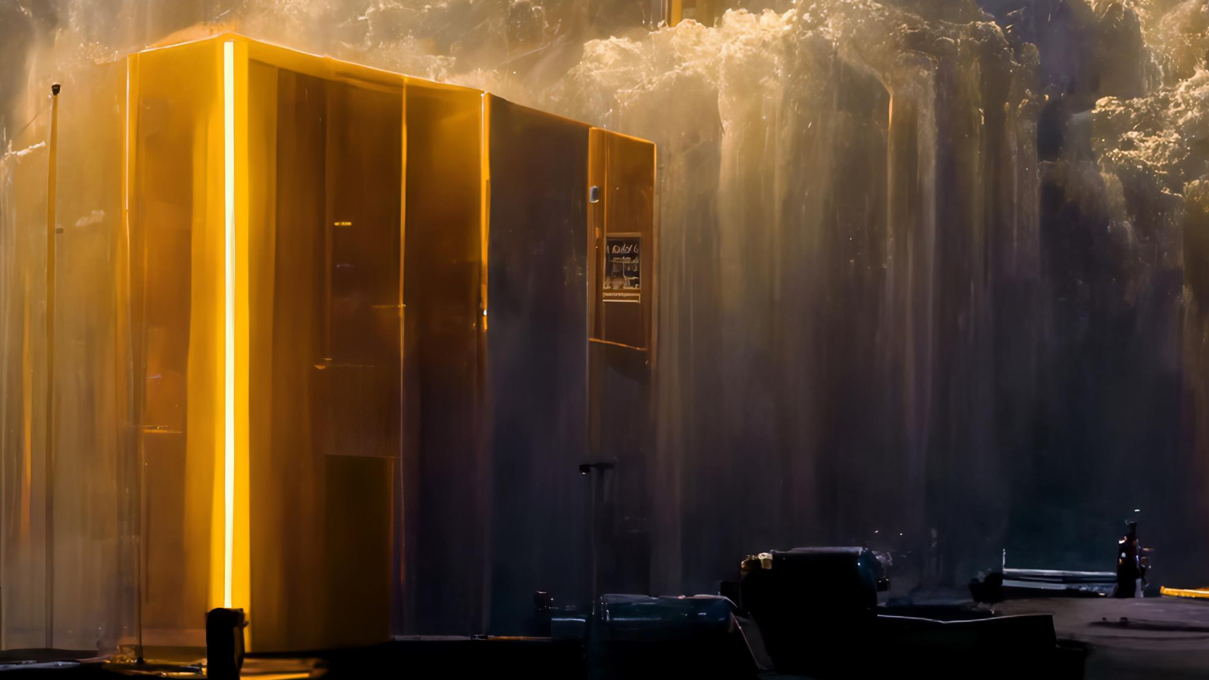

Through connections and extensions like AI-powered middleware solutions, advanced microservices applications, and refreshed user interfaces that harness the power of data, enterprises are modernising legacy technologies and using them to drive digital transformation.
Trend 6
Connect & extend:
Mainframe modernisation hits its stride
Notes:
Thomas

Slide 12
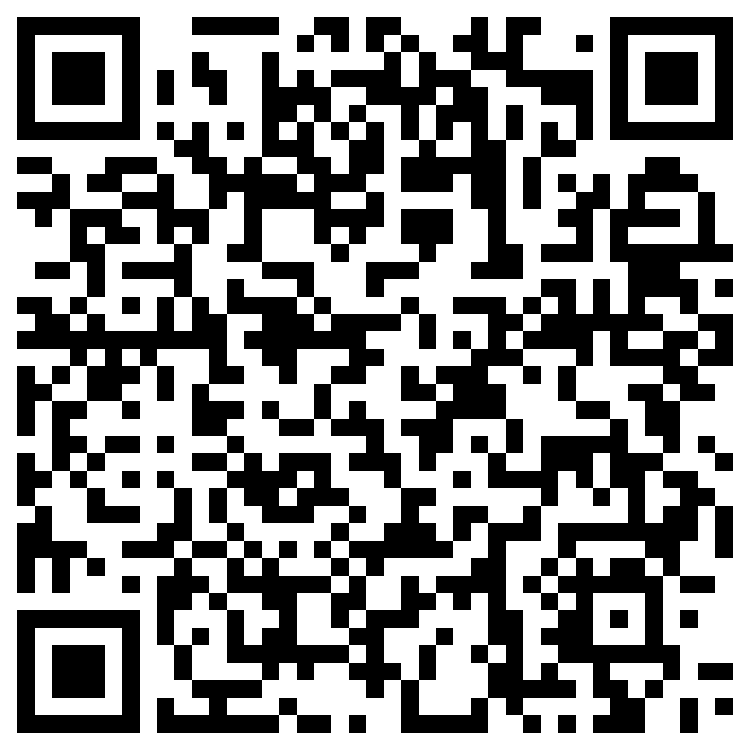
Scan to download the report

