Slide 1
Why having a datawarehouse is wrong ?
Barak Chizi, PhD
Chief Data & Analytics Officer
KBC Group

Slide 2

Notes:
Don’t fall in love with technology

Slide 3
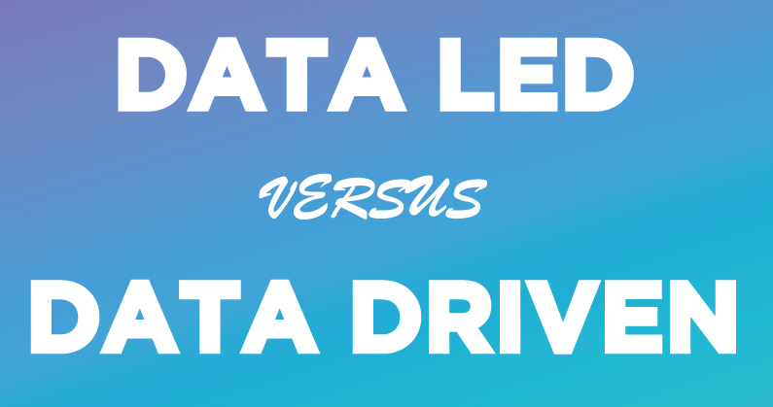

Slide 4


Slide 5


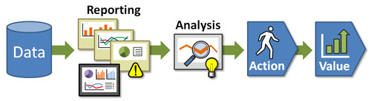
Data Led Philosophy
Observe If something happened

Slide 6

We will need to collect to duplicate all data to make it optimal to query
Our reports need to be predefined
Always we will need some data people to explore it for us and serve us with insights
Domain Expert is a must to understand better the insights but also to crystalize the actions
It costs a lot…
Being a Data Led

Slide 7
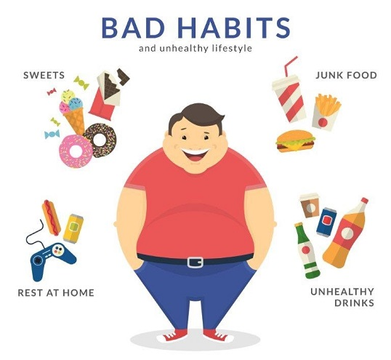
Expert based decisioning
Reports
EUC as a common practice
Focusing on the causes not on the results

Slide 8








Data Driven Philosophy
Describing the customer
Using Historical Sales
Feedback
Omni Channel Approach

Slide 9
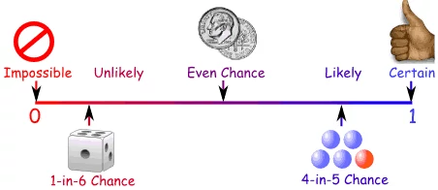


Predicting Success
Preserving Knowledge

Slide 10

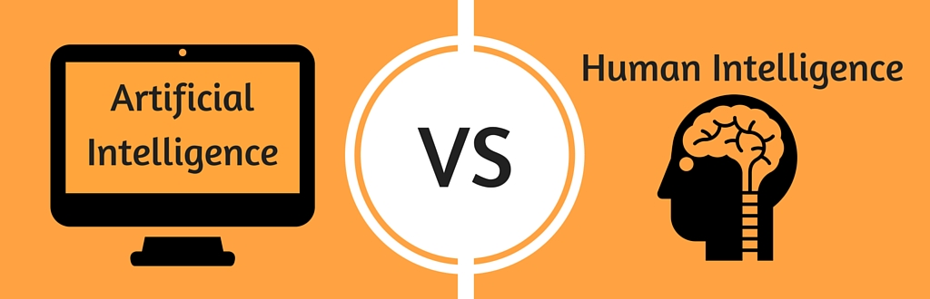
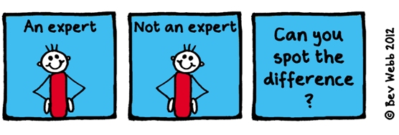

Slide 11
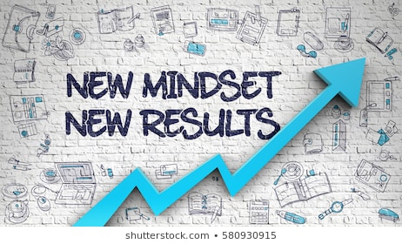

Slide 12


Slide 13

Under the hood

Slide 14
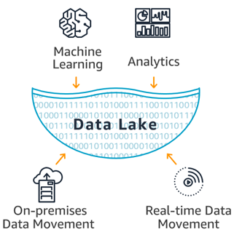

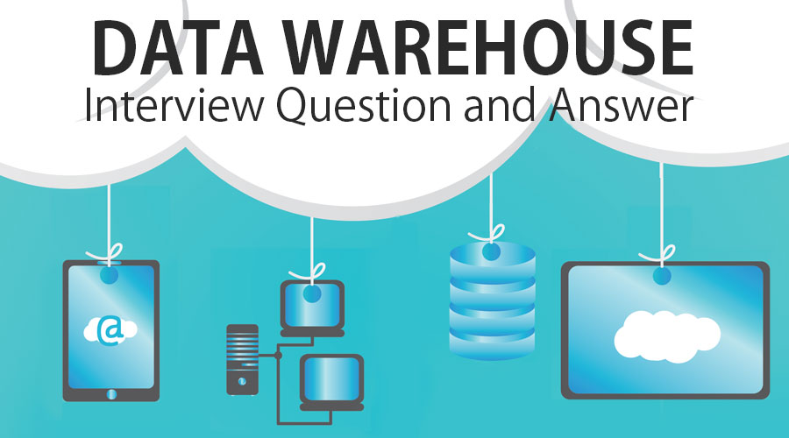

Slide 15

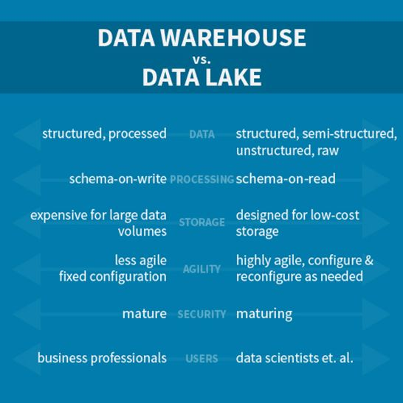

Slide 16
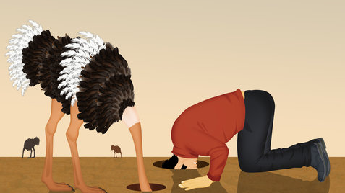

Slide 17


Slide 18

Questions ?

