Slide 1
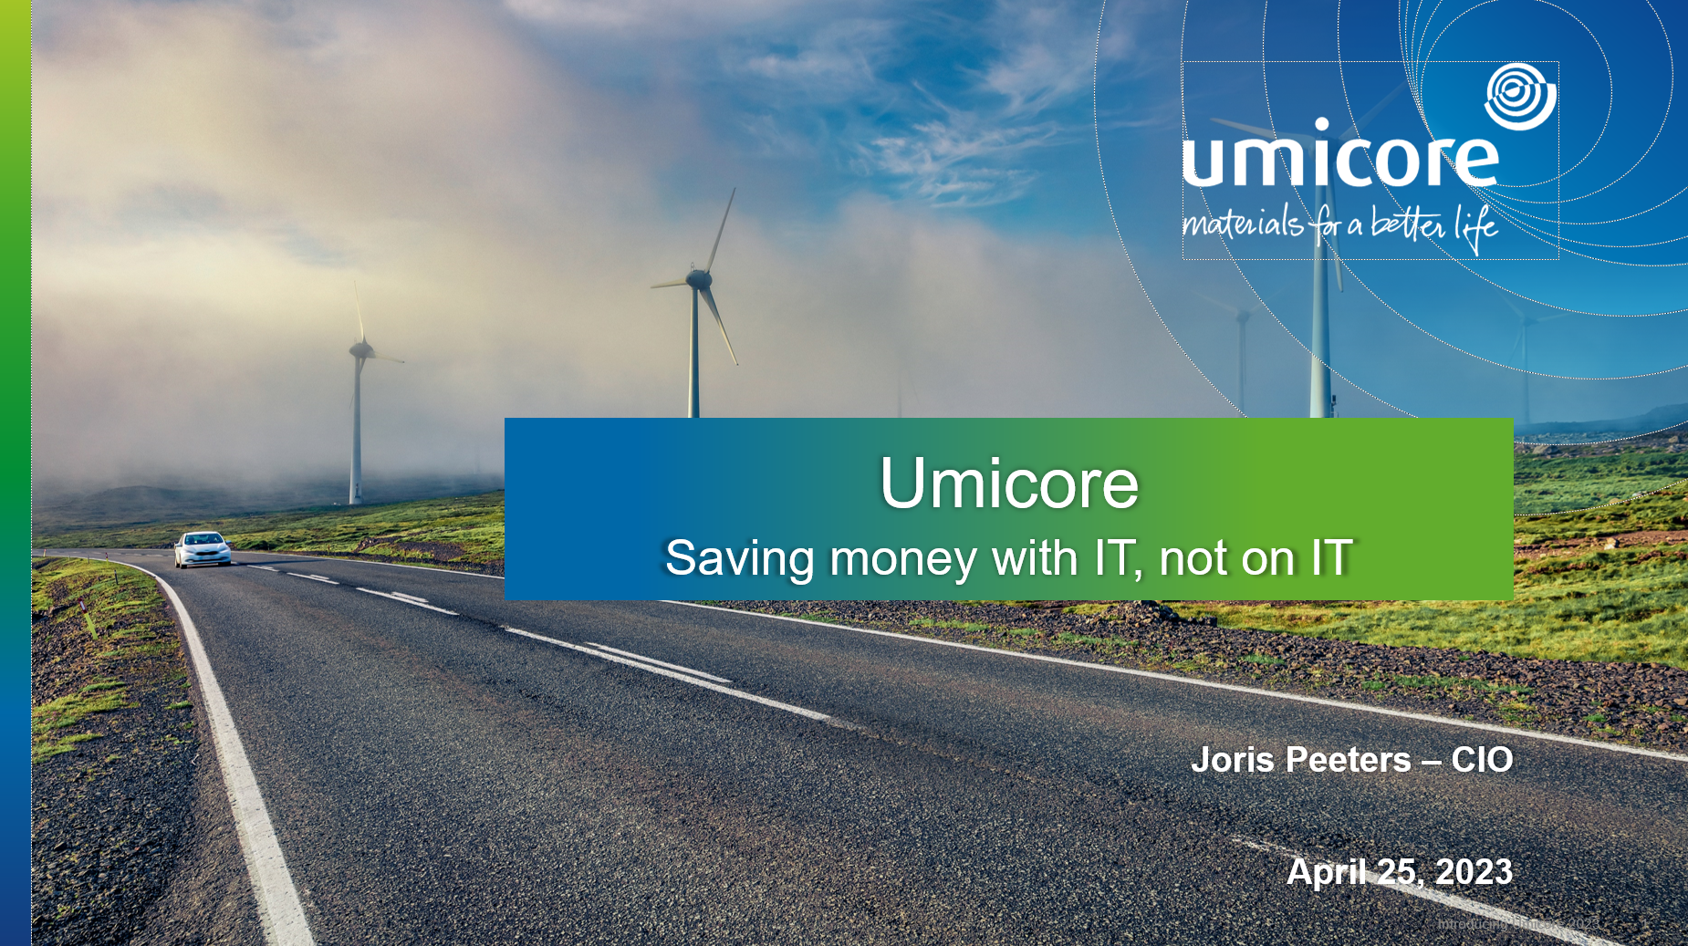
Notes:
In this presentation we explain what makes Umicore unique for our stakeholders: our foundations, our unique technology and market positions in our activities, our strategic ambitions, our sustainability approach, our strong commitment to innovation and our solid financial structure.

Slide 2
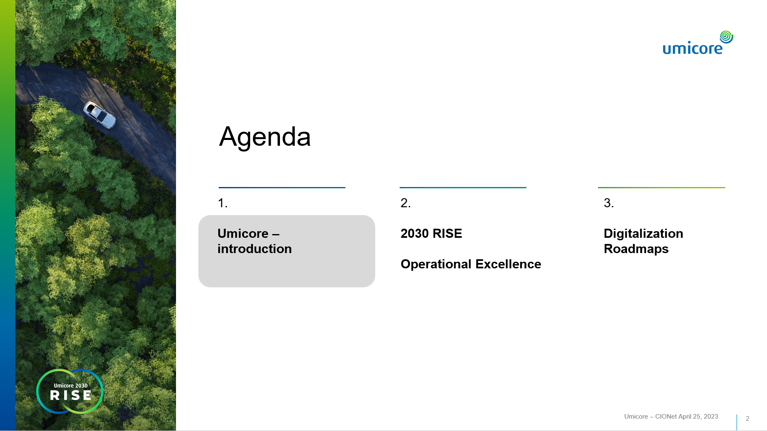
Notes:
Next 45 minutes:
Why the mobility transformation will create exponential demand for Umicore’s cathode active materials
How Umicore will play a differentiating role with its unique competences along the value chain and thus creates value to its partners and customers
And HOW we will capture the growth in a profitable and sustainable manner

Slide 3
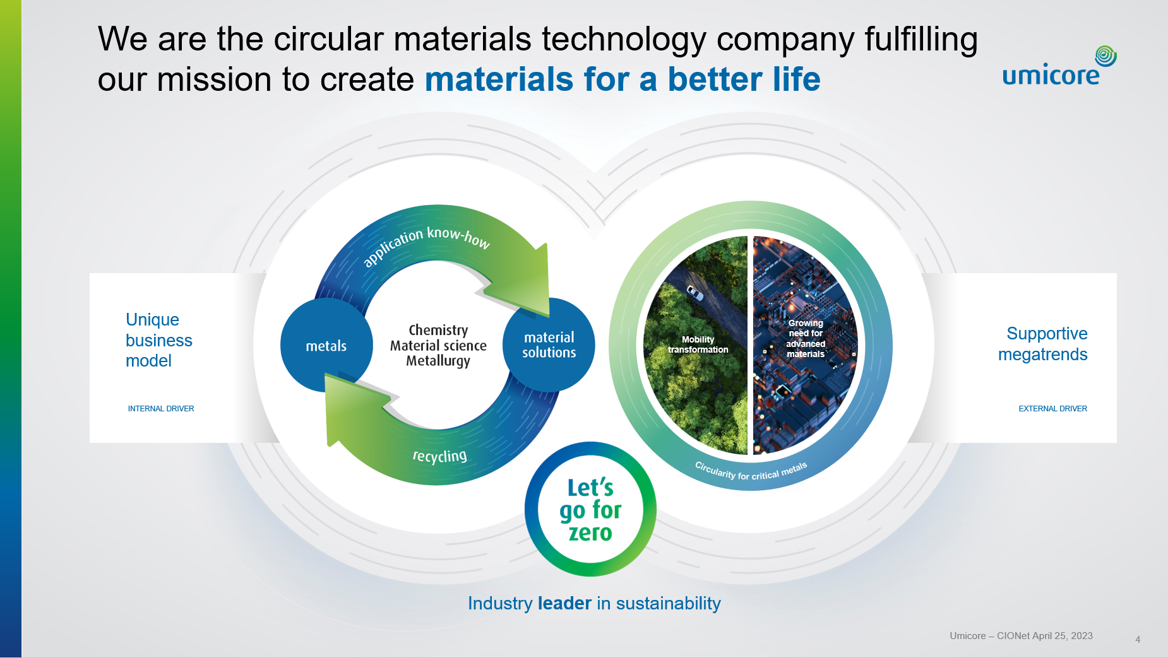
Notes:
Our strongly rooted foundations provide an excellent strategic roadmap on our next exciting chapter of sustainable growth and value creation. They have become even stronger with the acceleration of megatrends, the resulting reinforcement of our unique business model (which has become even more differentiated) and turning sustainability into a competitive edge.
We have a history of anticipating megatrends that define the next decades and we embrace them as our business drivers. Today we have three supportive “megatrends” as our external drivers exposing us to the right markets.
- Mobility transformation: We are moving further and faster to accelerate the global transition to carbon free mobility. Thanks to our expertise in clean mobility materials and recycling technologies, we are able to guide our customer’s transformation journey, from start to finish.
Growing need for advanced materials: Advanced materials are key enablers for faster, more scalable, more efficient, and more sustainable solutions that tackle the challenges of society today and tomorrow. We develop the next generation of sustainable advanced materials ensuring that they are used again and again through our recycling technologies.
Circularity for critical metals: the rapidly growing conviction that the future economy will be even more of a circular economy, we enable full circularity for critical metals and we will see how we integrate circularity in everything we do - within the transformation of mobility and the growing need for advanced materials.
Our unique business model is the internal driver – reinforcing our portfolio and creating value in these markets
Our circular business model is a powerful differentiator, and it will continue to be the basis on which we carry out our business and the basis on which we build our strategy. It is designed to deliver positive environmental impact in parallel with economic value creation.
Industry leader in sustainability
Our pioneering approach to sustainability is also a factor of distinction for Umicore and a true differentiator. It has already been part of our DNA for many years, and it is transversal in everything we do. We have pushed industry standards for sustainability with our Let's Go For Zero approach. In order to continue to be successful as a company and continue to be a sustainability leader in our industry, we have to raise the bar and have to be bolder and broader, we have to act faster and be better. By this we mean net zero greenhouse gas emissions by 2035.

Slide 4
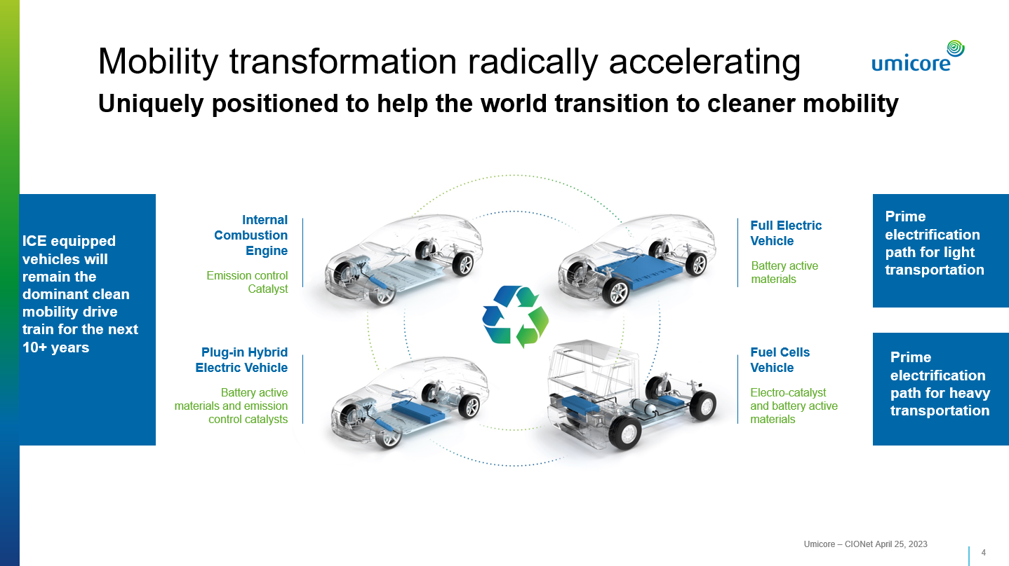
Notes:
Umicore is unique. Umicore is the only circular materials technology company that provides a full offering to support the roadmap towards ever cleaner vehicles.
We have long experience, deep understanding and close cooperation with the vast majority of OEMs for decades.
- With more than 50 years of expertise in catalyst technology development and manufacturing + 25 years of electrification roadmap with battery active materials and emerging fuel cells we are able to support our customers as a partner along the mobility transformation.

Slide 5
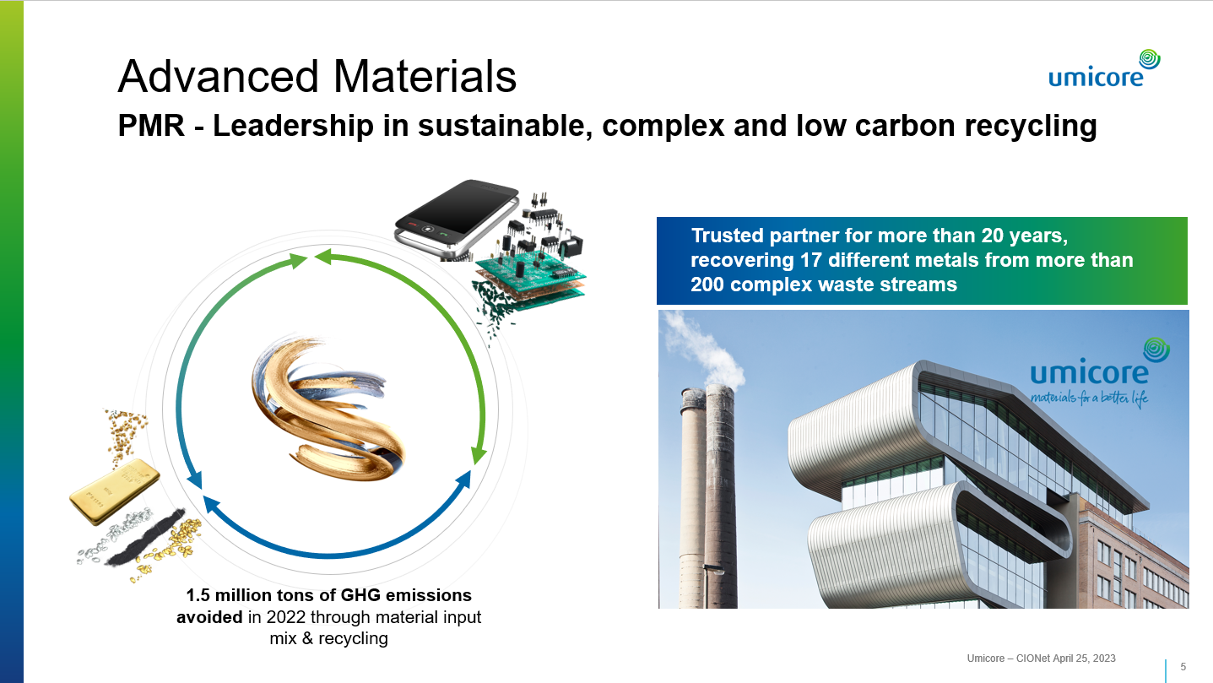
Notes:
We are a world leader in sustainable, complex and low-carbon recycling
Competitive edge: closing our own and our customers’ materials loop and offering a sustainable, circular approach in a world of metals scarcity
R:
Superior processing flexibility to treat a broad range of input materials in line with changing market demand and customer needs
Trusted partner for more than 20 years, returning high metal value to customers through superior sampling and metal yield
Reliability in precious metals transactions and in value consignment
Enabling customers in their journey towards lower carbon footprint and higher recycled content
I (Innovative metallurgy and chemistry)
- Leverage our unrivalled pyro and hydro expertise to further improve yields and expand input streams
Leading CO2 performance with our “NextGen” technology: becoming the world-leading low carbon precious metals recycler
Sustainability Champion – Key partner for the circular economy
- Maximizing closed-loop benefits
Majority of input mix from secondary sources
Conflict-free and responsible sourcing certified operations
- Sustainable co-existence with the neighboring communities - the challenge of running an industrial operation close to a residential area
Committed to minimizing environmental impact of operations
Building a green zone in Hoboken
Excellence in Execution
Enhance operational excellence: safety, process efficiency, sampling & assaying, high yields through digitalization and automation

Slide 6
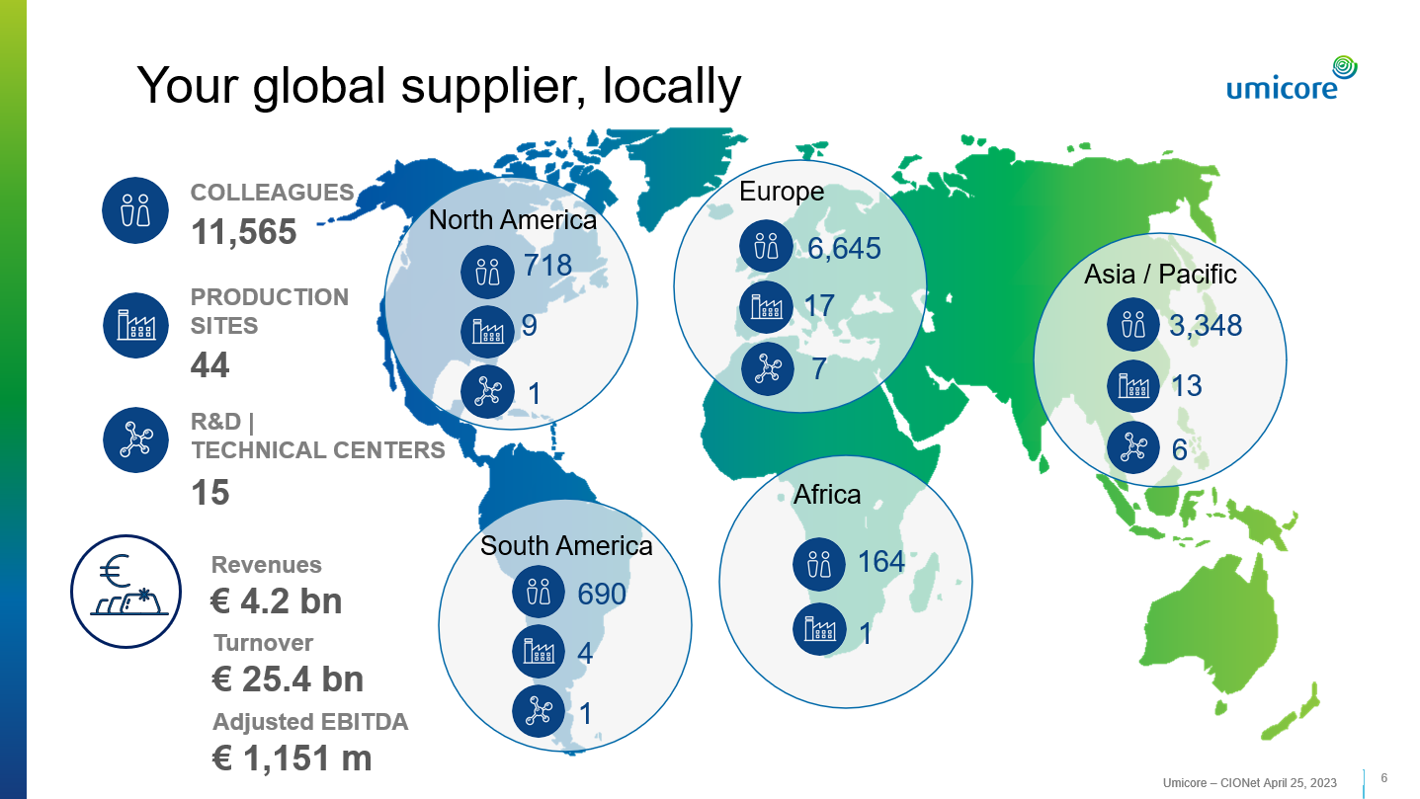
Notes:
This gives you a global overview of where Umicore has its operations. The company has developed a truly global profile in the past 20 years with significant production presence close to our customers. Some of our production sites and R&D Technical centers are located on the same site but are counted as separate entities under our global presence figures.

Slide 7
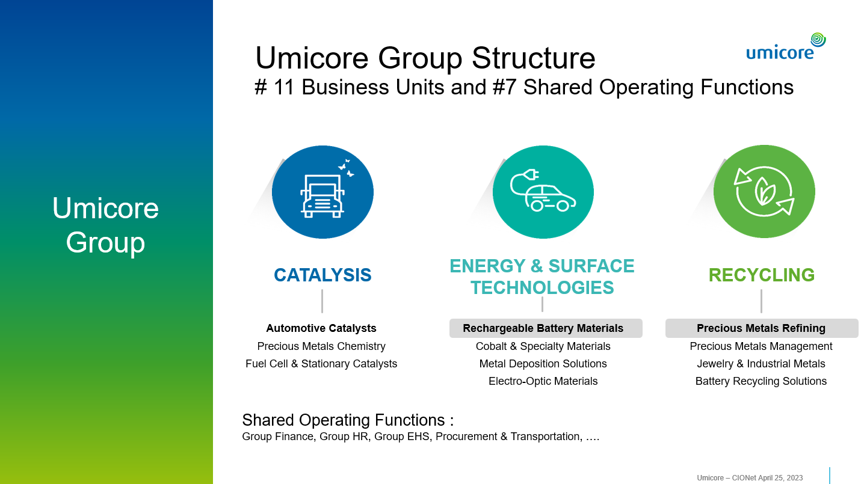

Slide 8
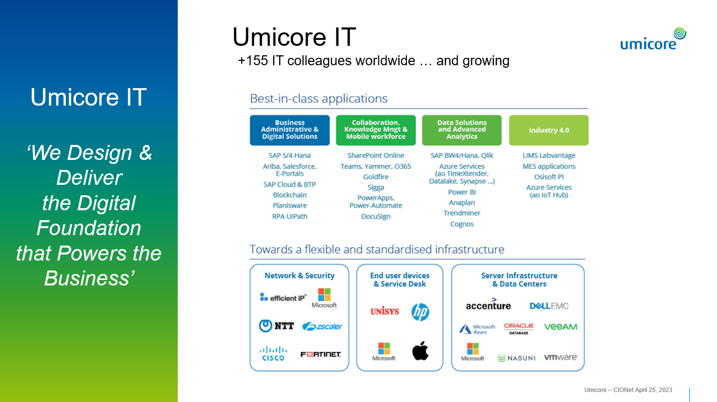

Slide 9
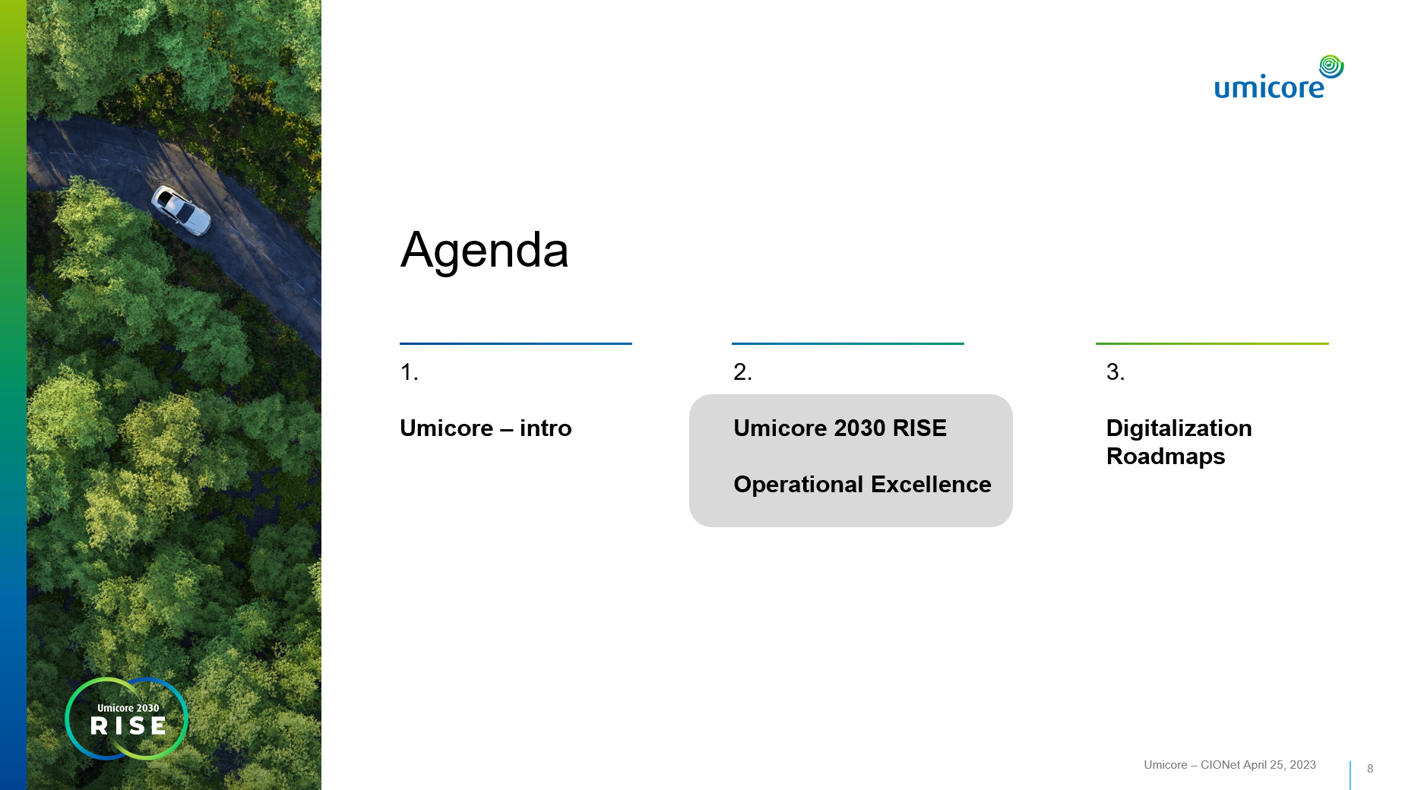
Notes:
Next 45 minutes:
Why the mobility transformation will create exponential demand for Umicore’s cathode active materials
How Umicore will play a differentiating role with its unique competences along the value chain and thus creates value to its partners and customers
And HOW we will capture the growth in a profitable and sustainable manner

Slide 10
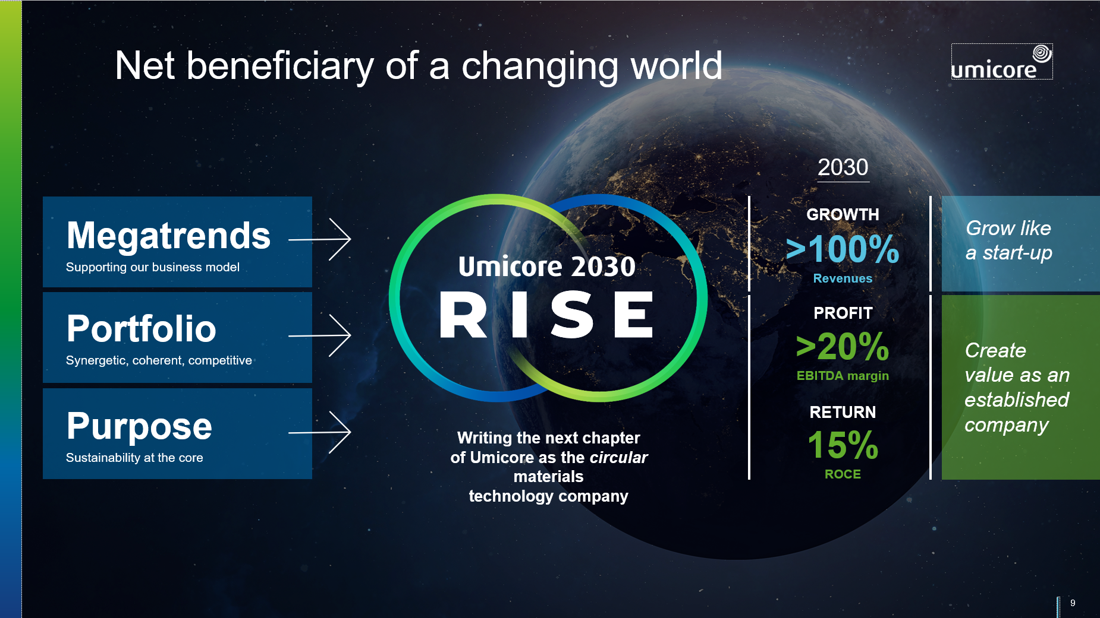
Notes:
Key take-aways of our RISE strategy are on this page:
1.
- Anticipating megatrends and embracing them as our business drivers
- Unique portfolio of mutually reinforcing activities
- Strong foundations and successful track record
- Sustainability deeply embedded in our DNA
2. RISE pillars will accelerate / enable our success
3. This will result in the perfect and UNIQUE combination of fast growth with uninterrupted value creation –Growing like a start-up and creating value as an established company
We will be the net beneficiary of a changing world esp. taking full advantage of mobility transformation

Slide 11
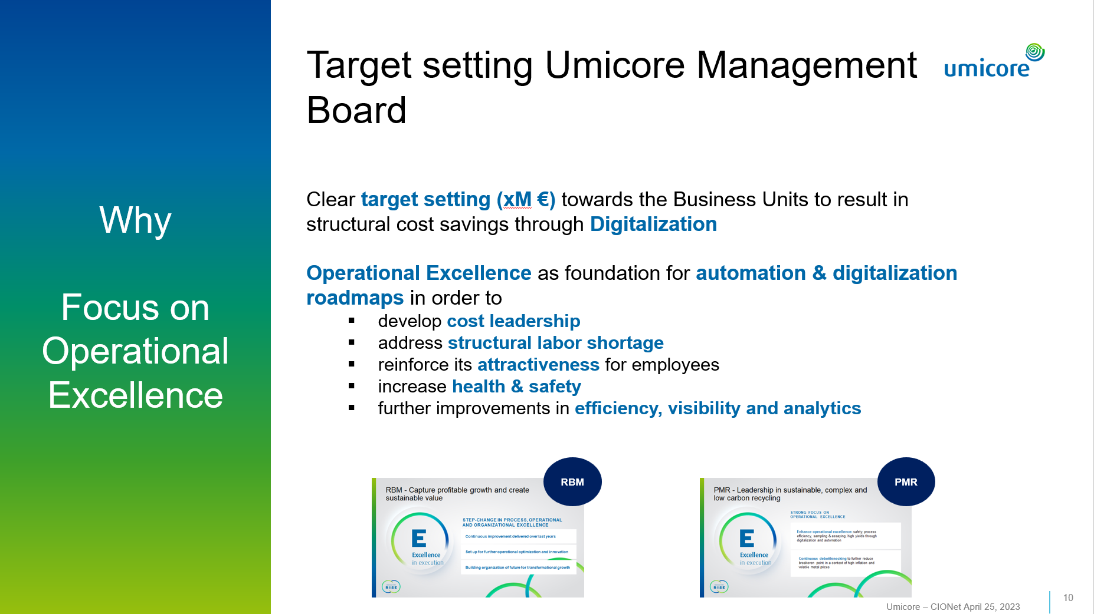
Notes:
The historical roots of Umicore go back more than 200 years
PMR: first activities started in 1887 (almost 150 years ago
RBM: In Nysa Poland we have build Europe’s first battery materials giga factory

Slide 12
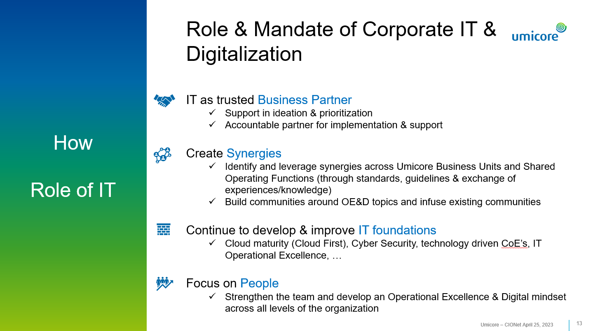

Slide 13
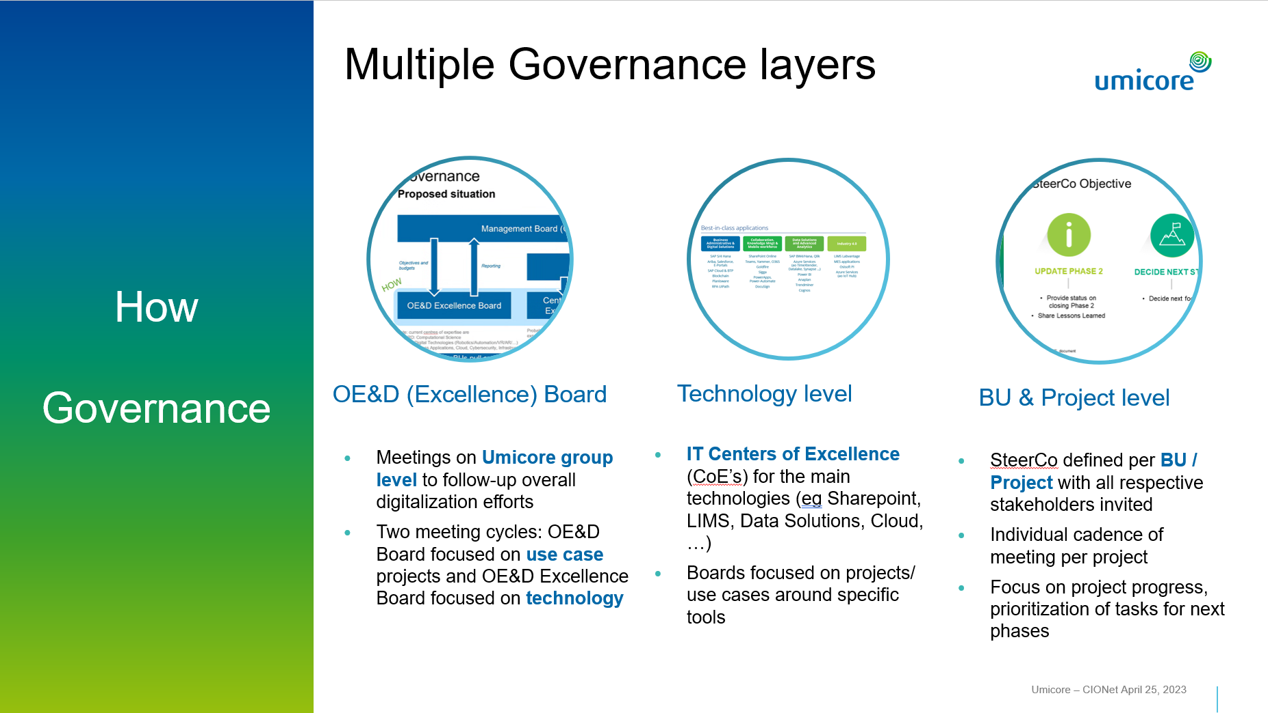

Slide 14
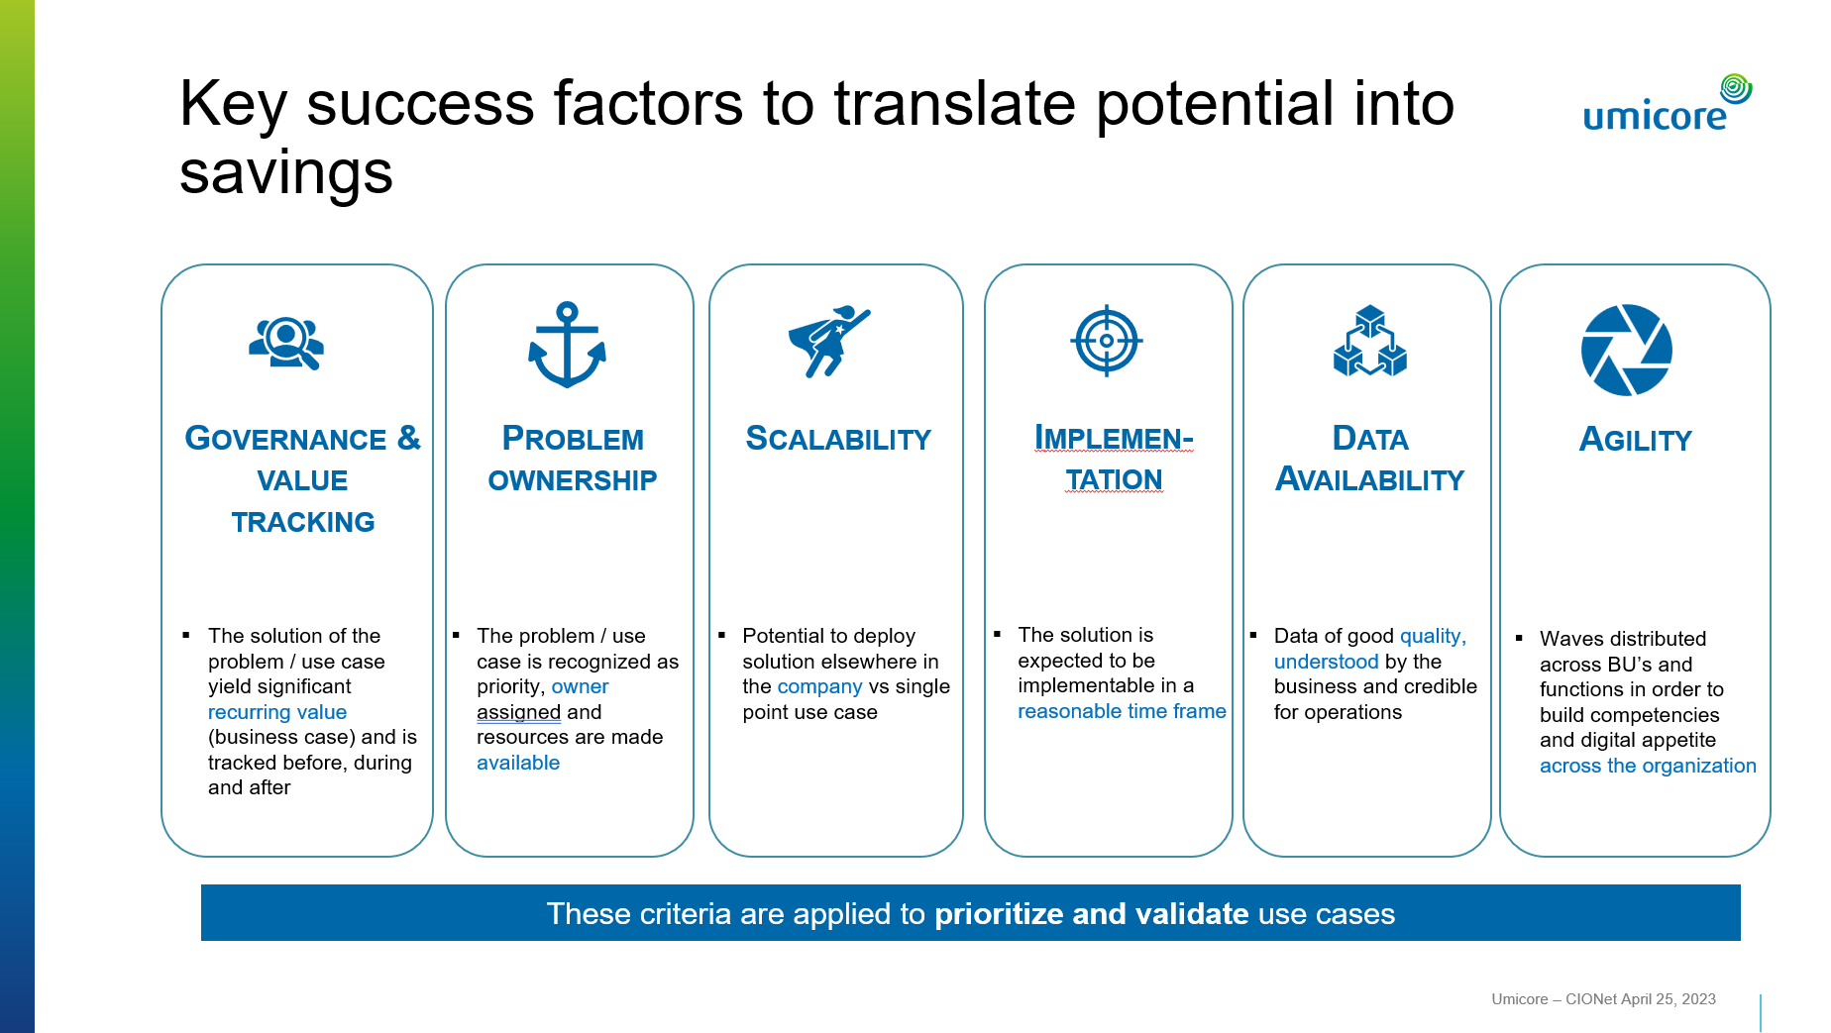

Slide 15
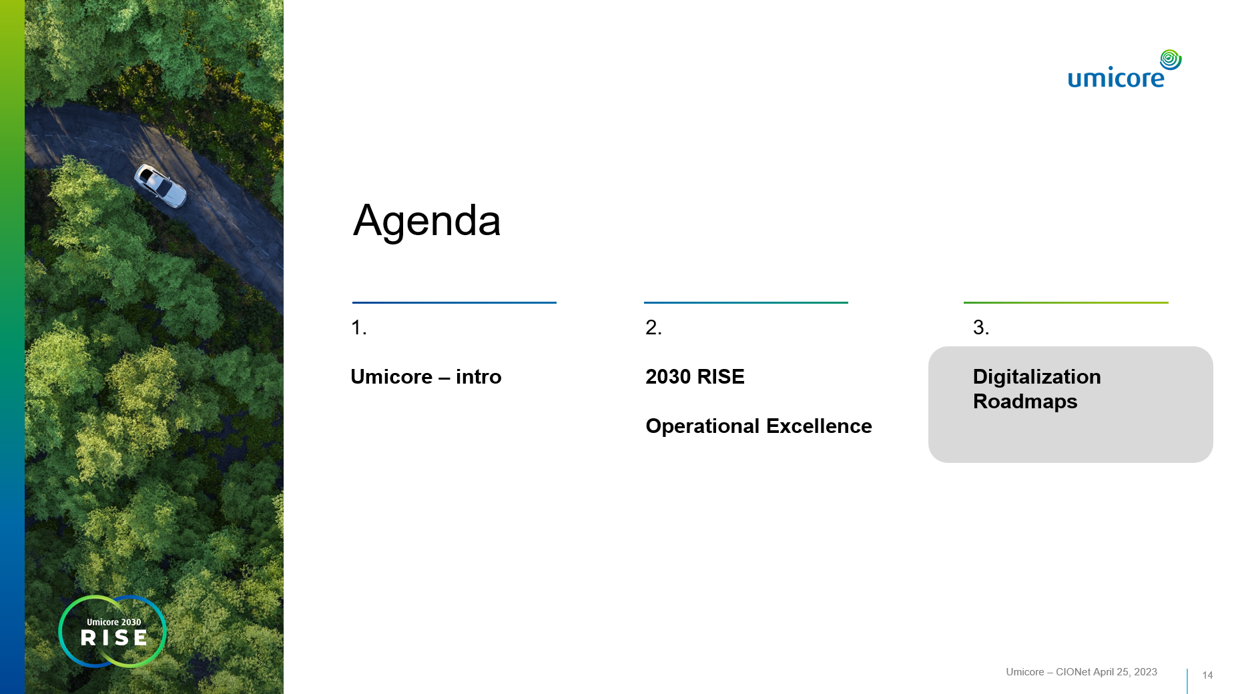
Notes:
Next:
Why the mobility transformation will create exponential demand for Umicore’s cathode active materials
How Umicore will play a differentiating role with its unique competences along the value chain and thus creates value to its partners and customers
And HOW we will capture the growth in a profitable and sustainable manner

Slide 16
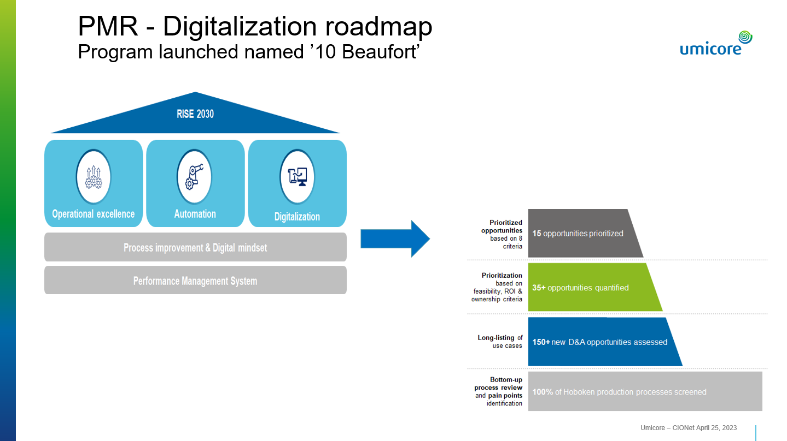

Slide 17
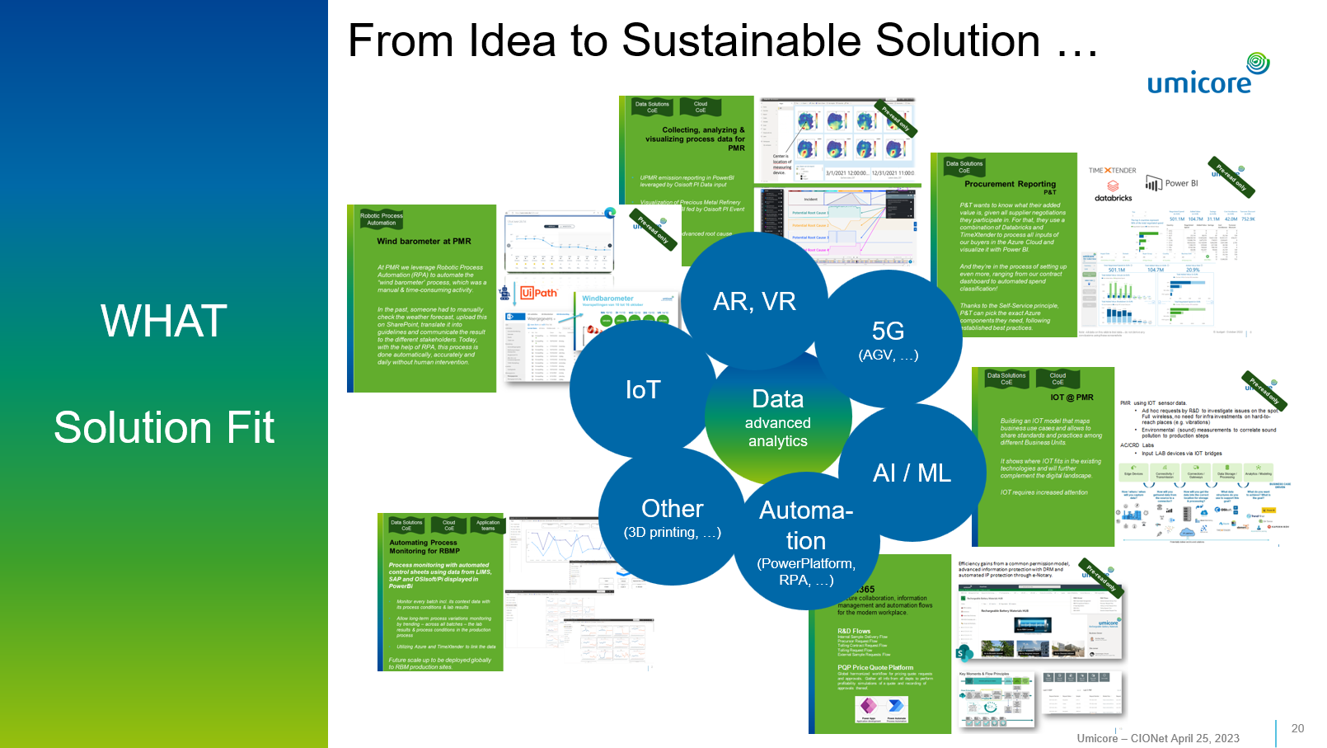

Slide 18


Slide 19
