Slide 1


Slide 2


Slide 3
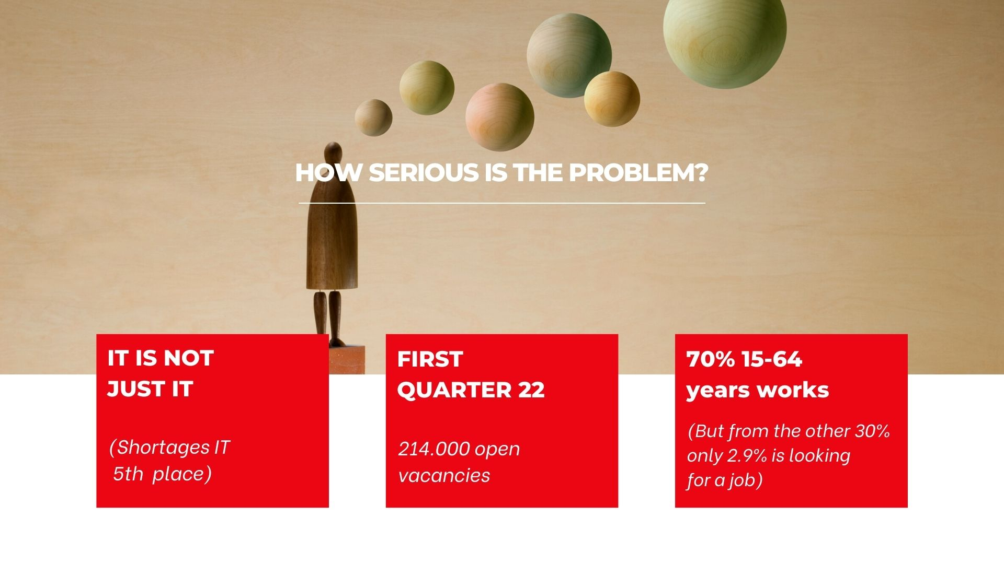

Slide 4
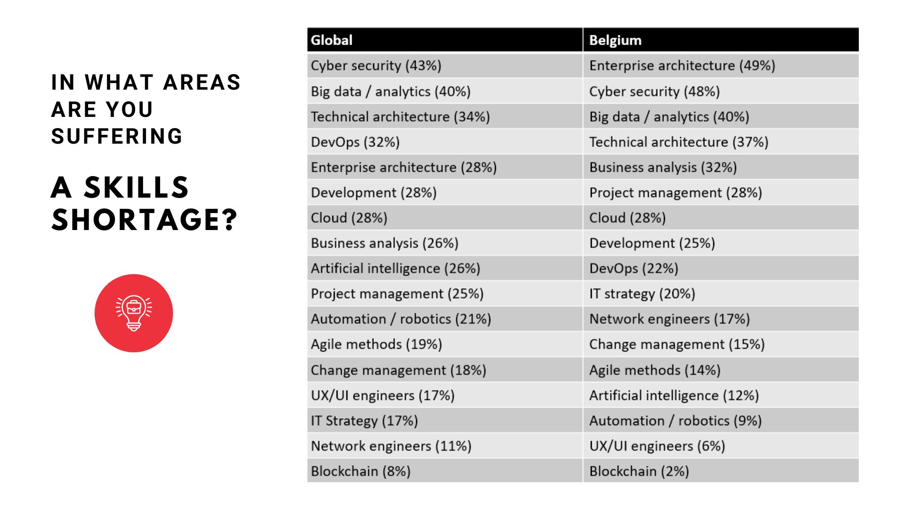

Slide 5
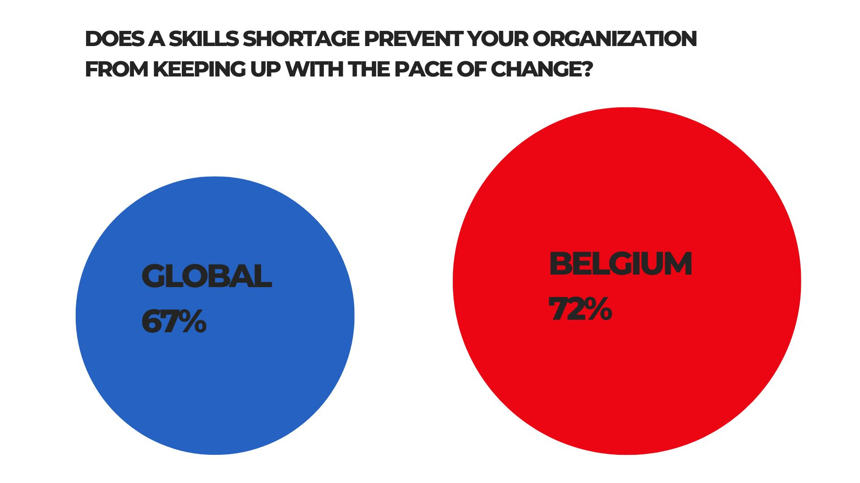

Slide 6
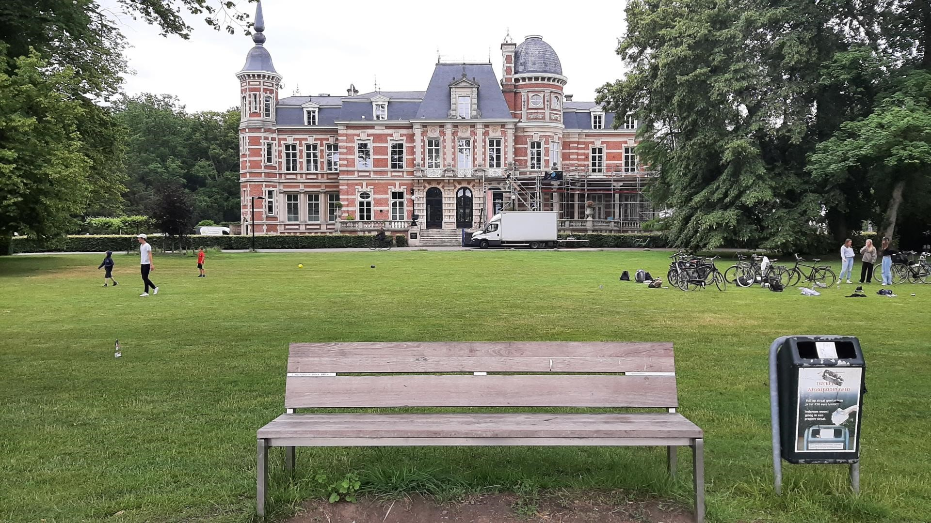

Slide 7
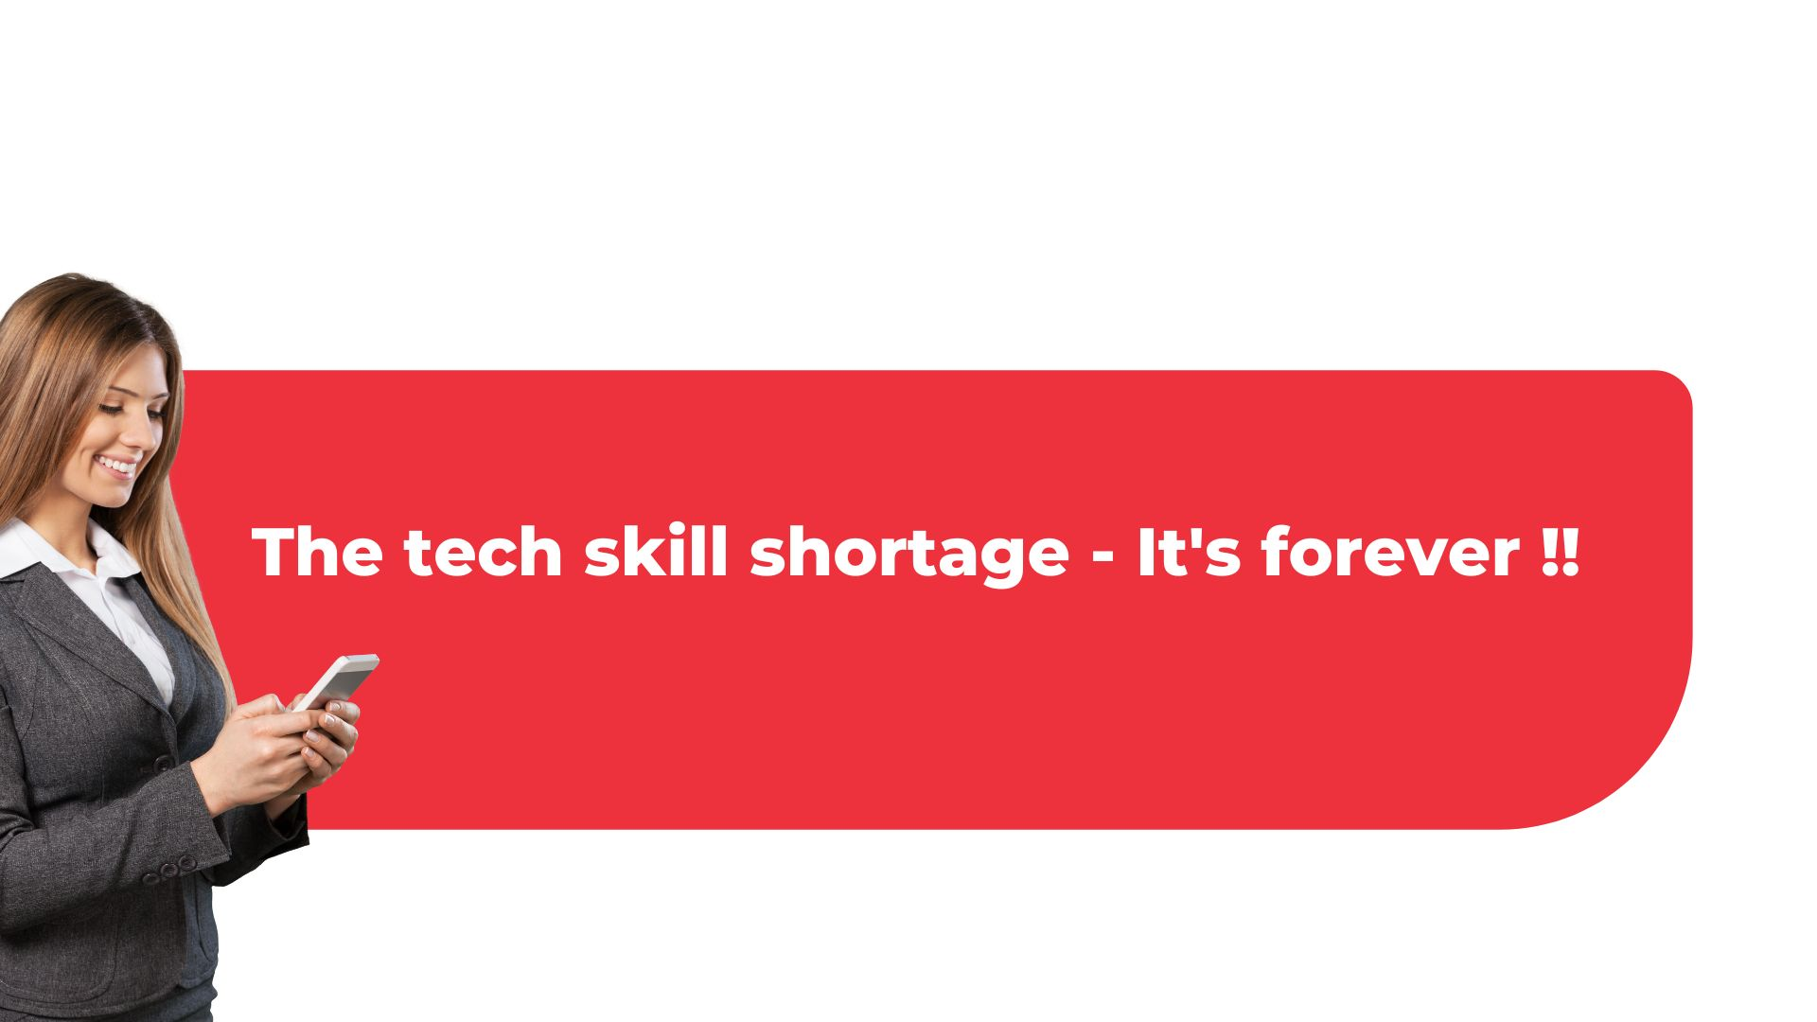

Slide 8
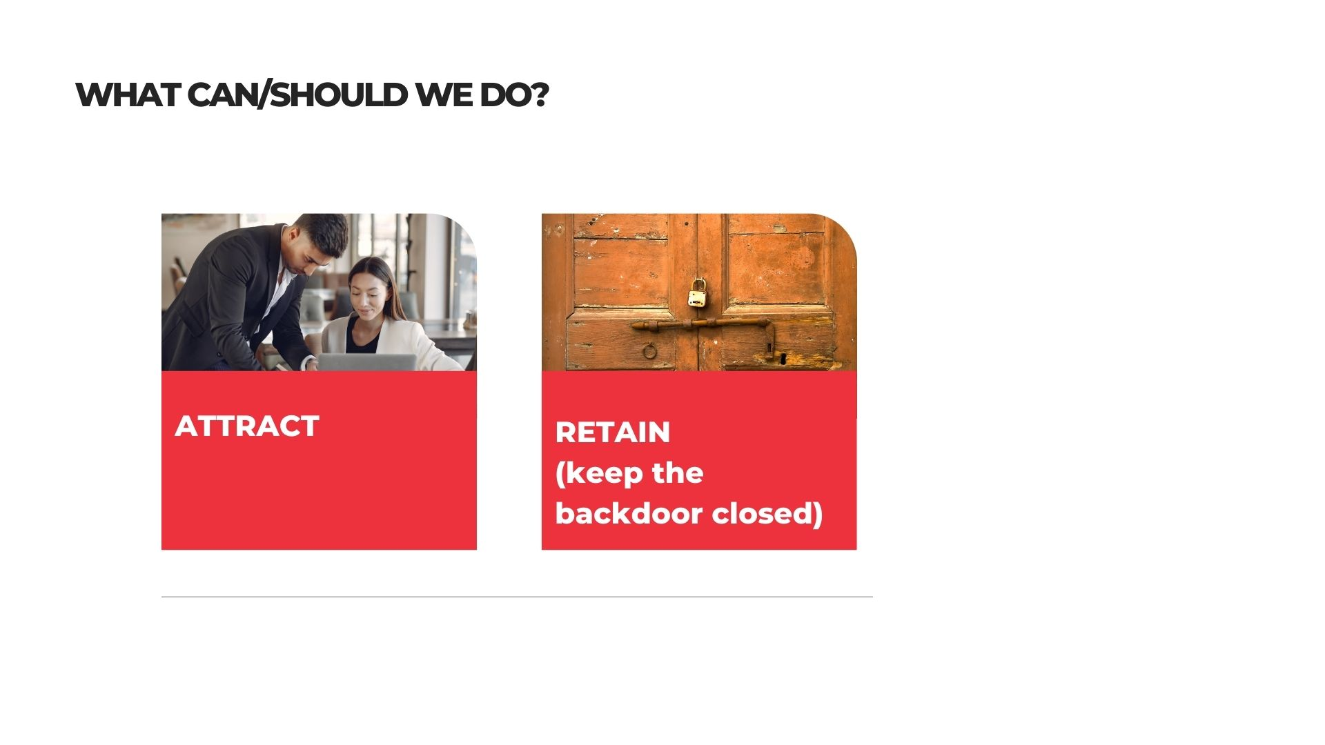

Slide 9
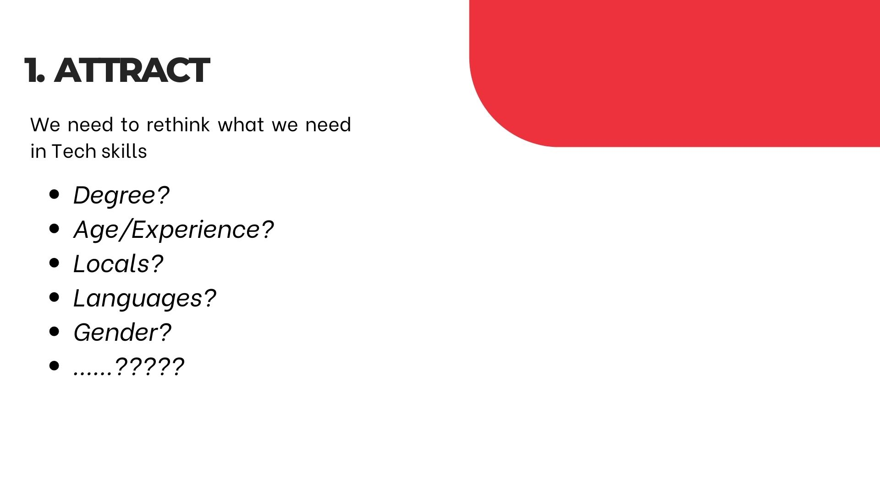
(Higher remuneration/ changes faster)
(87% between 35 – 49 years works)
(Culture eats strategy for breakfast)
(It’s all about English!)
(Creativity, other social skills)
AND ...............RETRAIN current population!!

Slide 10
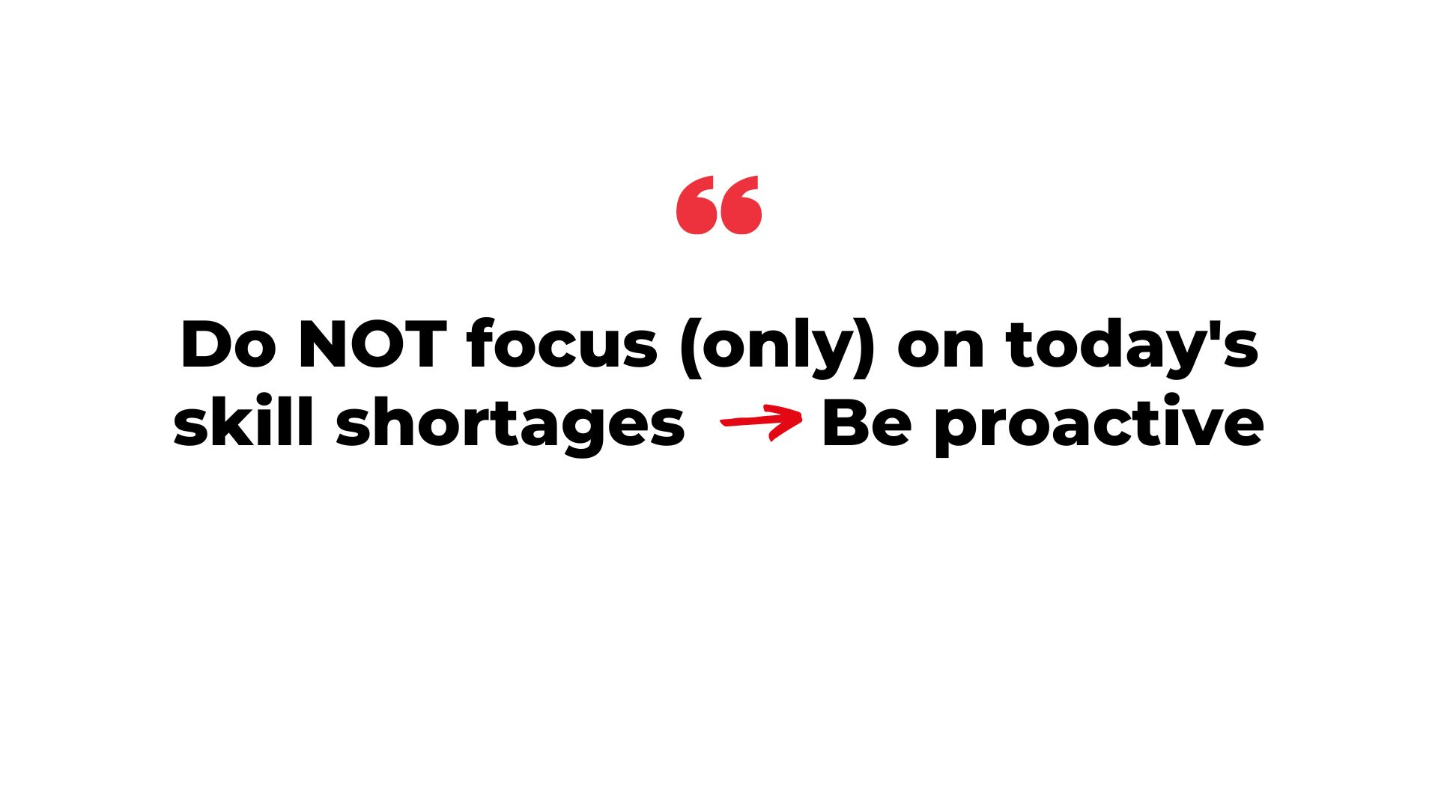
Junior Class Unexperienced now
Experienced in 4 years!!

Slide 11
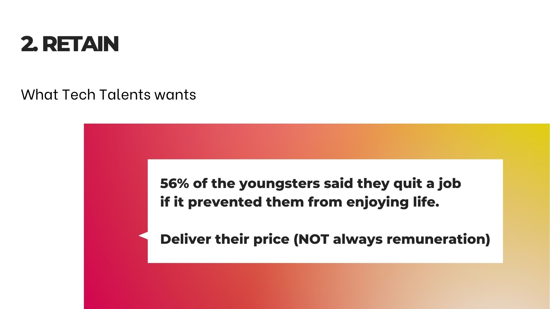

Slide 12
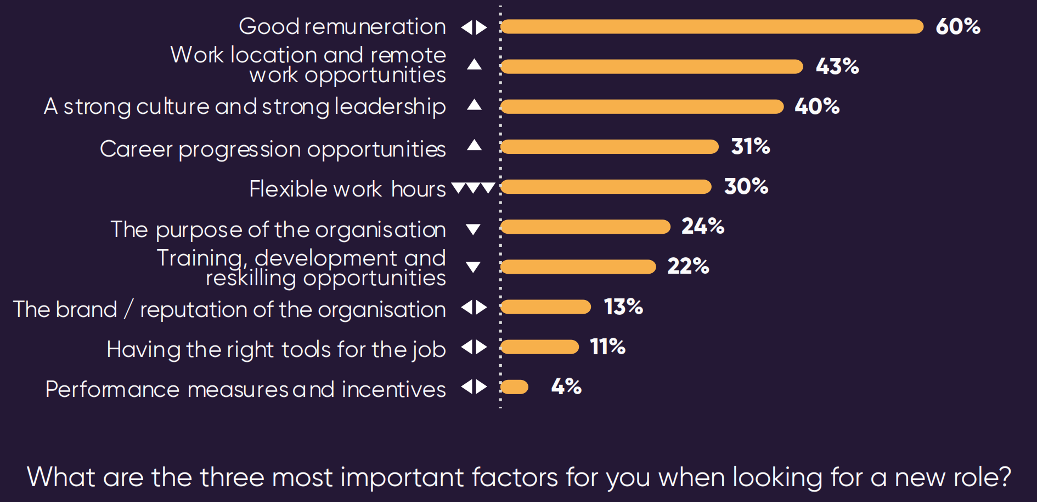
What tech talent wants

Slide 13
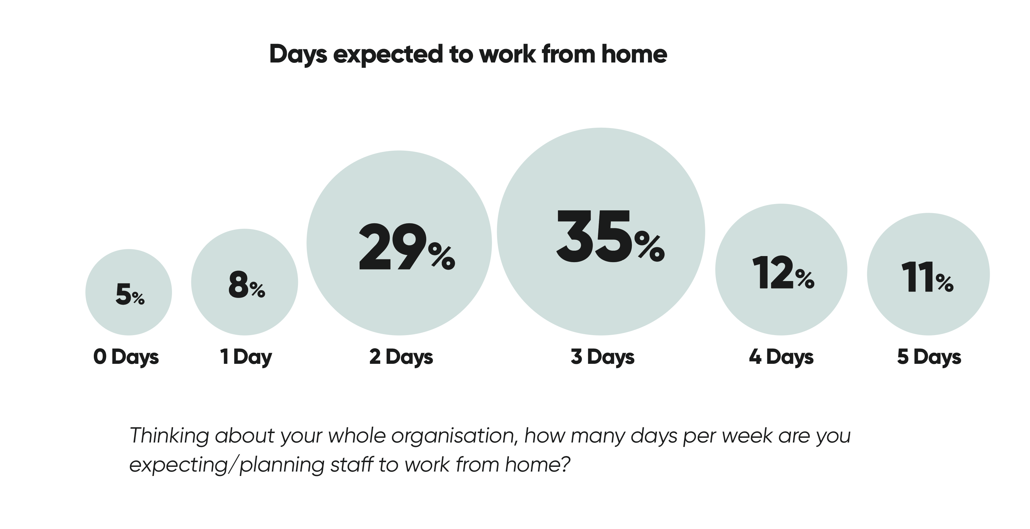
Homeworking has changed the game
Notes:
As we all know, the pandemic has had a dramatic effect on where and how we work. We are only just beginning to realise the consequences.
Overall organisations expect around half their staff’s days to be worked from home from now onwards.

Slide 14
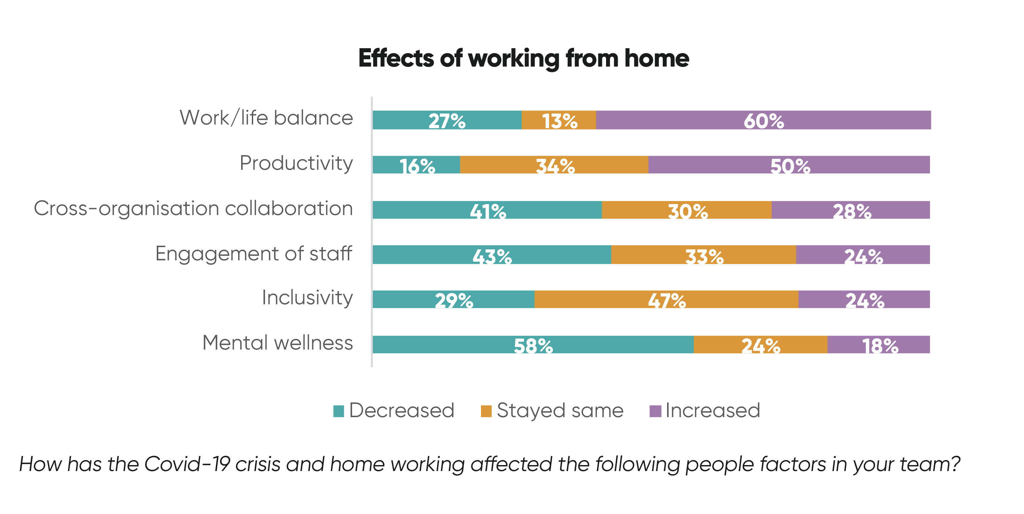
Homeworking has changed the game
Notes:
Homeworking appears to have had some very positive effects on work/life balance and productivity but it has had a major negative effective on mental wellness, collaboration and – perhaps surprisingly - inclusiveness.
Parallel to this eight in ten of our respondents say the pandemic has made their staff reconsider their life priorities and made the job of retention harder to some extent or worse.
Many of the leaders we speak with, both in technology and HR, are still trying to work out how to make this all work. Some feel it’s not sustainable.
Remarkably, only a third of digital leaders have redesigned their employee offering to reflect the new hybrid model of work and this is significant given the slow but relentless rise in skills shortages.
Those organisations that are able to really embrace the new hybrid model, and create an organisation with clear purpose have an opportunity to be highly attractive.

Slide 15
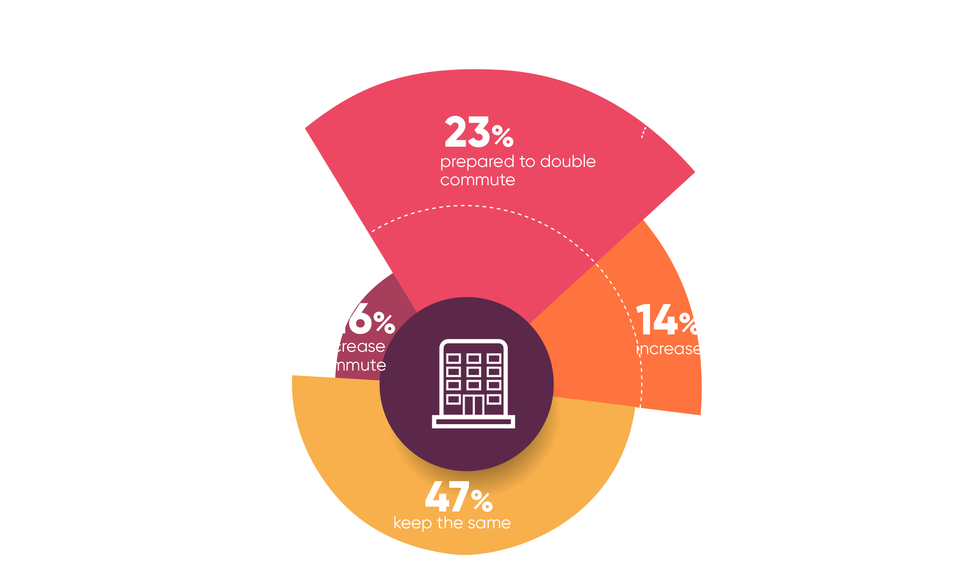
Homeworking has changed the game
Notes:
From the talent perspective, people have changed their view on how far they are prepared to travel to work.
With hybrid working, almost one quarter are prepared to double their commute time and 15% prepared to stay overnight near work. This is making a significant change on potential candidates for roles.
Interestingly 16% want to decrease their commute, possibly to avoid close contact on public transport.

Slide 16
