Slide 1





CIONET Belgium Community Event
May the cloud force be with you

Slide 2



Benoit Roosens
Leading the Cloud Center of Excellence at AG and Ageas Group
Next to work…

Slide 3
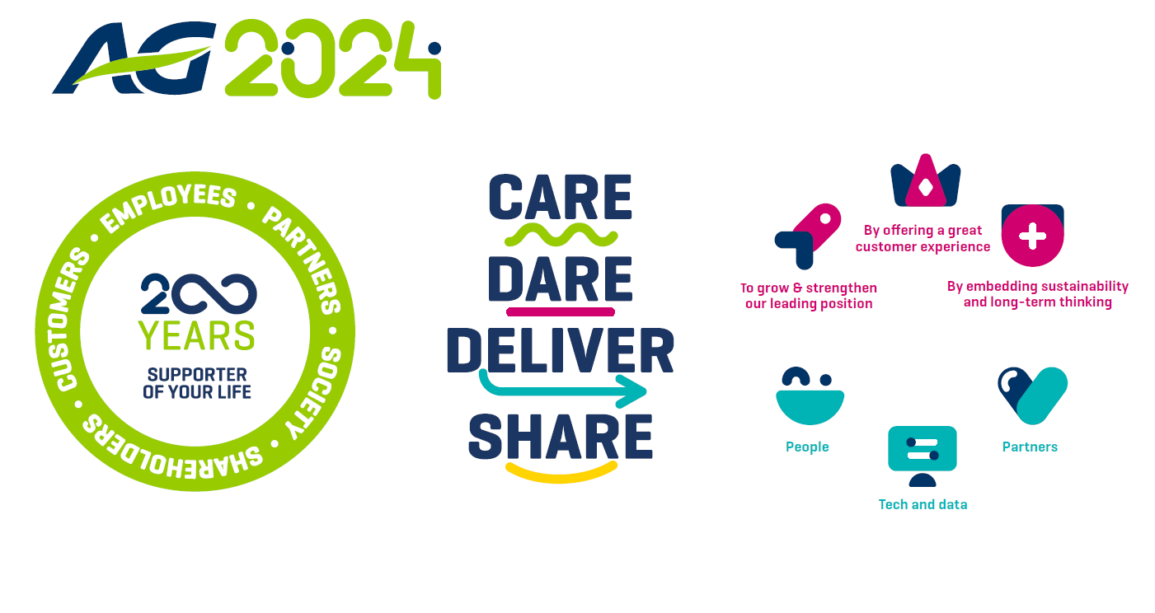




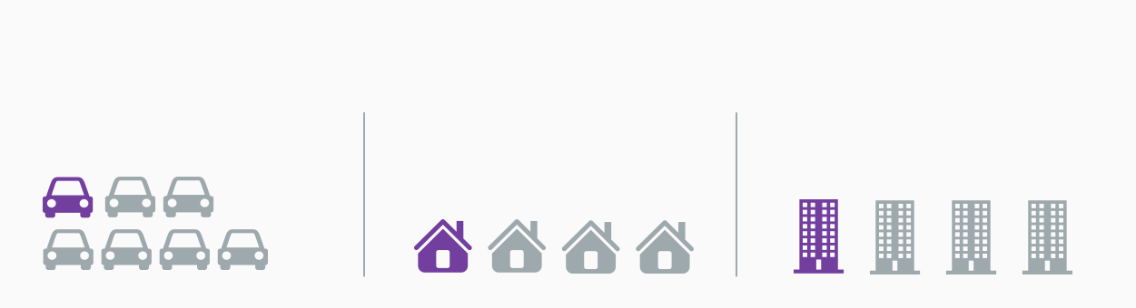


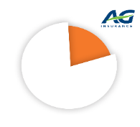
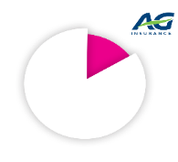
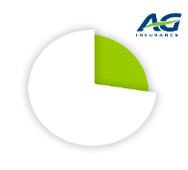
AG in a nutshell
199 years
of expertise
2023
We insure
To grow & strengthen
our leading position
By offering
a great customer experience
By embedding sustainability
and long-term thinking
1 out of 7 cars
1 out of 4 homes
1 out of 4 businesses
Market share
FOCUS
#1 Total
23.1 %
#2 Non-Life
16.7%
#1 Life
29.5%
A great place to grow
Leveraging Tech and Data
High partner satisfaction
Source: Assuralia, 2021

Slide 4
Observation in Tech & Data
# services
# systems
Exponential portfolio growth
Agile and resilient (incl. cyber resilience)
At a reasonable cost

Slide 5
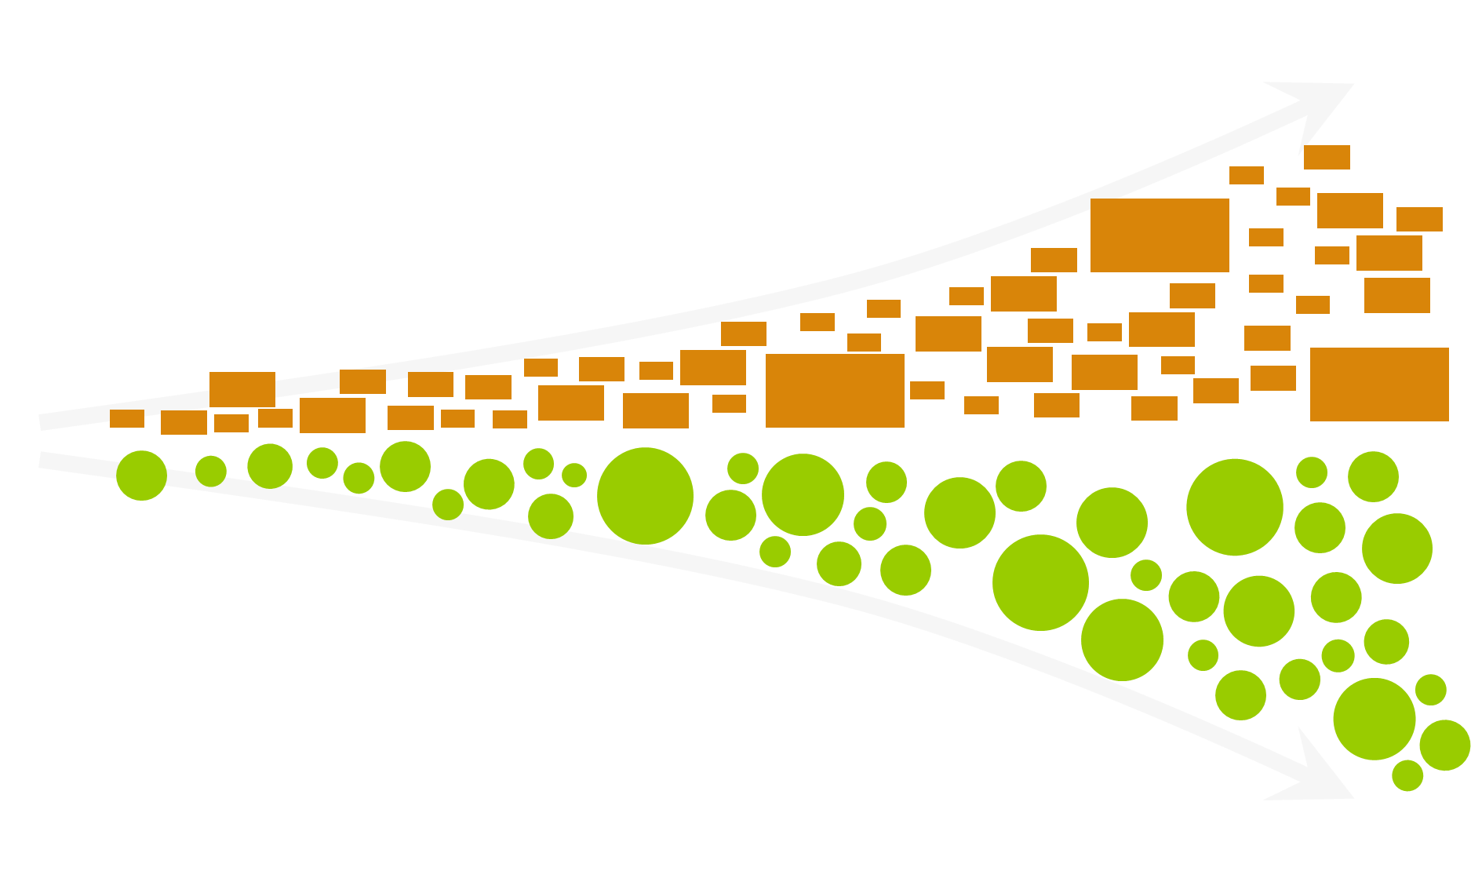
Observation in Tech & Data
Modernize
Transition from monolithic towards a disentangled, domain and even driven, architecture
Partnerships
Outsource a part of the complexity so that we can focus on what is most important for AG

Slide 6
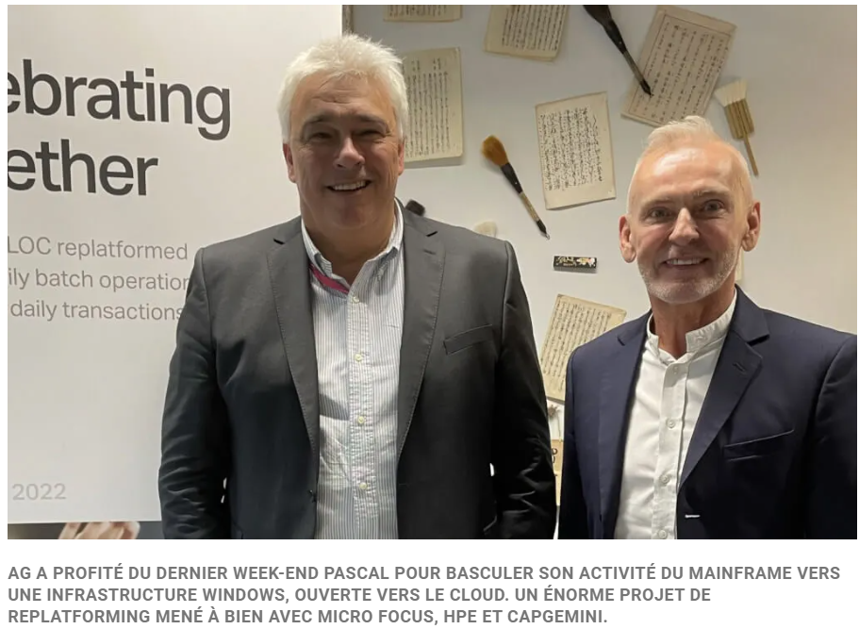
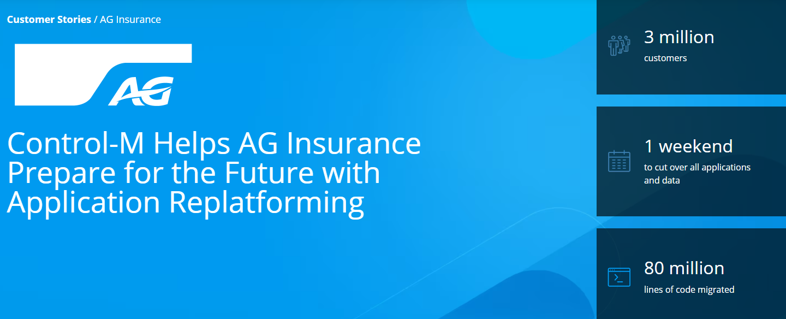
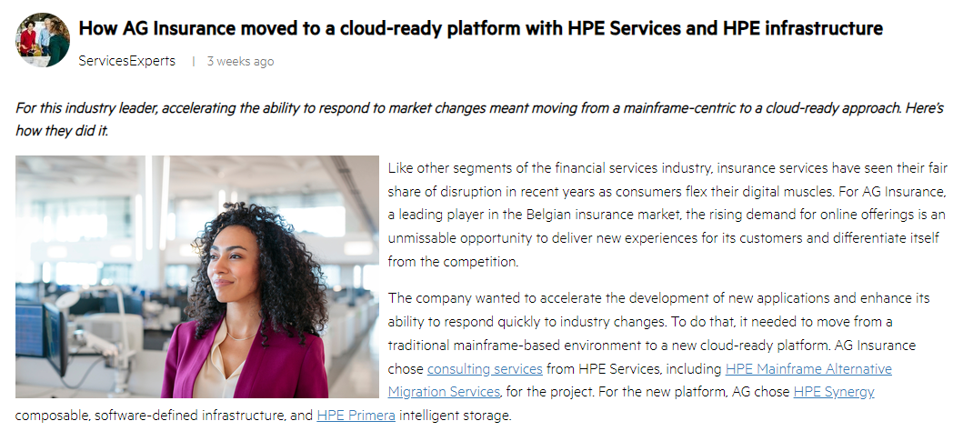
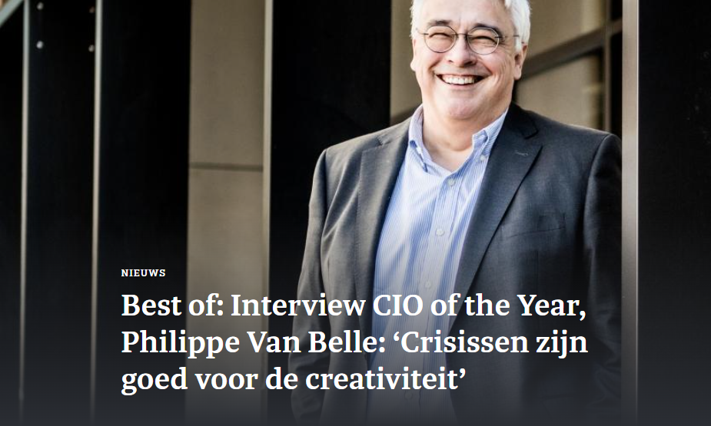
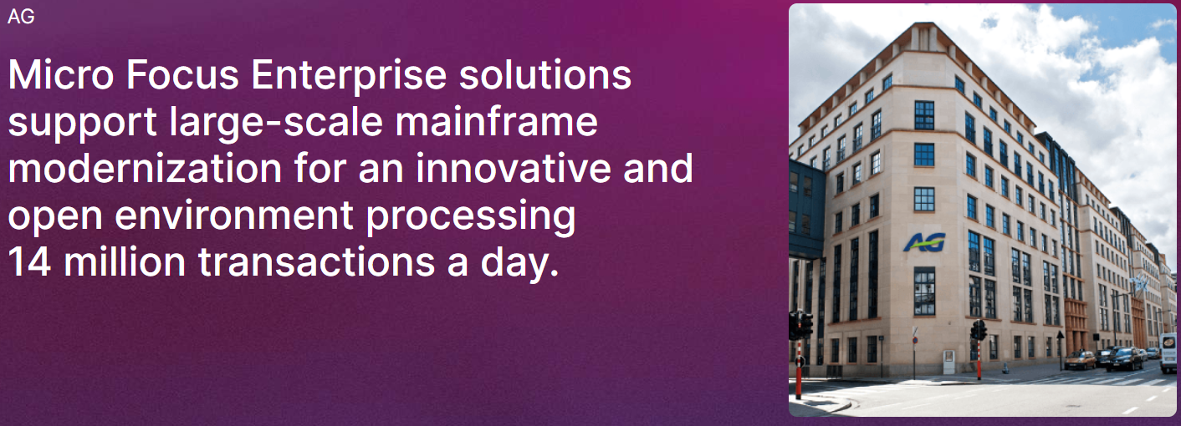

Slide 7


The broader picture
Serviced hosting
On-premises
Public cloud
Traditional IT
Cloudscape
FE / APP / DOMAIN
IBM Mainframe
MAGICS
HYBRID
DOMAIN
Easter 2022
MONOLITHIC
MONOLITHIC
FE / APP / DOMAIN
NEW TECH
closed ecosystem
open ecosystem
Unified Data Backbone

Slide 8
RISK & COMPLIANCE
TECHNOLOGY .
Cloudscape
CHANGE MANAGEMENT
FINOPS .

Slide 9

AG’s strategic intent
Leverage technology as enabler of AG’s business strategy to enable business agility, to leverage market leading technology capabilities and/or to remain best in class from a cost, risk, availability and performance perspective
We use and will use cloud and in its different flavors where appropriate, based on an informed decision-making process integrating the risk aspects (in full respect of the AG cloud policy)
Without the need for a big-bang migration but a gradual transition grasping full business benefits from the cloud concepts
By using the public cloud as they are secure and performant enough
We will not build a private cloud

Slide 10

RISK & COMPLIANCE
TECHNOLOGY .
Cloudscape
CHANGE MANAGEMENT
FINOPS .

Slide 11

RISK & COMPLIANCE
Policies, Limits & Minimum Standards and Guidelines
Criticality
security
contractual
privacy
RESIDUAL RISK ACCEPTANCE
OUTSOURCING & CLOUD RISK REGISTER
BRA
RISK MITIGATIONS
Type of data
exit strategy
residency
continuity
reoccurrence
1
For each cloud project, a Business Risk Assessment is conducted to define the unambiguous operational impact on AG and the type of data used
2
We use policies, LMS and guidelines to define the risk mitigations depending on the operation impact and type of data (risk-based approach)
3
Upon implementation of the risk mitigations, residual risk is accepted. Derogations to the policies, LCM and guidelines are approved in BRLC CITO
4
The cloud solution is added to the outsourcing and cloud risk register. A periodic review is scheduled, periodicity depending on the criticality

Slide 12
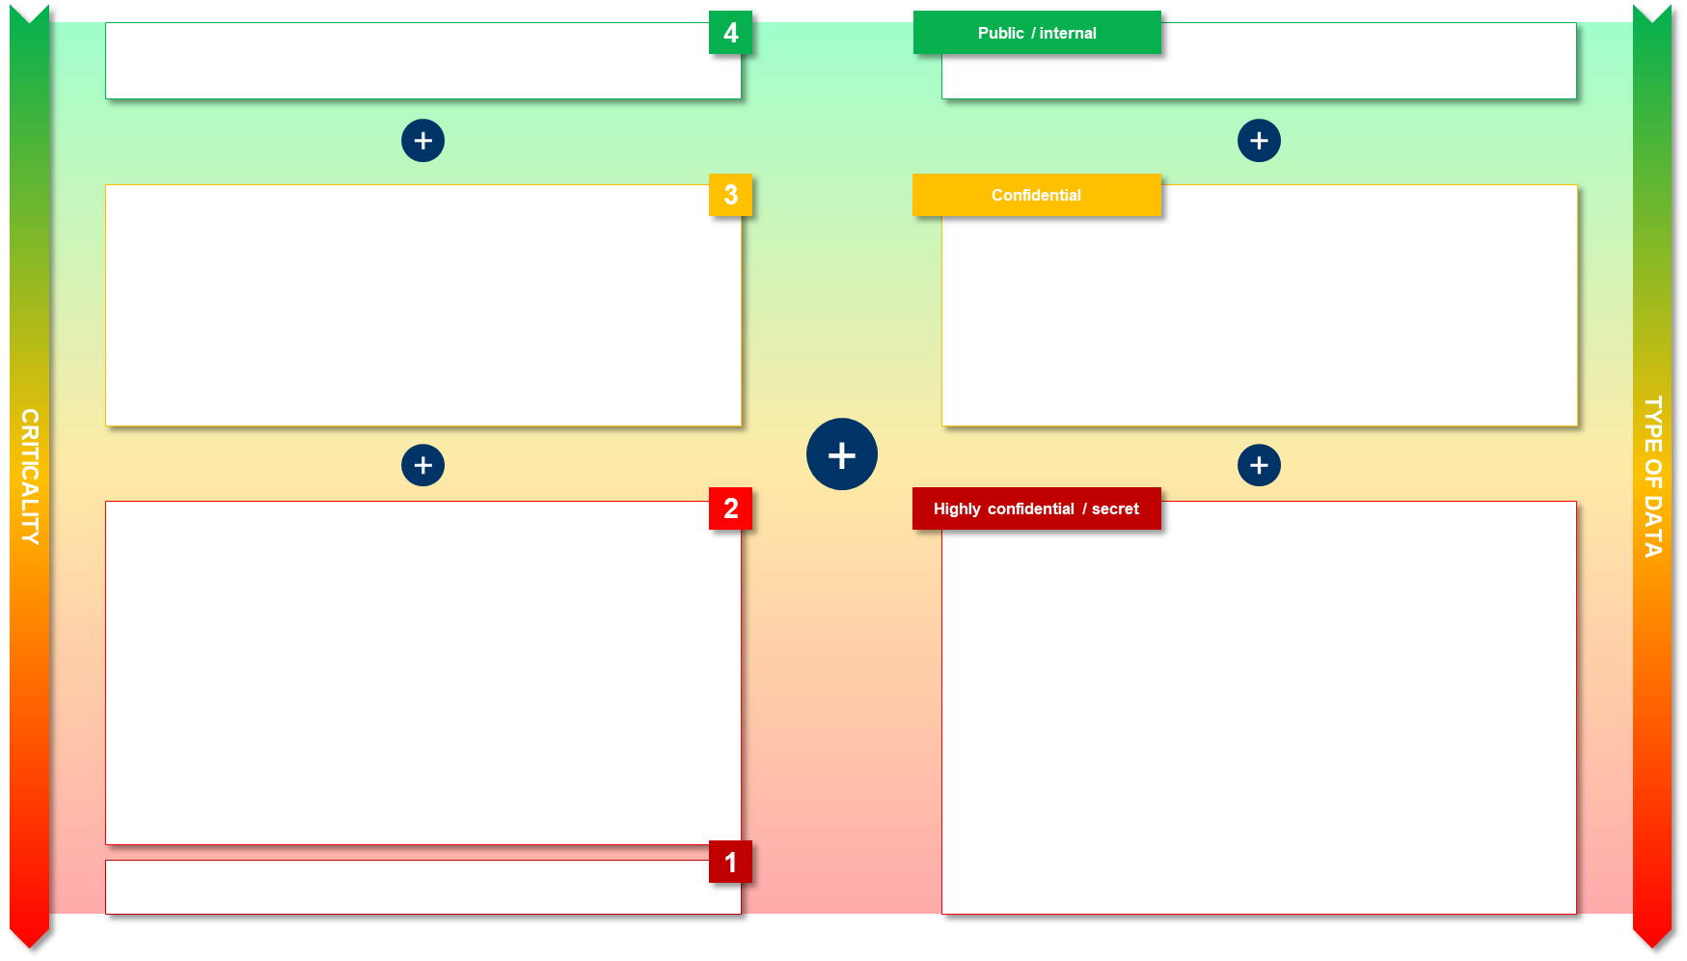
RISK & COMPLIANCE
Geographical redundancy
Yearly security certification
Data at rest encrypted with CMK

Slide 13
RISK & COMPLIANCE
TECHNOLOGY .
Cloudscape
CHANGE MANAGEMENT
FINOPS .

Slide 14
TECHNOLOGY
Traditional IT way to deliver and operate applications (caricature)
GO
Architecture
Infrastructure provisioning
Development
Risk management
🔃 Drive agility through automation, reusability and greater autonomy
Cloud Service Catalog
Selection
Development
Cloud IT way to deliver and operate applications (caricature)

Slide 15










TECHNOLOGY
LANDING ZONE
Different, reusable and automated, landing zone archetypes as unit of request
With preapproved public cloud services that can be used to compose and configure tailored applications
Including pre-deployed transversal IT services
Compliant by design thanks to security guardrails
networking
IAM
automation
monitoring
backup
cost management
SECURITY GUARDRAILS

Slide 16
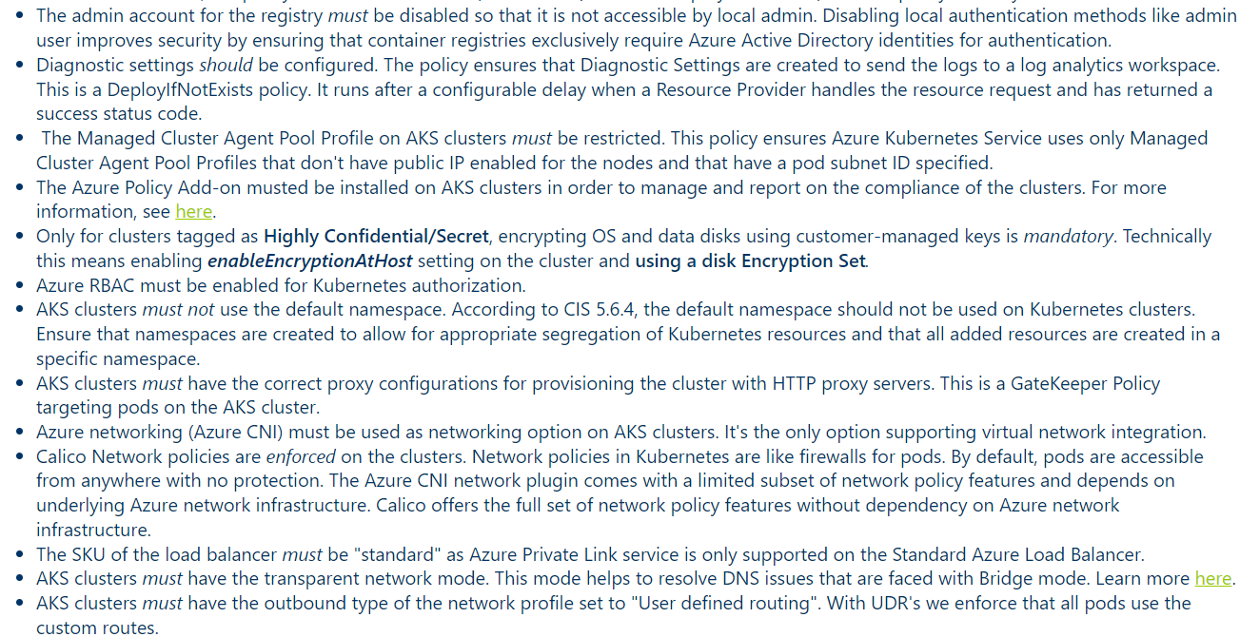
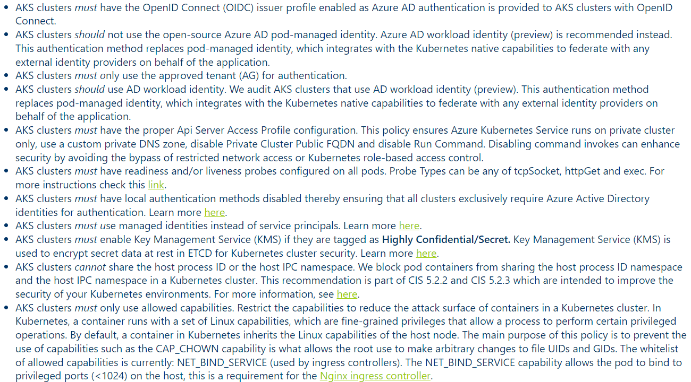
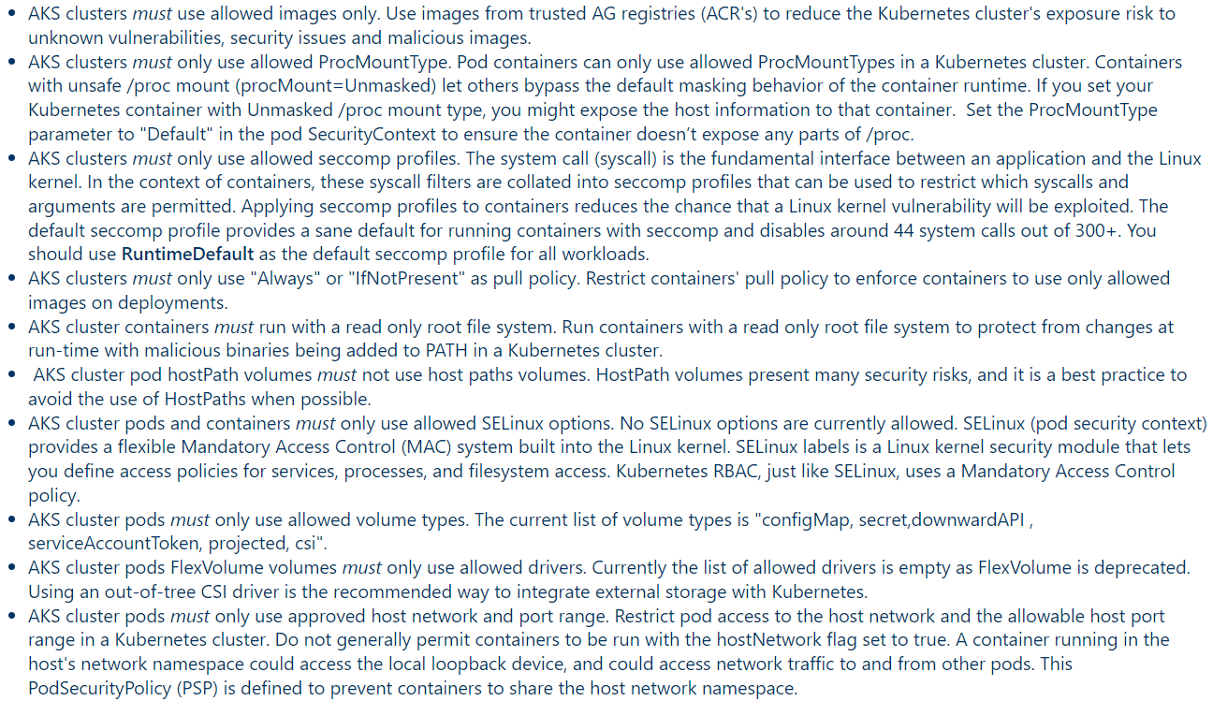
TECHNOLOGY

Slide 17
RISK & COMPLIANCE
TECHNOLOGY .
Cloudscape
CHANGE MANAGEMENT
FINOPS .

Slide 18
CHANGE MANAGEMENT
🔎 Monitoring
💰 Cost management
Application monitoring
Monitor and continuously optimize
cloud workload
Users
make sure they can
make sure they can
Cloud Center of Excellence
monitor our own stuff…
monitor our own stuff…
make sure it integrates
make sure it integrates
Enterprise-level monitoring
(cloud and on-prem)
Enterprise-level cost management
(cloud and on-prem)
Organization

Slide 19
RISK & COMPLIANCE
TECHNOLOGY .
Cloudscape
CHANGE MANAGEMENT
FINOPS .

Slide 20
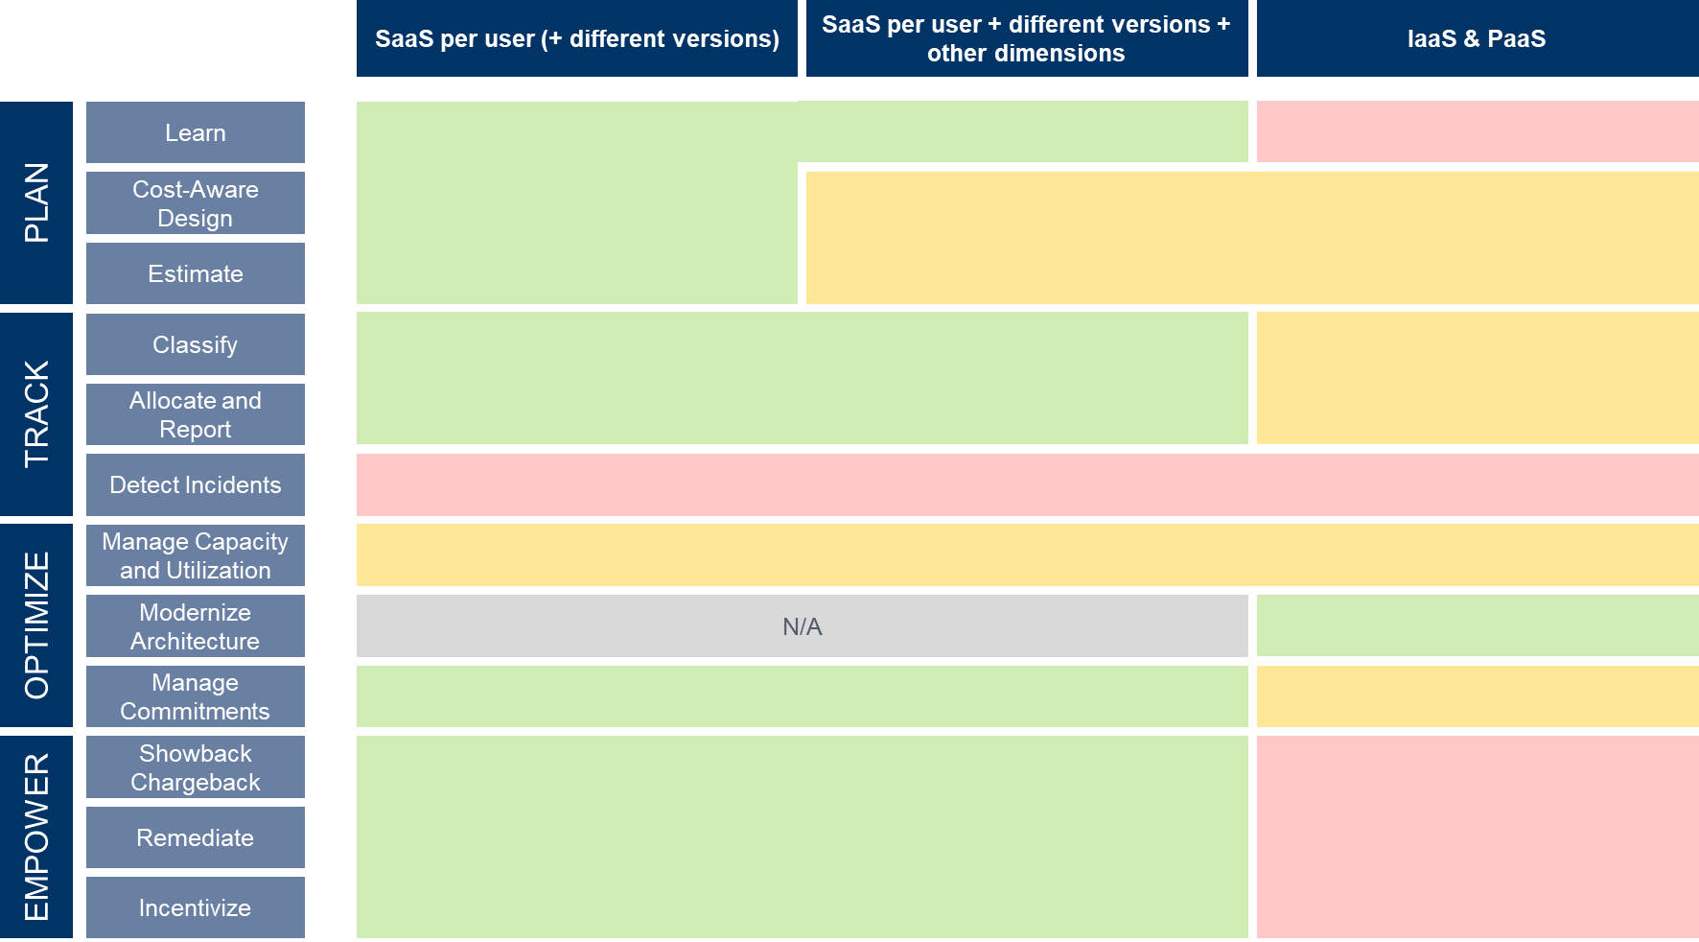
FINOPS

Slide 21
New budget habits to improve predictability (culture hack)
GROWTH BUDGET
GROWTH BUDGET
NEW
SPARE CAPACITY
OVER-BUDGET
NEW
BASELINE
BASELINE
on-prem
cloud

Slide 22

HELP
Thank you!

