Slide 1


Challenges in Governmental ICT
From collaborative advantage to thriving ecosystems
CIOnet Belgium Annual Event – 20 January 2026
frank.robben@mail.fgov.be
@FrRobben
frank.robben.be
ksz.fgov.be
ehealth.fgov.be
smals.be

Slide 2

My professional experience
Building on solid expertise & experience in Legal, ICT & Management
  Policy making support
  Running large ICT organizations
  Creating ICT ecosystems
  Privacy advocacy

Slide 3


BUILDING
COMPETITIVE ADVANTAGES
PRIVATE
PUBLIC
SECTOR Dynamics
SECTOR Dynamics
Profit driven
Benefits driven
Market focus
Broad society focus
Competitive
BUILDING
COLLABORATIVE ADVANTAGES
Cooperative
Limited audience
Inclusive
Microeconomic
Macroeconomic
Shareholders
Collective ownership
Innovation
Innovation² ?

Slide 4



Consistent strategy
ICT as A COST CENTER
ICT as STRATEGIC INVESTMENT
Cost Avoidance Through
Shared Services
Enabling Ecosystems for Sector-Wide Strategic Advantage

Slide 5


COST-focus:
Economies of Scale
Common ICT infrastructures
Shared ICT services
Re-use software components, API’s…
Communities of practice

Slide 6


VALUE-focus:
Reducing complexity
Only once-principle
Legal constructs
Factual information
Authentic data sources
Data duplication
Secure exchange
Ecosystems approach

Slide 7
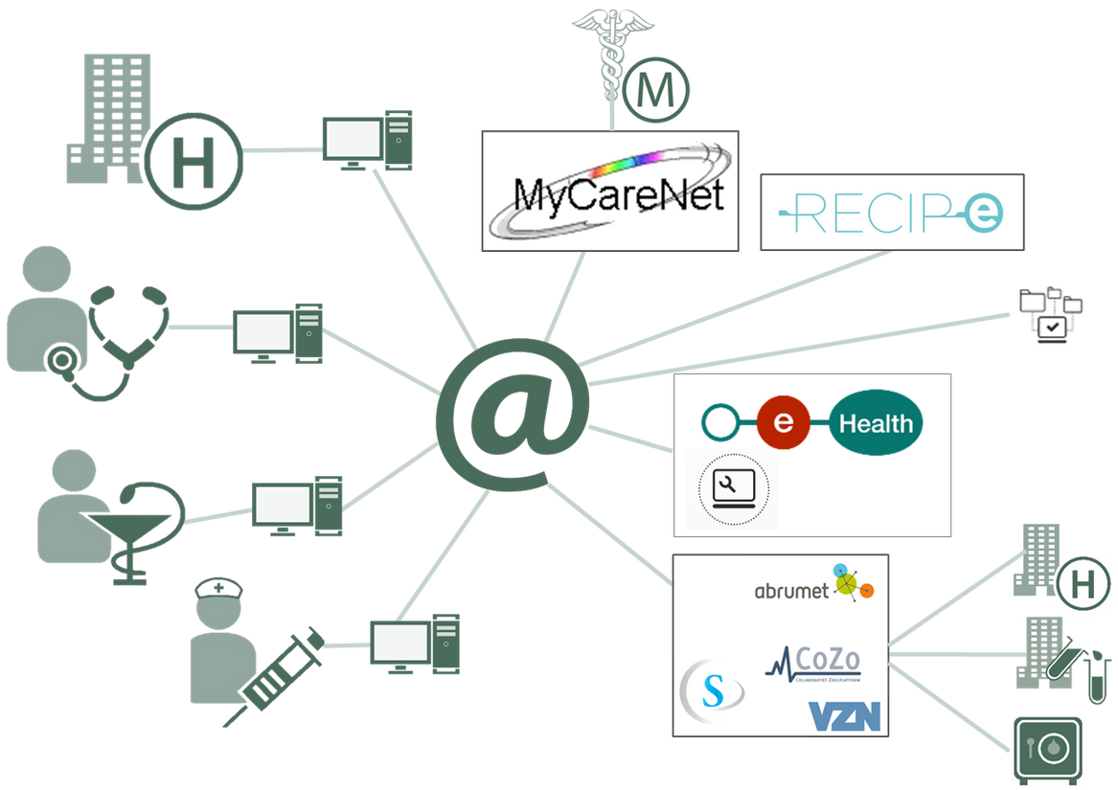

Example: eHealth-ecosystem
High adoption rate
High transactions volume
>17.000.000.000 in 2024
High adoption rate
  >11.400.000 citizens informed consent 96,7% of BE population
Offering essential tools to
Medical professionals, Hospitals
Government agencies, Software vendors...

Slide 8







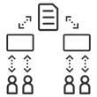

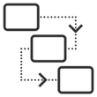



Common ICT services & ecosystem approach
Value added services (medical actors, civil society, commercial actors…)
Basic ICT services (government funded platform, compulsory)
eHealth
certificate
services
Integrated
user & access management
Timestamping
End-to-end
encryption
Secure
electronic
messaging
Logging
Directory & index
Web Portal
Process
orchestration
National Register lookup
Pseudonymise
& anonimise

Slide 9
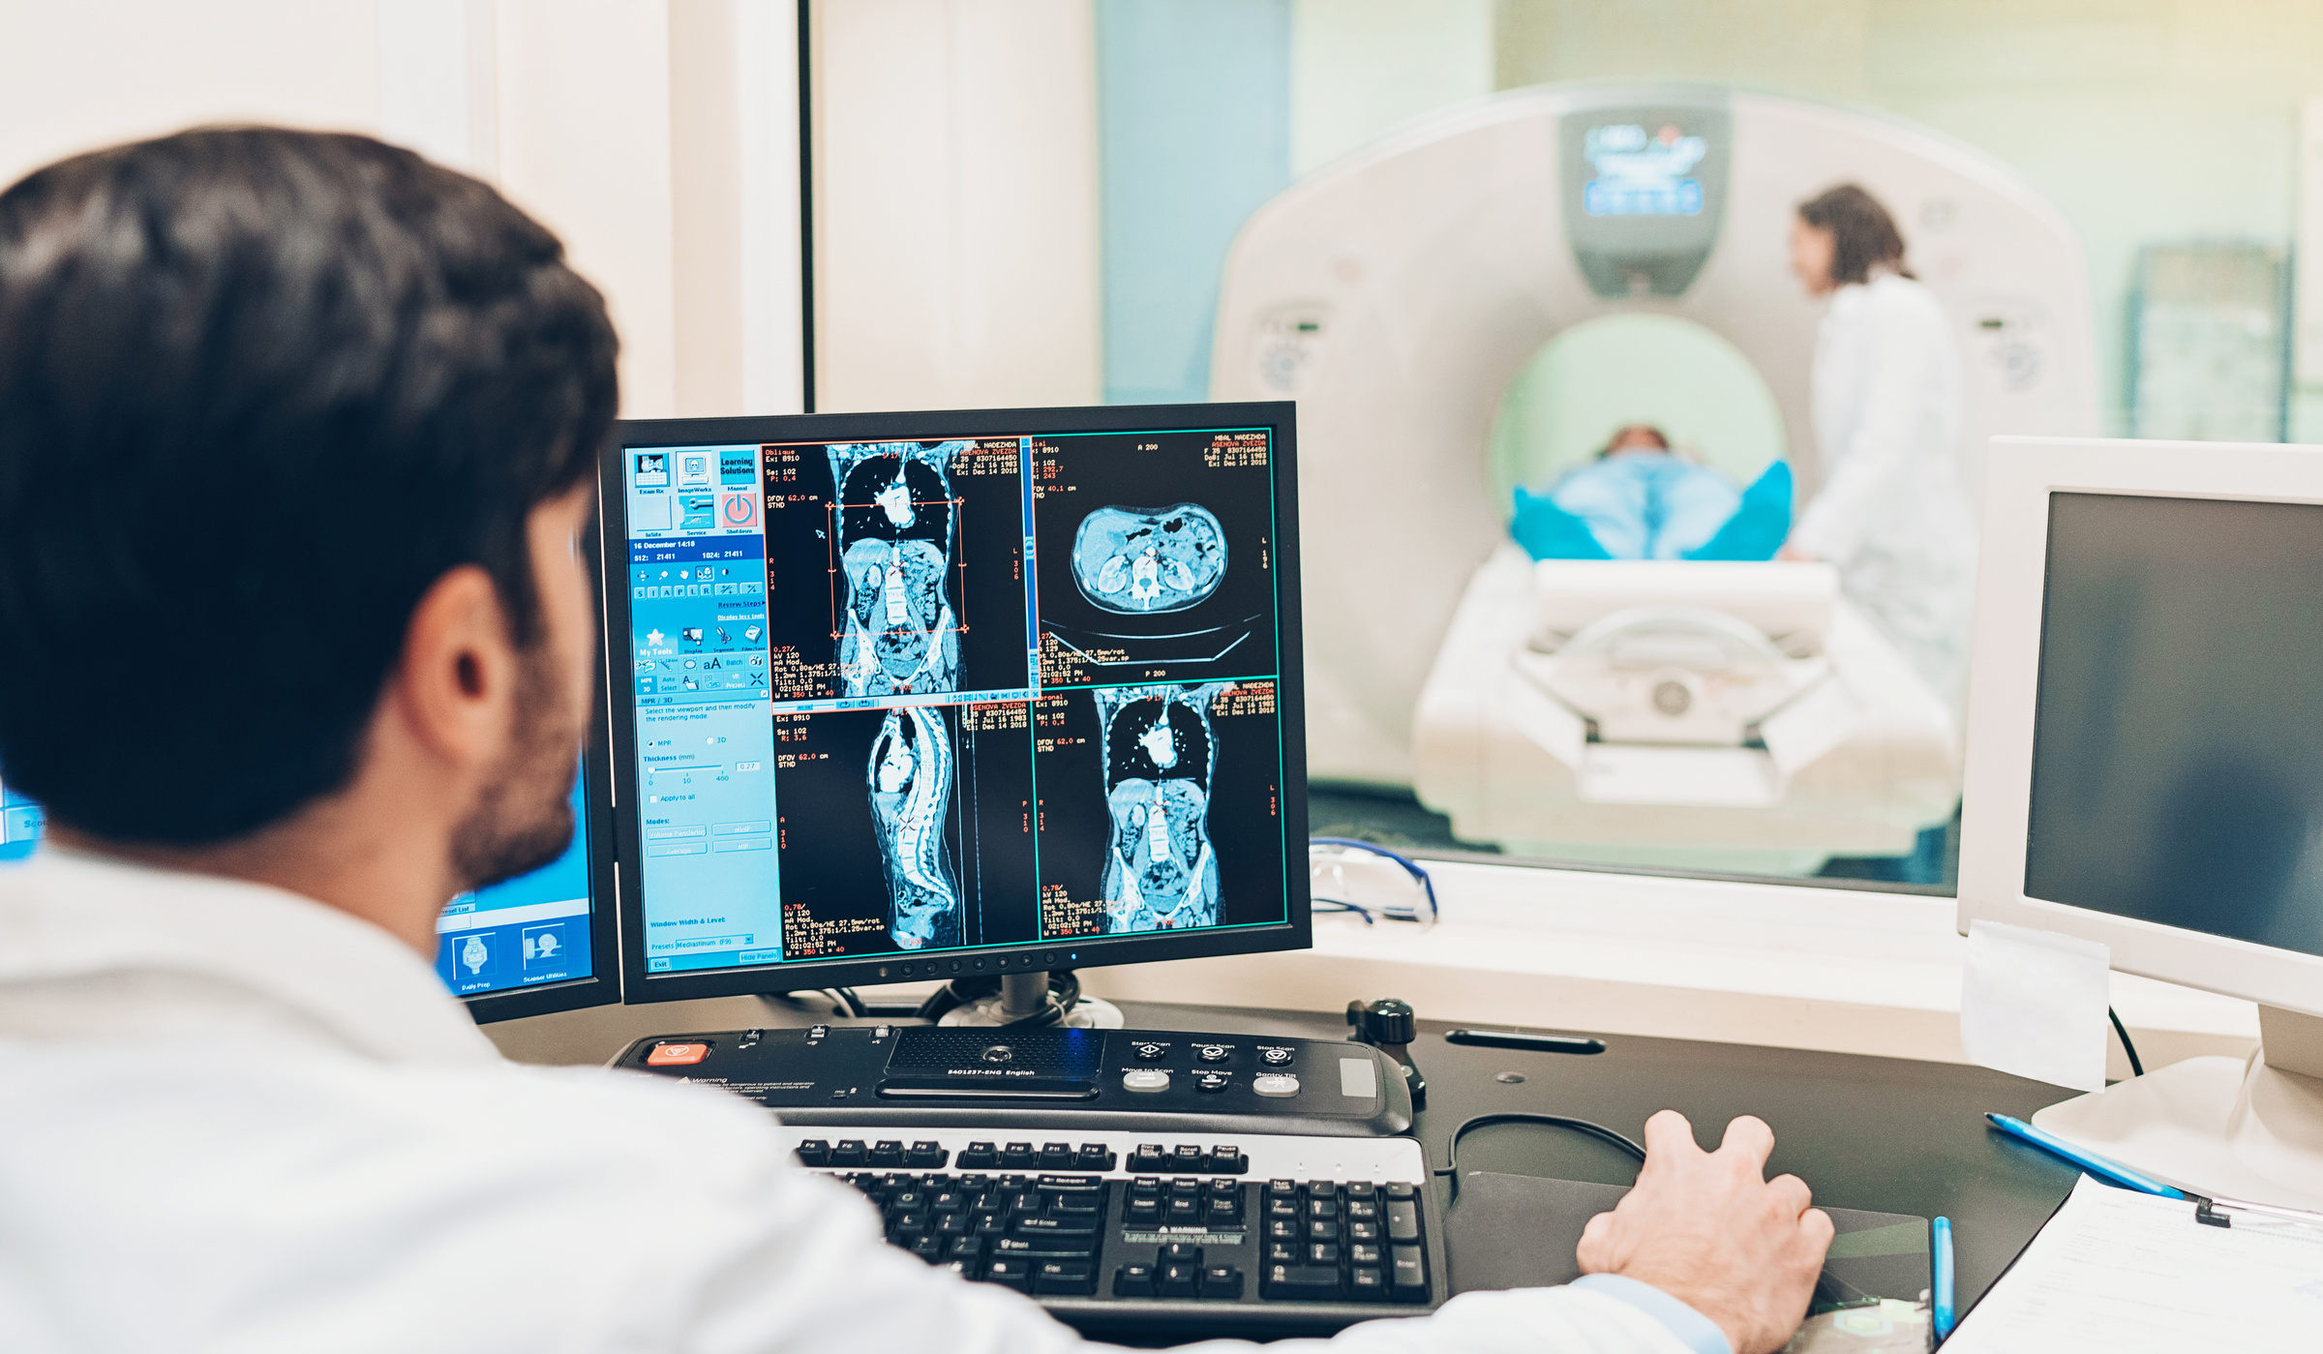

Real world benefits
General practitioner
Overview - Summary Electronic Health Record
Consulting patient’s medical history & antecedents
Consulting lab results, medical imagery, etc
Single Sign-On = MORE TIME for actual patient care
Fully privacy proof
Referral to specialist, hospital…
Electronic referral & scheduling
Electronic messaging (eHealth-box)
Consulting patient’s medical history & antecedents
AVOIDING REDUNDANT medical examinations
Global medical care = better care, more efficient
Especially for chronic illness treatment (1 in 4)

Slide 10







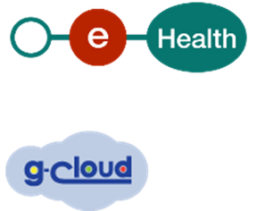

Belgian e-government achievements
1990 -
now
2003 -
now
2016 -
now
SIS-CARD
eID
ICT ReUse
INITATIVE
EHEALTH-PLATFORM
CROSSROAD BANK
FOR SOCIAL SECURITY
MULTIFUNCTIONAL
DECLARATION
DMFA
G-CLOUD
1998
2003
2008 -
now
2019 -
now
Structured & secure data exchange between 3000 actors dealing with social security contributions & social benefits
Social Information System Card
Electronic
Identity Card
Single, factual quarterly declaration to ALL social security institutions for >240.000 employers in Belgium
Secure data exchange platform for Belgian healthcare actors
Infrastructure-focused ICT collaboration between institutions
Catalogue of reusable software components & API’s

Slide 11


Partnering with private sector ICT-players
Governmental
vision & strategy
Public policy
NOT ONLY PUBLIC TENDERS
Many collaborative models available:
  Price comparison
  Framework agreement
  License / Concession
  Public-Private partnership (PPP)
  ‘Open government services’
  Platform & API Economies
Private Entrepeneurship
Private Entrepeneurship
Private Entrepeneurship
Private Entrepeneurship
Ecosystems

Slide 12







Critical success factors
Complex governance
Privacy & other fundamental rights
Information silos
Digital divide
Citizens’ digital literacy
Lack of alignment between legal & technical & practical concepts
Employment status for civil servants unfit for recruiting ICT staff
Specific financing & purchasing rules
Strategic sovereignty

Slide 13





Future: lookout
LEGISLATION - AS - CODE
MOBILE FIRST
ARTIFICIAL
INTELLIGENCE
INFORMATION SECURITY
www.smalsresearch.be/ai-maturity-model

Slide 14
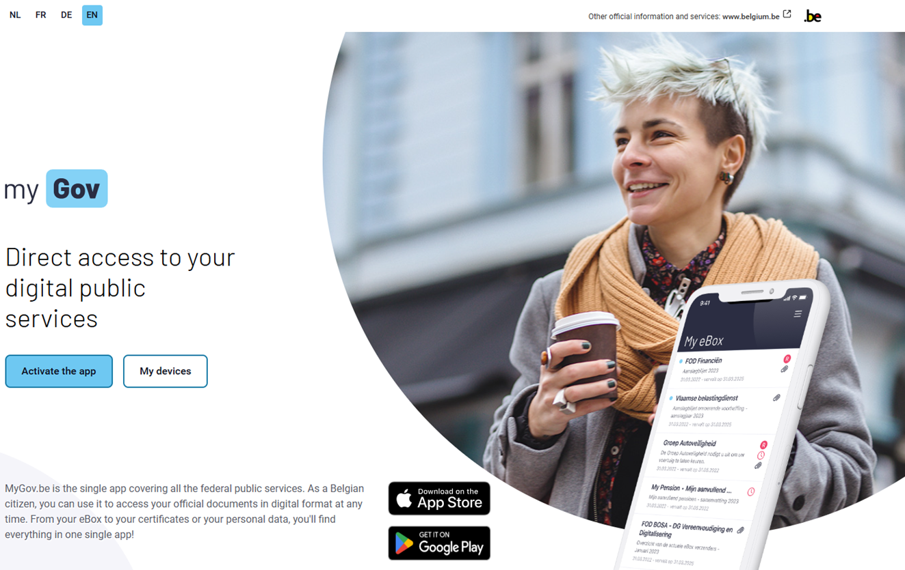
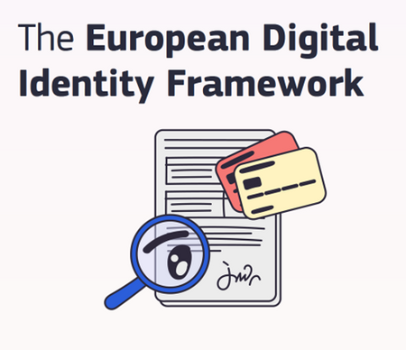
eIDAS – European Digital Identity Wallet

Slide 15
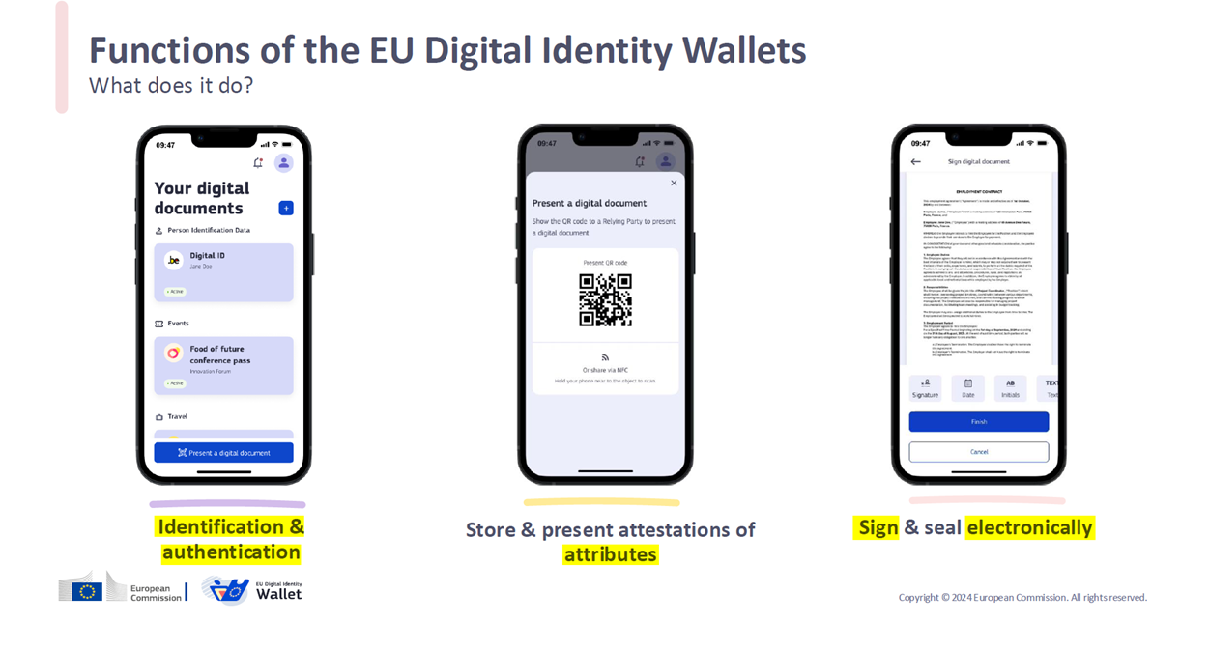
eIDAS – European Digital Identity Wallet

Slide 16



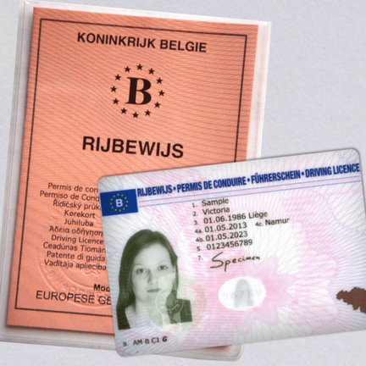




1
Instant Messaging
2
Automating back-office processes
eIDEAS European Digital Identity Wallet
3
Documents anywhere, anytime
4
Scanning tool

Slide 17
“Together, we invest and innovate for collective prosperity”
frank.robben@mail.fgov.be
@FrRobben
frank.robben.be
ksz.fgov.be
ehealth.fgov.be
smals.be

Slide 18
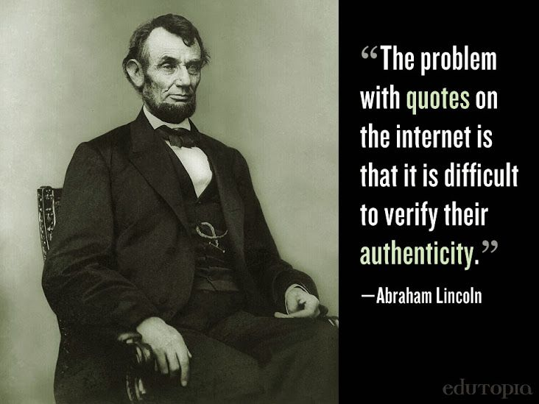
frank.robben@mail.fgov.be
@FrRobben
frank.robben.be
ksz.fgov.be
ehealth.fgov.be
smals.be

